Slide 1
“What we hope ever to do with ease, we must learn first to do with diligence.” – Samuel Johnson
EMS EVALUATOR WORKSHOP
Emergency Care Systems
January 2022
DOH 530-227 January 2022
Notes:
This course was developed by the Washington State Education Workgroup for the purpose of providing consistent statewide EMS Evaluators to fulfill requests from local trainers seeking an approved State EMS Evaluator training program. This program is an effort to develop a uniform approach to skills evaluations (at all levels) across the State.

Slide 2
THANK YOU
This course was developed by the Washington State
EMS Education Workgroup under the oversight
of the Prehospital Technical Advisory Committee.
This revision reflects the latest changes of the
Washington Administrative Code and
National EMS Educational Standards and Instructional Guidelines.
Notes:
There has been a lot of input from instructors around the State. During the developmental phase, many others have contributed, but it reached a point where it was almost impossible to keep track of all those who have offered insight and support.

Slide 3
Introductions
You
Your Employer and Role
Education/Training Background
Notes:
Share your name, agency, title, and credentials for conducting this class. Have your students share by answering the questions above.

Slide 4
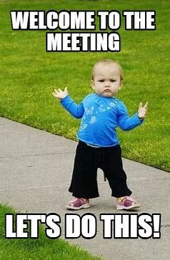
Tenants of An Online Meeting (optional)
How to mute/unmute
How to type in chat
Certificates of completion

Slide 5
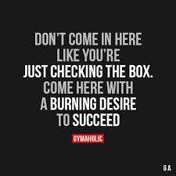
What do you like about
EMS education?
Why are you taking this course?

Slide 6
EMS Evaluator Course
The purpose of evaluator workshops are to teach methods and techniques to enable people to provide reliable, objective practical skill evaluations while properly using evaluation skill forms identified by the Department of Health.

Slide 7
Cognitive Goals
(Mental Processes, Knowledge, Critical Thinking)
Identify resources for accurate information
Know the difference between individual skills evaluations, the Comprehensive End of Course evaluation and an OTEP skill evaluation
Know how to apply to become an EMS evaluator
List the components of a practical skills evaluation
Understand legal considerations
Discuss the role of the evaluator in EMS education
Understand how to perform a skill evaluation
  “Blessed is the influence of one true, loving human soul on another.”
  -George Elliot
Notes:
Evaluators can perform at a variety of levels. We will discuss all activity levels even though some will perform only at one level or another.

Slide 8
Affective Goals
(Interests, Attitudes, Values)
Be aware of the importance of understanding the policies and procedures related to EMS education in Washington
Participate in this class in a way that exemplifies a commitment to excellence when conducting practical skill evaluations
  “Everything can be taken from a man but . . . The last of the human freedoms - to choose one’s attitude in any given set of circumstances, to choose one’s own way.” - Victor Frankl
Notes:
Evaluators can perform at a variety of levels. We will discuss all activity levels even though some will perform only at one level or another.
Note the last goal - When we get to the skills portion, it is important for each of you to take that portion seriously. We have a tendency to sometimes “goof off” during simulations, but if we expect our those we are evaluating to be serious, then, we must set the example. Here and in our home areas.

Slide 9
Psychomotor Goals
(Hands on, Touch the Toys)
Demonstrate the ability to use practical skill evaluation sheets in state-approved skill packet as well as those approved by the MPD to perform objective skill evaluations
Demonstrate the ability to remediate a student who is having difficulty
Notes:
There are a wide variety of skill sheets throughout the profession. It is important that the evaluators be familiar with those approved by the State.

Slide 10
Module 1
Roles and Responsibilities of the EMS Educator/Evaluator
“ To accomplish great things, we must not only
act but also dream, not only plan
but also believe.”
- Anatole France

Slide 11
Washington EMS Educators
  SEI (Senior EMS Instructor)
  EMS Evaluator/Instructor
  Nationally Recognized CPR Instructors
  Note: Guest lecturers must have specific knowledge and experience in the skills of the prehospital emergency care field for the topic being presented and be approved by the MPD to instruct EMS topics.
  An SEI (initial EMR or EMT classes) or EMS evaluator (for OTEP classes) should be present during the guest lecturer’s presentation.
Notes:
There might be some value in compiling a list of those who might be used as “guest lecturers” and getting MPD approval for all of them at one time. Keeping a master list and adding names, as the MPD approves them would be less bothersome to the MPD.

Slide 12
What is an SEI?
Senior EMS instructors are responsible for the overall instructional quality of initial EMR and EMT courses under the general supervision of the MPD.
Prerequisites: EMS evaluator, NAEMSE instructor course completion or state-approved equivalent, completion of state mentoring program requirements, MPD recommendation and DOH approval
Notes:
One should not strive to become an SEI unless there are sufficient classes are taught, in the community, to enable the individual to be initially recognized and subsequently re-recognized according to DOH policy.

Slide 13
General Instructor Requirements
EMS Evaluator, SEI, or Guest Instructors
Competent as an instructor
Knowledgeable in the topic content
Approved by the MPD

Slide 14
What is an EMS Evaluator?
EMS evaluators are responsible for the evaluation of skills within their own scope of practice.
This takes place in a variety of settings:
  Individual skills evaluations in initial EMR/EMT courses
  End of course skills evaluations for EMR/EMT courses
  Evaluations of skills during OTEP
  Evaluations as needed for Traditional CME recertification
Notes:
CPR Instructors are tasked with the evaluation of that one specific skill. It is intended to be under their direction to ensure that the most current knowledge and skills are taught and technical proficiency evaluated accurately.

Slide 15
Becoming an EMS Evaluator
Be a currently certified EMS provider and completed at least one certification cycle. Certification must be at or above the level being evaluated.
Complete an MPD-approved EMS evaluator workshop
Complete the EMS evaluator application
  MPD recommendation
  DOH approval
CPR instructor highly recommended, but not required

Slide 16
Evaluating the Evaluator
Evaluators should demonstrate proficiency on any skill they will evaluate before performing the evaluation on another.
Performing skill evaluations as an EMS evaluator does not meet the requirement to be competent in any skill for recertification purposes.
Each EMS evaluator must perform each skill, be evaluated by another EMS evaluator, and be determined successful in performing each skill to meet competency requirements for recertification.

Slide 17
Module 2
Administrative Issues
“Misinformation is one of the greatest dangers of modern education.”
- Charles F. Kettering

Slide 18
Resources
Up-to-date information is available from the Department of Health at:
EMS Education and Training | Washington State Department of Health
or
www.doh.wa.gov/hsqa/emstrauma
Additional sources of up-to-date information:
    State EMS education staff 360-236-2842
    Your MPD
    Local senior EMS instructors
    Local and regional EMS council members
    Members of local, regional and state committees
Notes:
All of the material needed to teach an initial certification class are available. There are also links to other useful sites. Policies and Procedures, the UDA document and evaluator applications are available to download. As forms change frequently, it is a good practice to download what is needed each time rather than keep copies which may be outdated.

Slide 19
Individual Skills Evaluations
During an Initial EMR/EMT Course
Use DOH-approved skill sheets only
Demonstrate proficiency individually
Evaluations done throughout the course
Must achieve a minimum score
No errors in the Critical Criteria section

Slide 20
End of Course
Comprehensive Skills Exam
Supervised by a SEI, but usually performed by an EMS evaluator
Four scenario-based role-play stations with moulaged patients
Evaluated as a team with a time limit
No critical criteria errors allowed
No instruction or feedback is given
Notes:
These skill sheets are found at the end of the DOH/EMS skills packet addendum.

Slide 21
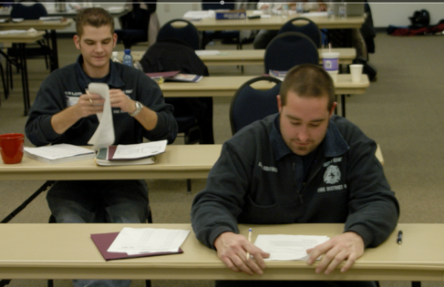
RECERTIFICATION
Continuing Medical Education + Testing
Under the direction of an SEI
Practical skills test using DOH/EMS
  approved skills sheets for the specific
  certification level
State certification exam (NREMT CAT)
Requires CME (hours dependent upon skill level) and skills proficiency requirements
Notes:
Since most of the State is now using the OTEP method of recertification, it may be difficult to locate sites providing CME classes for the purposes of recertification.

Slide 22
RECERTIFICATION
Ongoing Training and Evaluation program
Local direction. SEI not required.
Skill evaluation sheets shall be DOH approved or MPD approved for the level
Evaluations/not tests/competency based
  Written evaluations are topic specific and are taken after completion of the didactic portion
  Skill evaluation where remediation are reevaluation are allowed
  Multiple learning opportunities
Didactic portion may be via a live person presentation or web-based online presentation
A safe, realistic and challenging learning environment
  Minimum knowledge and skills are evaluated
  Repetition and remediation are key to learning and skill proficiency

Slide 23
Paperwork & Documentation
Initial Courses
Course completion certificates
Graduation forms
Individuals submit initial application and other required documents
Recertification
Individuals submit recertification application and other required documents
Retain verification of training for four years

Slide 24


Retention Requirements
Training record retention requirements should be aligned with Training program under WAC 246-976
Or in alignment with EMS Service or department retention policy.

Slide 25
Module 3
Legal Issues in EMS Education
“ Education does not mean teaching people what they know… It is a painful, continual, and difficult work to be done by kindness, by watching, by warning, by precept, and by praise, but above all-by example.” - John Ruskin

Slide 26
Legal Issues in EMS Education
Falsification of Records
Sign and Leave
Forging
Overstating Content
This is A Direct Representation of Your Professionalism

Slide 27
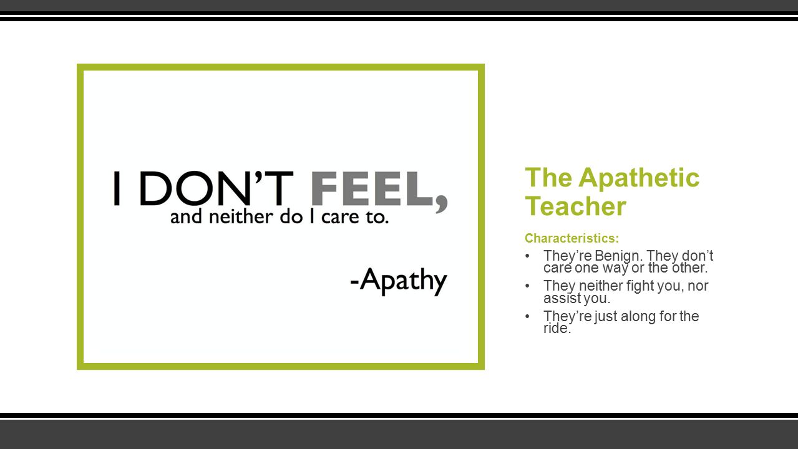
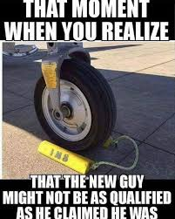

Slide 28
Pensacola News Journal
View Comments
Former Mass. EMT sentenced to jail for falsifying training records
Four other co-defendants awaiting trial; part of larger investigation into training certification in state.
“….Codair permitted EMTs to sign course rosters without attending the course. Codair then submitted the rosters to OEMS, falsely certifying all signers' attendance at those courses, thus enabling the signers to qualify for recertification.”
EMS1 Apr 23, 2012
Four former members of Escambia County's Emergency Medical Services division have been arrested following a year-long investigation into allegations of falsifying training documents.
Jim Little Pensacola News Journal
March 24, 2020
State public health officials have suspended the licenses of 207 emergency medical technicians and paramedics across Massachusetts because they were involved in falsifying training records.
The Eagle-Tribune June 18, 2010

Slide 29
Legal Issues in EMS Education
HIPPA
Health Insurance Portability and Accountability Act of 1996 (HIPAA)
A federal law that required the creation of national standards to protect sensitive patient health information from being disclosed without the patient’s consent or knowledge.
Lawsuit alleges EMT shared crash photos
The EMT took photos, not for diagnostic or legitimate purposes, of the man with her cell phone and later circulated them throughout the community
Sep 4, 2013

Slide 30
Legal Issues in EMS Education
Discrimination
To avoid accusation of discrimination
Publish course guide with class rules and consequences
Hold each student to the same rules and consequences
Exercise fair and consistent treatment for all students
Notes:
Fair and consistent treatment includes providing the same opportunities for each student and conducting discipline the same for all students.
Evaluators should read the students’ course guide regarding class rules and consequences so they are aware of what is expected of the students.

Slide 31
Legal Issues in EMS Education
Harassment
To avoid accusation of harassment
Conduct yourself beyond reproach
Have a professional attitude and maintain professional relationships with your students
Avoid one-on-one situations where it is just you and a student

Slide 32
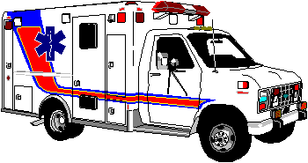
Legal Issues in EMS Education
The UDA
Protects the public
Administered by the DOH
See DOH document “The Uniform Disciplinary Act (UDA)”
Notes:
This should be included in the handouts the students received.

Slide 33
Legal Issues in EMS Education
Negligence
Not keeping or retaining records
Release of confidential information
Intentionally teaching something incorrectly
Releasing students early from class, thus not allowing them adequate time to learn a skill
Negligent classroom supervision

Slide 34
Legal Issues in EMS Education
Freedom of Information Act
Training agency can’t disclose student/provider academic standing to others without their consent
Student/provider records must be kept confidential
The Family Educational Rights and Privacy Act (FERPA) (20 U.S.C. § 1232g; 34 CFR Part 99) is a Federal law that protects the privacy of student education records. The law applies to all schools that receive funds under an applicable program of the U.S. Department of Education.
Notes:
The Freedom Of Information Act inquiries may have affiliation, financial, employment and credibility implications. Make sure you do not talk about student/provider skills performance with anyone but the SEI/Training Officer.

Slide 35
Legal Issues in EMS Education
INTEGRITY OF EVALUATOR
CPR TO NATIONAL STANDARDS
MPD APPROVED PROTOCOLS
RECERTIFICATION REQUIREMENTS
Notes:
Areas where evaluators may not be as obedient as they should be. They should be familiar with the associated rules and regulations and follow them. This is one area where the affective domain interacts with the cognitive and psychomotor.
The integrity of the evaluator is tantamount to the integrity of the EMS program, be it an Ongoing Training & Evaluation Program or college level EMS Education program. Shortcuts taken by evaluators are related, by students, to the shortcuts evaluators would take when caring for a patient. ‘If you talk the talk, then you better walk the walk !’

Slide 36
Legal Issues in EMS Education
Recertification Documentation
Individuals are responsible for their personal certification documentation (4 YEARS)
Course outline/name of instructor
Knowledge evaluations (“test” scores)
Skill sheets (or copy)
Remediation documentation

Slide 37
Legal Issues in EMS Education
Remediation Documentation
Document all activities and remediation efforts
Mark skills sheets appropriately, documenting specifically the actions that were done incorrectly
Document remediation efforts, including when and how you approached it and the outcome
File with the appropriate repository

Slide 38
Module 4
The Evaluator IS an Educator!
“Every person is gifted in some area.
We just have to find out what.”
- Evelyn Blose Holman
Notes:
The evaluator who does not recognize that he or she is truly an instructor also, will never reach the heights that are possible in adult education. Evaluators can be a “sage on a stage” and just stand back and watch critically or they can be a “guide on the side” who nurtures learning of all those they evaluate.

Slide 39

Adult Learners
Each person perceives, processes, stores and retrieves material in a unique way. Even though they may have a tendency toward one learning style, adults are flexible and able to adapt to a variety of styles.
As an evaluator, you must identify the individual “pieces” and “put them together” to maximize the learning experience
There should be no students or teachers; only learners and facilitators of learning. Participants should change roles frequently during any encounter. - Geri Chumley
Notes:
Learning is defined as “an active process of communication between students and instructors, resulting in the gaining of knowledge and mastering of information; learning results in a relatively permanent change or modification in behavior.

Slide 40
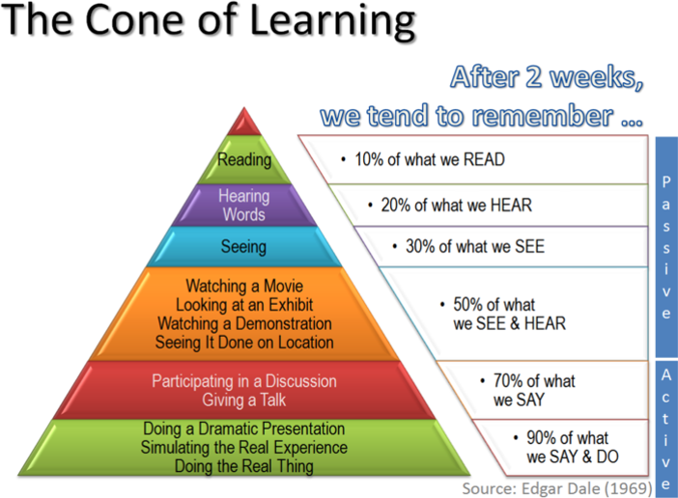

Slide 41
Learning Styles
Visual/Spatial
Auditory
Verbal/Linguistic
Kinesthetic
Logical/Mathematical
Interpersonal
Intrapersonal

Slide 42
Learning Styles
Visual/Spatial Learners
All about information presented visually
Graphs, charts, maps, and color coding can help organize information in a person’s mind

Slide 43

Learning Styles
Auditory learners
  Learns best through sound
  Music, rhythms, and speech patterns help learners remember important information
  Make sure everyone can hear when a skill is being discussed
Notes:
Look closely and you will see he has a note pad in front of him, but he’s not using it. The evaluator needs to make sure that everyone can see & hear; speak clearly and use proper medical language. Instruction sheets and notes pages are useful to this group. This group will remember verbal explanations and sounds associated with the material. This individual will benefit from listening to other participants verbalize what they are doing during the evaluation. In most situations, it is necessary for participants to verbalize what they are thinking in order to have an accurate evaluation. Let auditory learners listen until they are ready to be evaluated.

Slide 44
Learning Styles
Verbal/Linguistic
  Information transmitted through words (written or spoken)
  Reading and listening are common ways to learn, many people find speaking to themselves a good way to organize information
  Benefit from looking things up, writing things down, using “word pictures”
  Provide handouts, use posters, power point, slides, etc.
  Make instruction sheets available for equipment being used in the skill evaluation
Notes:
Tell the auditory learner what is expected; SHOW the visual learner. Demonstrate proper performance. Use visual aids and props. Speak to the left AND right sides of the group. This group will usually complete homework assignments.

Slide 45
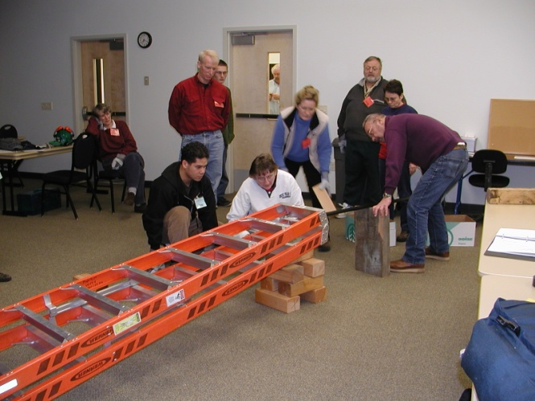
Learning Styles
Kinesthetic learners
  Learns best by touching and doing
  Benefits from taking things apart, making things work, using their hands
  Use three-dimensional models and replicas, lab sessions, scenarios and role-play
  Allow time to manipulate and touch the equipment before the evaluation
Notes:
This group often feels left out in the classroom setting.
Observe this photo. Some are thinking, some are touching. Others are standing back watching. There are many learning styles active here.

Slide 46
Learning Styles
Logical/Mathematical
Numbers and patterns are key for learning mathematically
Systematic and organized thinking helps people sort through lots of information.

Slide 47
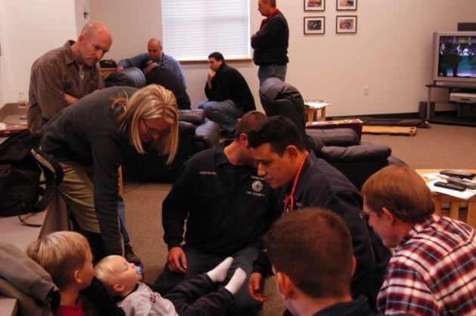
Learning Styles
Interpersonal/Social learners
  Process information best when multi-tasking in busy environments with other people
  Enjoy problem solving. Complex scenarios are challenging to these learners
  Classroom discussions, study groups, and skills groups are beneficial
Notes:
This group will respond to discussion questions. Ask the left side of the group “how”, the middle “what” and the right “why” questions. These people will enjoy observing each other during skills. They benefit from building on each other’s knowledge base, as well as their own.
Note the independent learner at the upper left of the photo.

Slide 48
Learning Styles
Intrapersonal/Independent learners
  Process information best when working independently or isolated
  Tend to work best in a quiet, undisturbed, regular study environment. Enjoy reading, reports, and written exams
  Will often benefit from watching the skill being performed by others before participating
Notes:
May not participate actively. This individual will benefit from seeing the instruction sheets for the equipment. Evaluation as an individual or when allowed to be the dominant leader may be beneficial. Remediation will be most beneficial if it is done one-on-one.

Slide 49


Slide 50
Domains of Learning
Not just for Instructors
Cognitive Domain (Knowledge): Learning includes memorizing facts, categorizing concepts and using rules to solve problems.
Affective Domain (Attitudes): Helps develop professional judgment which often determines excellence
Psychomotor Domain (Skills): The ability not only to use a skill, but also to know when and why it should be used
“We humans require convincing evidence of benefits before we learn a "new" way, and especially when changing from an old, established habit.” - Evelyn Wood
Notes:
Most EMS curriculums reference these 3 areas and we will cover them in the next slides.

Slide 51
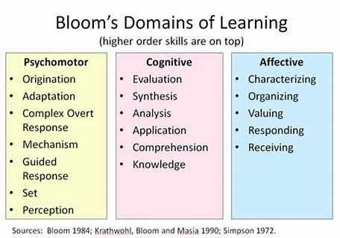

Slide 52
Cognitive Domain Concepts
That Maximize Learning
Lecture only when necessary
Use small group activities or discussions when possible
Present cognitive material in a logical sequence
Repeat, rephrase, problem solve
Summarize key points
Use vocabulary appropriate to group
Reinforce students for asking questions
Allow sufficient time for questions
Consider alternative approaches and techniques
Notes:
Maximum learning will only take place when the cognitive domain is considered part of the evaluation process!

Slide 53
Influencing
the Affective Domain
The affective domain skills often determine the patient’s perception of the quality of care received
Present to students the relevance of the information and allow them to attach the value
Ideal characteristic of providers
  Kindness
  Honesty
  Compassion
  Knowledge
  “Those having torches will pass them on to others” - Plato
Notes:
In order for your students to acquire these characteristics in their professional development, you must model them yourself - in the classroom and during actual patient care situations. To help evaluate the students adherence to the affective domain, get the patient’s perspective.

Slide 54
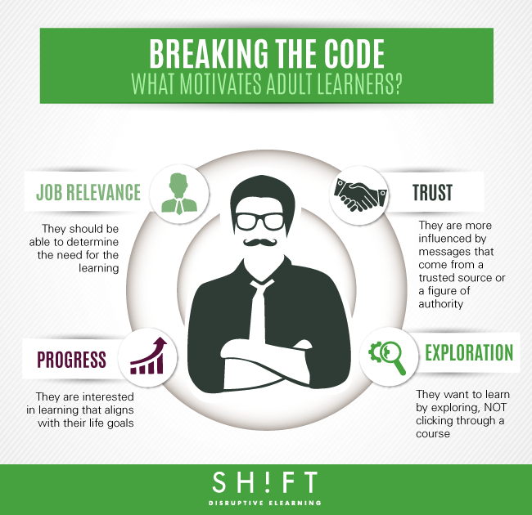

Slide 55



Slide 56
The Psychomotor Domain
The Essence of EMS Skills
Good skill performance is not an accident!
Skill = Accuracy Form X Adaptability X Speed
There must be as much preparation for the teaching of a skill (psychomotor) as for the lecture (cognitive)!
“Lucky is the teacher whose students want to know how things work.”
- Francis Bacon
Notes:
The psychomotor domain is where the action is relevant to evaluations. This is where demonstration begins and evaluation takes over. Remediation involves getting back into the psychomotor domain after “going back” to the cognitive domain, re-teaching what was not well learned the first time.

Slide 57
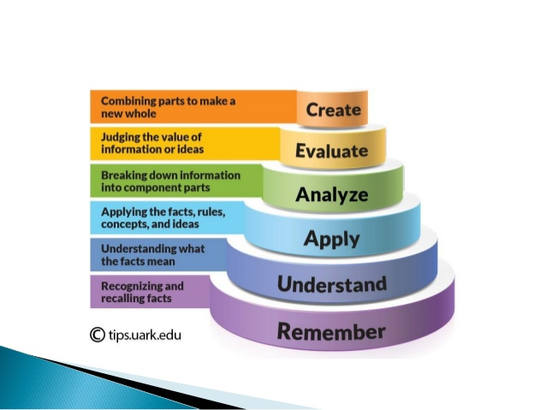

Slide 58
Teach Before Evaluating
Imitation
Student repeats what was demonstrated
“See one, do one”
Avoid modeling wrong behavior because the student will do as you do
Some skills are learned entirely by observation, with no need for formal instruction
Notes:
Adults learn complicated skills best when they understand the “why” not just the “how”. Direct modeling of an instructor typically results in non-transferable learning. They have difficulty applying it to a real life situation. Adults need to explore the process of each skill.

Slide 59
Teach Before Evaluating
Manipulation
Using guidelines or skill sheets
Making mistakes and thinking through corrective actions is a significant way to learn
Perfect practice makes perfect performance
The student begins to develop his or her own style and techniques
Notes:
Pushing students too fast may result in poor understanding of the task and may limit thinking skills

Slide 60
Teach Before Evaluating
The “whole-part-whole” technique
Whole: The instructor demonstrates the entire skill, beginning to end, briefly naming each action or step
Part: The instructor demonstrates the skill again, step-by-step, explaining each part in detail
Whole: The instructor demonstrates the entire skill, beginning to end without interruption and usually without commentary
Notes:
This technique is useful in teaching psychomotor skills to beginning students. It requires that the skill be demonstrated 3 times. Even when working with skilled providers, it is appropriate to review the parts before focusing on the whole.

Slide 61
Teach Before Evaluating
Progressing from a check sheet to a scenario
Student's practice using a skills check sheet after watching evaluator demonstration, then
Students memorize the steps of a skill, then perform the skill. verbalizing each step as they perform it, then
Students perform the skill while answering questions about their performance, then
Students perform the skill in context of a scenario or actual patient situation
Notes:
Allow students to learn parts before putting them all together or into a scenario.
Students should be allowed ample time to practice a skill before being evaluated.

Slide 62
Module 5
Evaluation Techniques
“He who wrestles with us strengthens our nerves
and sharpens our skills.” - Edward Burke

Slide 63
Why Evaluate?
To increase learning and improve performance
To test learning
Determine if a person meets the criteria to qualify for or retain certification
To determine teaching effectiveness and how to improve teaching
To gather information for decision-making

Slide 64
Characteristics of Skill Evaluations
Objectively measures similar performance consistently from one student/class or location to another (can be replicated)
Fair standards; Everyone knows “the rules”
As realistic as possible
Notes:
Evaluations can be performed in small groups where adults learn best. Allow them to work together to solve a common problem or complete a complicated scenario.

Slide 65
Subjective vs. Objective
Subjective:
  No set response
  “Correct” responses vary
  Evaluation based on “feeling”
Objective:
  Response set
  “Correct” responses do not vary
  Evaluation based on “fact”
Notes:
It is the evaluators responsibility to determine if performance was “satisfactory”. Unsatisfactory performance must be documented with an Objective reason for the failure.

Slide 66
Skill Evaluation Characteristics
Fair Standards
Standards are known by student and faculty - Make sure the students know “critical errors”
Practice is done with similar instruments during the training session
Minimize the “i” in EVALUATiON
Maximize the “u” in evalUation
Notes:
Set the student up to succeed. If you want to evaluate the use of a KED don’t simulate a critical patient. Multiple short sessions are usually more productive than a few long ones. Repeated performance of skills helps with retention.

Slide 67
Skill Evaluation Characteristics
Avoid labeling students!
You may alter your expectations of a student
You may alter the student’s ability to learn
Notes:
This is sometimes called the “Halo Effect”. Personal attitude influences the objectivity of the evaluator. It would be wise, when possible, for close friends to not evaluate each other.

Slide 68
Skill Evaluation Characteristics
Realism
Situations and patient information are plausible
Reactions or changes in the patients are realistic given the intervention and treatment
External distractions are realistic
Stress is similar to work environment
Skills sheets can be created locally if approved by MPD

Slide 69
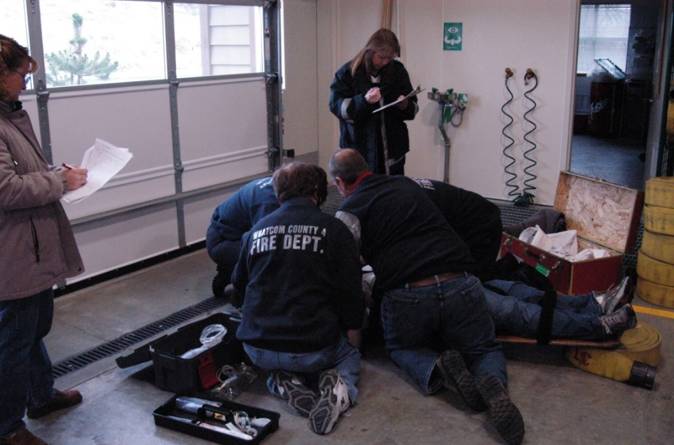
Evaluation Techniques
Basic types of practical skill evaluations
Rote
Situational

Slide 70
Rote Mechanical
Requires simple task analysis
Is the easiest skill examination to administer
May or may not reflect actual field performance, due to the lack of “real world stresses”
Generally, follows very specific order of steps
Uses Washington State-approved skill sheets
Not usually scenario-based
Does not show high level learning
Notes:
When practicing with equipment, emphasize areas that can become automatic. Increasing the ability to perform isolated functions automatically will increase long term ability to properly perform an entire skill.

Slide 71
Rote Evaluation Techniques
Evaluator demonstration followed by provider practice, then demonstration for evaluation
  Perform all steps before receiving feedback
  Do skill steps until any error is made
  Do skill steps until a critical error is made

Slide 72
Situational
Demonstration of a skill in the content of a scenario allowing for manipulation of the outcome or procedure
  Evaluates judgment and/or decision-making (critical thinking skills) as well as skills
  Is a more accurate predictor of field performance
  Difficult to develop and deliver, requires more elaborate simulations
  Proves higher level learning

Slide 73
Simulation and Scenarios
Simulations usually require:
  A patient “actor”
  Responding crew
  Bystanders
  An instructor (or facilitator), to give patient information that is not readily apparent
“The purpose of critical thinking is, therefore, to achieve understanding, evaluate view points, and solve problems. Since all three areas involve the asking of questions, we can say that critical thinking is the questioning or inquiry we engage in when we seek to understand, evaluate, or resolve.” - Victor P. Majorana, Critical Thinking Across the Curriculum

Slide 74
Teaching Thinking Skills
The benefit to simulation is that students use all three learning domains:
Cognitive (knowledge)
Psychomotor (skills)
Affective (attitude)

Slide 75
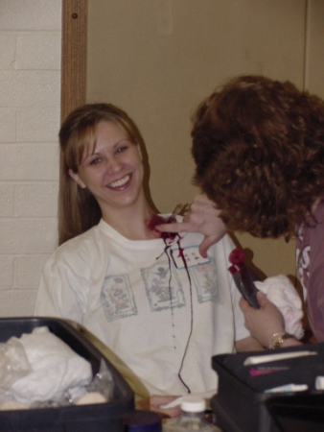
Teaching Thinking Skills
Ways to make simulations more realistic
Move to other locations
Moulage and makeup
Use background noise
Include sounds and smells
Use props such as pill bottles, medic alert tags, dishes, food, newspapers and other domestic items
Have simulated patients follow scripts or role-play in character
Notes:
Moulage handout included in packet of material. Use key words to guide patient performance, i.e.: “Command has been passed to the Chief” = patient deteriorates or “We have a second page” = patient improves.

Slide 76
A Successful Evaluator
Ensures that the participant:
  is able to integrate cognitive and affective components with skill performance
  understands why the skill is done a certain way
  knows when the skill is indicated
  performs the skill proficiently and with style
Doesn’t give up:
  On his or her ability to guide a participant on to perfection
  On the participant’s ability to learn and progress

Slide 77
BRAINSTORMING SESSION
Traction splint Hare, Sager, KTD
Extrication Long BB, KED, C-Collar, PVC Pipe Car
Open extremity Universal precautions, improvise
Open chest wound Scavenger hunt/portable wound
Oxygen therapy Put pieces together, contraindications?
BVM ventilation Real people, back of ambulance
CPR EMS evaluator not required
Scenario Sufficient evaluators, trained victims
Medical assessments Round table, skin signs, postural vital signs, combine with O2 therapy
CONSIDER LOCAL PROTOCOLS
Notes:
Discuss techniques for managing the different skills that need evaluated. Share tricks of the trade.
Paraquat (pesticide used on farms) poison: Only absolute contraindication to O2 (destroys lung tissue).

Slide 78
HANDS-ON PRACTICE TIME
Each EMS evaluator candidate will independently evaluate and remediate a two-person team performing a skill selected by the instructor and using a form common to the area!
Each EMS evaluator candidate will independently evaluate and remediate a two-person team performing a skill selected by the instructor and using a form from state-approved skill packet.
Following the evaluations, the group will critique the performance of the evaluator.
Notes:
This is the only activity scheduled; There are 2 slides left in this module to be used after the skills practice. In order to accomplish this task, the class will need to be broken into groups of four. Four skills will need to be performed with each evaluator taking a turn performing one evaluation with state-approved skill sheets and one utilizing a local form (if no local form, state-approved skill sheets or the local form can be used twice). Following each evaluation, the group will critique the evaluator. After one group has performed 2 evaluations and received 2 critiques, they teams should switch roles and the second group will evaluate the performance of the other team. Teams being evaluated should ensure that there is at least one item that can be remediated during each evaluation.

Slide 79
OTEP Evaluations -
The goal is learning
Evaluators should feel free to offer additional information or training (tricks of the trade) during an evaluation.
Watch for TEACHING MOMENTS!
Participants should be reminded to verbalize anything the evaluator may not be able to simulate or observe.
Notes:
Click after 1st bullet for “Watch for TEACHING MOMENTS.

Slide 80
Ethics Discussion
“Education has for its object the formation of character.” -Herbert Spencer
Participant who is dressed inappropriately
Patient who refuses necessary medical care for personal beliefs
Participant who is disrespectful to another participant
Someone asks you to sign off their OTEP because they missed the class and need it to re-certify under OTEP
Superior tries to “pull rank”
“Right is right, even if everyone is against it; and wrong is wrong, even if everyone is for it.” - William Penn

Slide 81
Module 6
Feedback
“Until the student knows how much you care,
he won’t care how much you know.” - Unknown

Slide 82
Research into Feedback
When feedback is given readily it produces better immediate post-training performance but poorer long-term retention.
Where feedback is given less frequently or in summary form, the performance is poorer immediately after training, but retention and transfer of the knowledge to other situations is increased.
Rational: Too much immediate feedback becomes a guide to behavior and the learning needed to produce proficient long-term performance does not occur or occurs at a weak level.
Notes:
When is immediate feedback necessary and when can it be postponed?

Slide 83
Guides to Giving Feedback
Praise in Public, Punish in Private
Provide feedback as soon as possible after an action
Use the “sandwich” technique (positive-negative-positive)
Check to ensure the message you sent was understood
Listen to the message, not just what is said
Use open body language
Notes:
Practice sessions should end with a correct performance or demonstration of the skill

Slide 84
Other Helpful Hints
Before mastery, interruptions to correct errors are appropriate.
Once mastery of skills has been obtained:
  Do not interrupt the scenario unless there is a safety issue
  Comment on timing and decision-making later
  Allow adults to develop their own style
  Allow advanced students to correct their own mistakes with only limited supervision
Ensure practice sessions end with a correct skill performance
Notes:
Adult learners need encouragement and positive feedback to reinforce the correct behaviors.

Slide 85
Module 7
Effective Remediation
A deliberate educational activity designed to correct deficits identified during formal and informal evaluations

Slide 86
Effective Remediation
Remediation follows a
systematic plan
Identify the problem
Identify where the deficits came from
  Student
  Educational program
Retrain the student
Re-evaluate the student
Notes:
“The practice of “reviewing”….. In general has nothing in common with the art of criticism” -Henry James

Slide 87
Steps of Remediation
Identify the problem
  If you jump to a solution before fully understanding the problem, you may not have the correct solution
  Ask the right questions
    Was the problem with the student’s performance due to a problem with their education or training?
    Did the student perform correctly previously?
      No: it may be a knowledge deficit
      Yes: it may be a motivation deficit
Notes:
Feedback and instruction should be given at the most appropriate time during or after the evaluation to allow for learning (consider the learning style of the student)

Slide 88
Steps of Remediation
Identify where the deficits came from
  Insufficient instruction
  Low expenditure of effort by the student
  Poor strategy for learning
  Student’s lack of ability
  Clearly state what needs to be improved to meet the objectives

Slide 89
Steps of Remediation
Retrain Student
  Use information gathered from the assessment of the problem to design a strategy for improvement
  Help improve student learning strategies
  Provide correct instruction and adequate time for practice
  Discuss why the correct performance is essential
  Discuss with the student how the skill should be done
  Give students the ability to increase their knowledge
  Encourage self-directed, independent learning
Notes:
Adults will benefit from being encouraged to actively monitor their own learning. The instructor should provide learning opportunities that allow the students to work through problems on their own with only the needed help offered.

Slide 90
Steps of Remediation
Re-evaluate student
  Repeat remediation process until successful outcome is achieved or logical stop point is reached
  Students who “fail” are allowed additional attempts to master the skill
  A student who is unable to complete a skill should be referred to the agency MSO or training officer for additional remediation
Notes:
Be sure the students are well enough prepared to have a reasonable chance to succeed

Slide 91

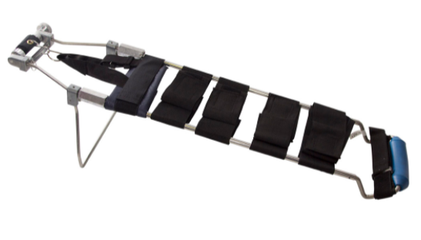
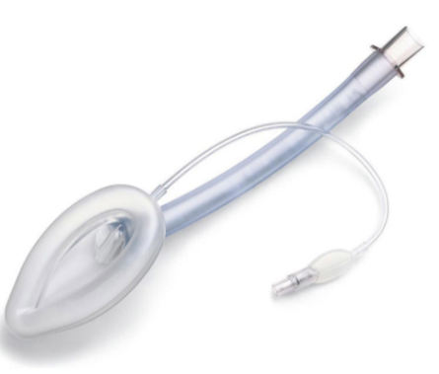


Module 8
Hands on Practice

Slide 92
REVIEW
A Good EMS Evaluator:
Understands the roles of an SEI, instructor and evaluator
Uses accurate resources for information
Knows how to perform the different types of evaluations
Knows how to perform the skills
Knows how to use the equipment
Knows how adults learn
Works professionally and always seeks self-improvement

Slide 93
. . . All that’s left is the paperwork
Course Evaluation
Instructor Evaluation
Evaluator Application
Evaluator Renewal
Notes:
Was paperwork done before the class or does it need to be done now?
Paper application for Initial EMS evaluators and those who have expired EMS evaluator credentials.
Renewal of an EMS evaluator credential can be done in conjunction with other primary EMS credential (EMT, AEMT, or PM).

