Slide 1
EMT-Special Skill
Supraglottic Airway
Companion PowerPoint DOH 530-253
for
Required curricula:
Supraglottic Airway Endorsement for EMTs
DOH 530-138
Emergency Care Systems

Slide 2
THANK YOU
This training aid was developed by the Washington State
EMS Education Workgroup under the oversight
of the Prehospital Technical Advisory Committee.
Notes:
Background / Scope
This curriculum was developed by the EMS Education and Certification workgroup to provide a consistent minimum standard for state Supraglottic Airway endorsement.

Slide 3
Supraglottic Airway Endorsement
The purpose is to teach the proper placement of a supraglottic airway (SGA) device in the patient experiencing an airway
or breathing emergency.
Notes:
The purpose of SGA training aid is to teach the proper placement of a supraglottic airway (SGA) device in the patient experiencing an airway or breathing emergency. Any currently certified EMT/AEMT/PM or EMT/AEMT/PM course student is eligible to participate in the class.
Successful completion of the SGA curriculum is required to receive endorsement by the Washington State Department of Health. Permission to use the supraglottic airway device is given by each county’s Medical Program Director by means of their county protocols.
Course Completion Requirements
Course participants must successfully complete all objectives.
Course participants must pass a written exam and that exam will be reviewed with the class by the instructor.
Course participants must pass the SGA practical skill evaluation.
Initial SGA Endorsement
The individual must successfully complete an initial SGA course. The SEI must submit to DOH the EMS Course Completion Verification roster form along with a copy of each student’s Certificate or Letter of Course Completion.
Renewal of SGA Endorsement
1. EMTs with an SGA endorsement must complete didactic and practical skills training/evaluation during their certification period via the OTEP or CME method.
Renewal of the SGA endorsement is ‘automatic’ when applying for recertification in the Secure Access Washington (SAW) system.

Slide 4
There are objectives the student must master to ensure the proper care of a patient experiencing an airway or breathing emergency
Demonstrate proper airway management for a patient in respiratory failure or cardiac arrest
Identify the need to place supraglottic airway (SGA) device
Demonstrate the proper technique for placement of a supraglottic airway (SGA) device
Explain the importance of continued monitoring of ventilations, waveform capnography, and airway patency

Slide 5
Why is it important?
Failure to manage the airway patency is a major cause of preventable death in the prehospital setting
Maintaining the patient’s oxygenation and supporting ventilation are critical steps to minimize the overall burden of injury and improve the likelihood of a good outcome
Early detection, rapid intervention and continuous reassessment are paramount
Notes:
Without a secure airway and adequate oxygenation and ventilation, other resuscitative measures are doomed to failure.
With the exception of the immediate defibrillation of the cardiac arrest patient, no single resuscitative maneuver takes priority over management of the airway.
EMS providers’ job is to:
Determine the best method of airway management,
Manage the airway minimizing hypoxia, hypercarbia, & aspiration,
Rapidly assess the need for airway management & urgency of situation,
Recognize when the basic airway intervention has failed and effectively choose/execute an SGA insertion.

Slide 6
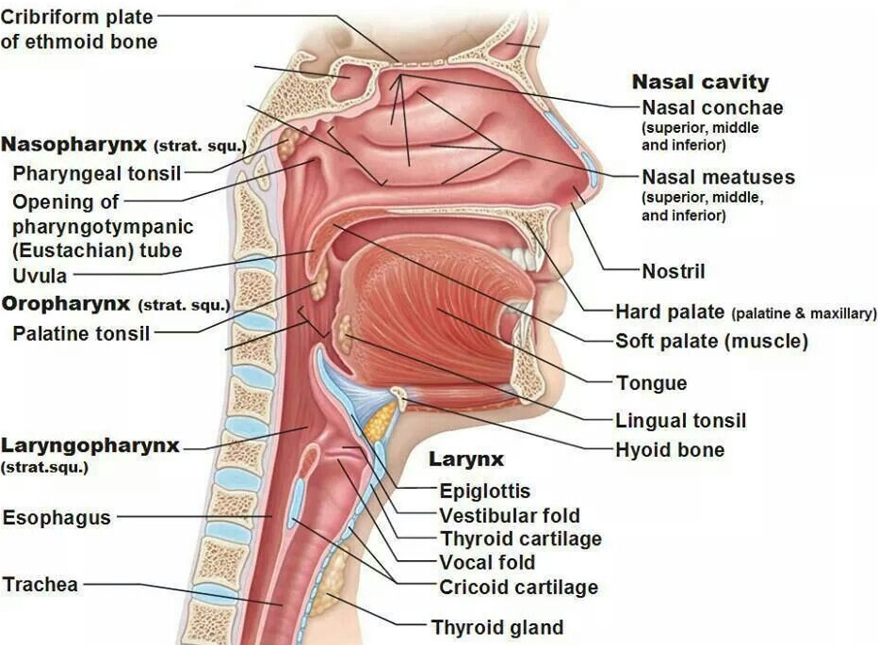
Anatomy of the Upper Airway
physio-pedia.com
Notes:
Function of the upper airway: turbinates warm, filter and humidify air; sinuses trap bacteria and are tributaries for fluid from eustachian tubes and tear ducts. A patent airway is the first component in the delivery of oxygen to the cells.
Sections are: Nasopharynx, Oropharynx, Hypopharynx, Larynx. Muscle tone of the pharynx keeps the airway open.
Nasopharynx is formed by the union of facial bones and the orientation of nasal floor is towards the ear not the eye. It is separated by septum and lined with mucous membranes and cilia. Note that improper or overly aggressive placement of nasal airways will cause significant bleeding which may not be controlled by direct pressure.
Oropharnyx has the teeth, tongue, palate and adenoids. The teeth require significant force to dislodge but they may fracture or avulse causing obstruction. The tongue is a large muscle attached at the mandible and hyoid bones and is the most common airway obstruction. The palate is the roof of mouth which separates the oro/naso pharynx. The anterior portion is the hard palate and the posterior portion beyond the teeth is the soft palate.
Hypopharynx is posterior to the tongue. The epiglottis is located here. The vallecula is the “pocket" formed by the base of the tongue and epiglottis.
Larynx is made of cartilage and is attached to the hyoid bone, which is a horseshoe shaped bone between the chin and mandibular angle whose function is to support the trachea. The larynx components are the: thyroid cartilage which is the first tracheal cartilage and is made of cartilage anteriorly and smooth muscle posteriorly. The laryngeal prominence (Adam’s Apple) is the anterior prominence of thyroid cartilage with the glottic opening directly behind it. The glottic opening patency is heavily dependent on muscle tone and contains: the vocal bands which are white bands of cartilage produce that produce the voice; arytenoid cartilage; and pyriform fossae. The cricoid ring is the first tracheal ring and is completely cartilaginous. Compression of cricoid ring occludes esophagus as in the Sellick Maneuver. The cricothyroid membrane is a fibrous membrane between the cricoid and thyroid cartilage. It is the site for advanced surgical and alternative airway placement.
Note- slide graphic annotated on physio-pedia website as ‘free to be used and share”.

Slide 7
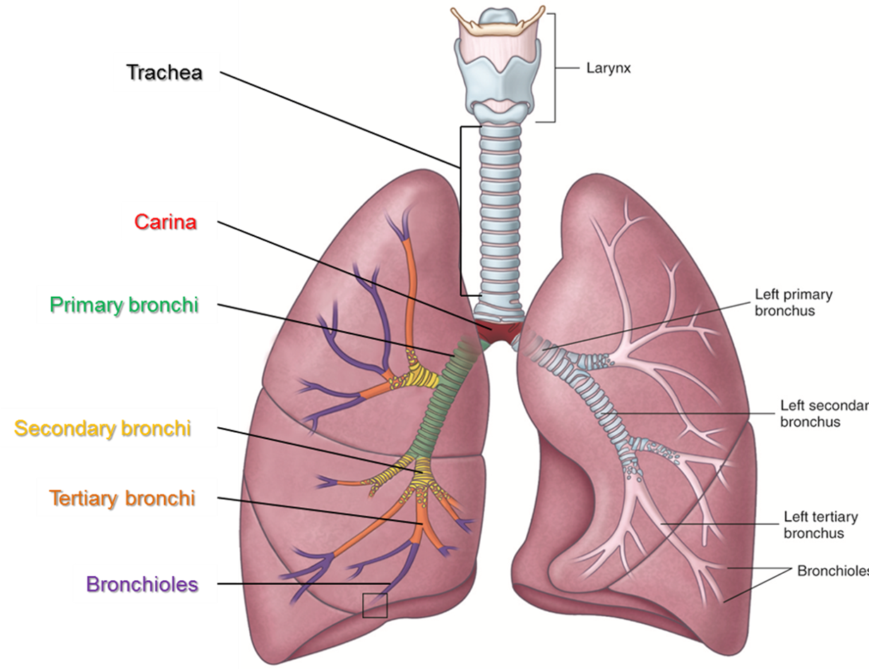
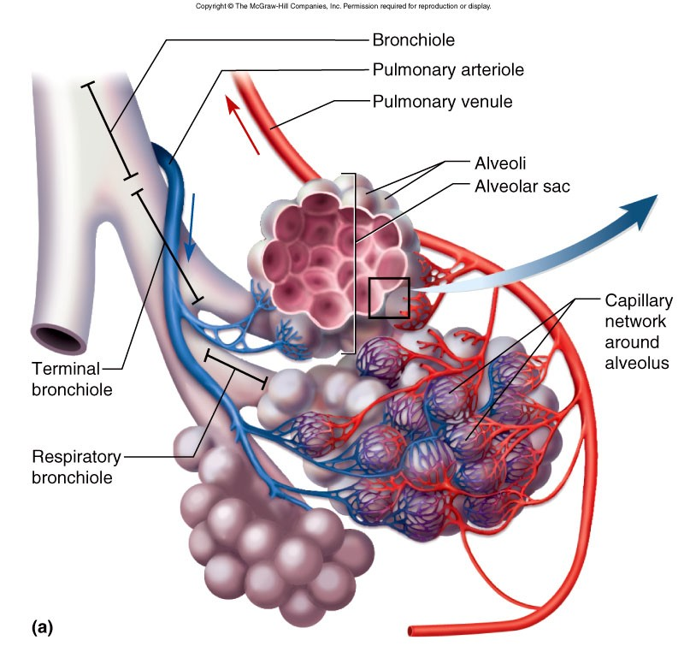
Anatomy of the Lower Airway
Notes:
Function of the lower airway: exchange of O₂ and CO₂
Sections are: Trachea, Bronchi, Alveoli, Lungs. https://www.youtube.com/watch?v=IIkEbGJAsqE
Trachea lies in front of the esophagus; it is a rigid tube about 4.5 inches (12 cm) long and 1 inch (2.5 cm) wide. C-shaped rings of cartilage encircle the trachea to reinforce it and keep it from collapsing. The open part of the “C” faces posteriorly, giving the esophagus room to expand during swallowing.
Primary bronchi-at the carina, the trachea branches into two bronchi, which are also supported by C-shaped rings of cartilage. The right bronchus is slightly wider and more vertical than the left, making this the most likely location for aspirated food particles and small objects to lodge. (Primary bronchi is shaded green in right lung.)
Immediately after entering the lungs, the primary bronchi branch into secondary bronchi: one for each of the lung’s lobe (two on the left and three on the right). (These are shaded yellow in right lung.)
Secondary bronchi branch into smaller tertiary bronchi (shaded in orange in right lung) The cartilaginous rings surrounding the bronchi become irregular and disappear in the smaller bronchioles.
Tertiary bronchi continue to branch, resulting in very small airways called bronchioles (shaded purple in right lung). Bronchioles divide further to form thin-walled passages called alveolar ducts which are throughout the lungs and terminate in clusters of alveoli called alveolar sacs.
Alveoli- The lung passages all exist to serve the alveoli, because it’s within the alveoli that gas exchange occurs. Deoxygenated blood flows into alveoli through pulmonary arterioles, and oxygenated blood leaves alveoli via pulmonary venules. Alveoli are separated from one another by a thin layer of tissue. A mesh of pulmonary capillaries encases each alveolus. The extremely thin walls of the alveoli, and the closeness of the capillaries, allow for efficient gas exchange. Elastic fibers give alveoli the ability to expand during inhalation and spring back into shape during exhalation. During inspiration, air flows into the alveoli, inflating them like tiny balloons. The ability of alveoli to expand as they fill with air and recoil as they expel air depends on their own elasticity as well as the compliance of surrounding lung tissue. Once alveoli fill with air, oxygen crosses the respiratory membrane and moves into red blood cells in surrounding capillaries. As red blood cells take up oxygen, they release carbon dioxide, which then passes into the alveoli. Alveoli deflate during expiration, expelling their content of carbon dioxide, which travels back up the conducting airways to be expelled by the lungs.

Slide 8
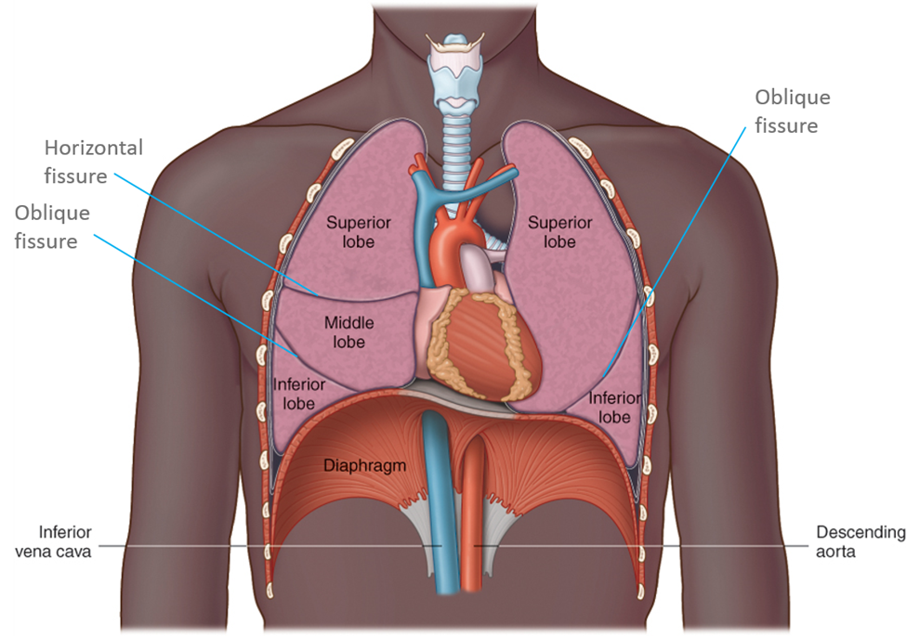
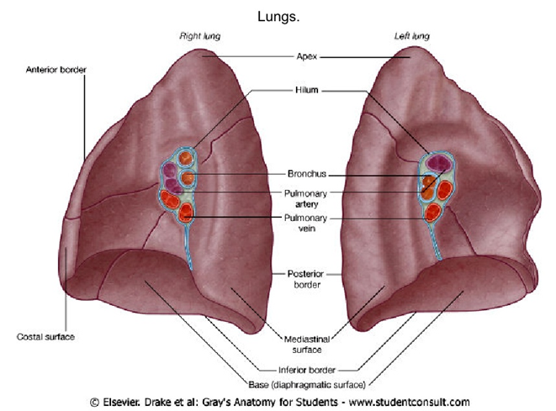
Anatomy of the Lower Airway
Notes:
Lungs- The lungs are large, spongy, cone-shaped organs that fill the pleural cavity. https://www.youtube.com/watch?v=CDEYWok94uQ
Function of the lower airway: actual site for exchange of O₂ and CO_{2.}
The primary bronchi and pulmonary blood vessels enter each lung through a slit on the lung’s medial surface, called the hilum.
The top, or apex, of each lung extends about ½” (1.5 cm) above the first rib; the base of each lung rests on the diaphragm.
The right lung is shorter, broader, and larger than the left. It has three lobes (superior, middle, and inferior) and handles 55% of the gas exchange. The right lung contains two fissures: the horizontal fissure and the oblique fissure.
The left lung has only two lobes: the superior and inferior. It contains one fissure (the oblique fissure).
The lobes are made of lung parenchyma which comprises a large number (~700 million) of thin-walled alveoli, forming an enormous surface area, which serves to maintain proper gas exchange. The membranous outer lining is called pleura (visceral pleura covers the lungs and parietal pleura lines the chest wall).
Total lung capacity in an adult male is ~6,000 mL/adult female is ~4,000 mL.
Not all inspired air enters alveoli as minor diffusion of O₂ takes place in the alveolar ducts and terminal bronchioles.
Tidal volume is the volume of gas inhaled or exhaled during a single respiratory cycle which is about 5-7 mL/kg (500 mL normally).
Dead space air is air remaining in air passageways, unavailable for gas exchange (Approximately 150 mL). Anatomic dead space is in the trachea & bronchi. Physiologic dead space is formed by factors like disease or obstruction (COPD, Atelectasis).
Minute volume is the amount of gas moved in and out of the respiratory tract per minute. It is determined by Tidal Volume (amount of air moved in/out of your lung in a single breath) x Respiratory Rate minus the dead space volume.
Inspiratory reserve volume is the deepest breath you can take after a normal breath. Expiratory reserve volume is the maximum amount of air you can force out after a normal breath. Residual volume is the gas that remains in the lungs just to keep them open, it just does not move during ventilation.

Slide 9
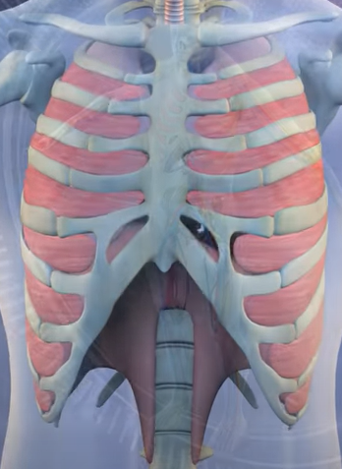
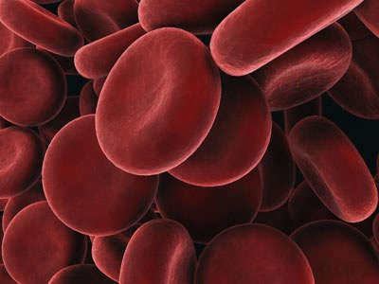
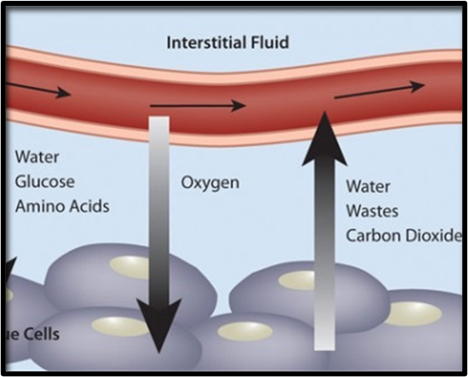
Physiology
Ventilation: mechanical movement
Oxygenation: circulatory perfusion
Respiration: gas exchange diffusion
Notes:
Table is on Notes page for instructor

Slide 10
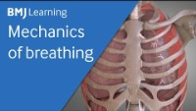
Physiology
Notes:
Mechanics of ventilation https://youtu.be/NM3PK5qy9uA

Slide 11
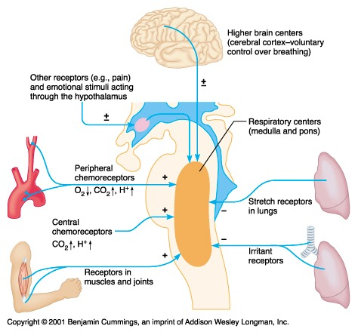
Regulatory Center
Notes:
Respiratory Controls- usually an involuntary process
Medulla is the primary involuntary respiratory center. It is connected to respiratory muscles by vagus nerve.
Pons has the:
Apneustic center which is the secondary control center if medulla fails to initiate respiration
Pneumotaxic center which controls expiration via stretch receptors.
Lung Receptors – Irritant receptors are found in the epithelium in the conducting airways, and sensitive to particulates and noxious gas, and initiate the cough reflex.
Hering-Breuer Reflex receptors are located in sensitive smooth muscles, and decrease ventilation rate and volume thus protecting against excess lung inflation.
J-receptors are located near alveolar capillaries, are sensitive to increased pulmonary capillary pressure, and initiate rapid shallow breathing, hypotension and bradycardia.
Chemoreceptors – Central receptors are located near the respiratory centers in the brain, and are
sensitive to very small changes in hydrogen ion concentration in the CSF. CSF pH reflects PaCO2 because hydrogen ions diffuse across the blood-brain barrier.
Peripheral receptors are located in the aortic and carotid bodies and arch of the aorta, and are primarily sensitive to oxygen levels. As PaO2 and pH decreases they signal increased ventilation.
Miscellaneous stimuli – pain, fear, emotion, illness, medications, drugs, and voluntary.
All feed into the respiratory centers in the medulla and pons that signal increase or decrease in respiration.
Hypoxic Drive- occurs when the respiratory stimulus is dependent on oxygen rather than carbon dioxide concentration in the blood.

Slide 12

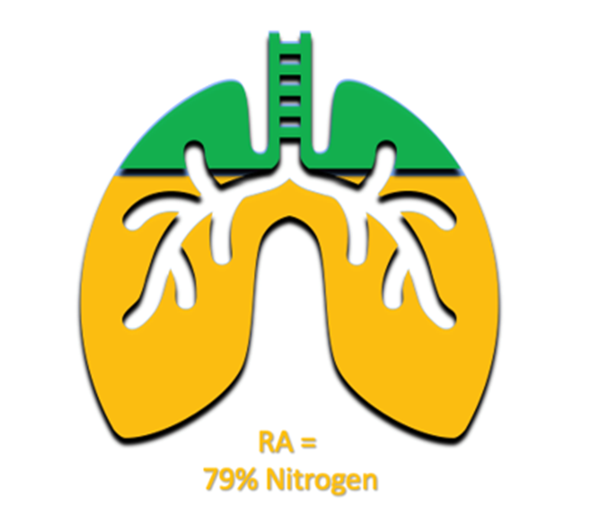
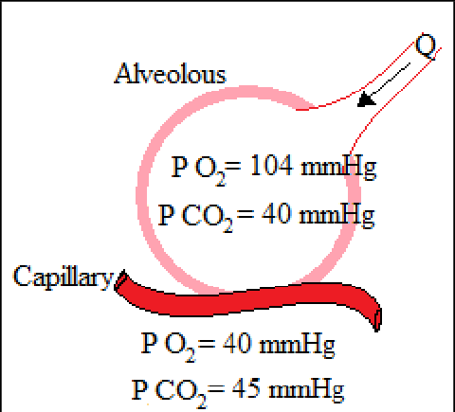
Measurement of Gases
Notes:
External Respiration-
Concentration/percentage of gases in the atmosphere = Nitrogen 78.62% , Oxygen 20.84%,
CO2 0.04%, Water 0.50%.
Concentration/percentage of gases in the alveola = Nitrogen 74.9%, Oxygen 13.7%,
CO2 5.2%, Water 6.2%.
Total pressure is the combined pressure of all atmospheric gasses and equals 100% or 760 Torr or 1 atm (1 standard atmosphere) and is measured in ‘mmHg’ at sea level.
Partial pressure is the amount of gas in air or dissolved in fluid such as blood. It is measured in millimeters of mercury mmHg).
In the alveoli (in air) the partial pressure of oxygen (Pao₂ ) is 104 mmHg and carbon dioxide (PaCo₂) is 40 mmHg.
In the blood (in fluid) the partial pressure of oxygen (Pao2 ) is 80-100 mmHg and carbon dioxide (PaCo2) is 35-45 mmHg.

Slide 13
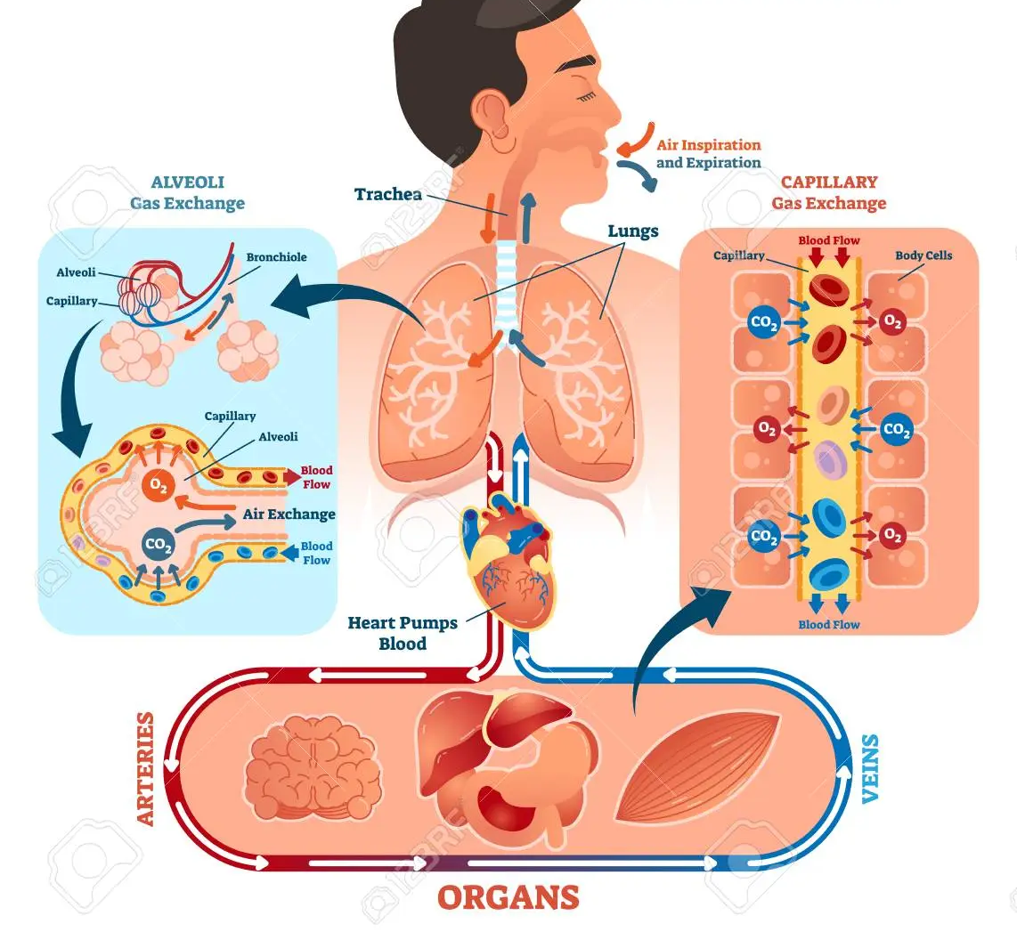
Exchange of Gases
Courtesy: 123RF LLC, Chicago, IL, image 99658748
Notes:
Diffusion: Passage of Solution from area of Higher concentration to Lower concentration.
In the alveoli (higher concentration site) dissolved oxygen crosses the pulmonary capillary membrane (to lower concentration site) and binds to the hemoglobin (Hgb) of red blood cell. Oxygen is carried on hemoglobin molecule as well as dissolved in plasma. Approximately 97% of total oxygen is bound to hemoglobin. Because hemoglobin carries 97% of the oxygen delivered to the body tissues, oxygen saturation is an indication of the amount of oxygen available to end organs. This will be further discussed when we talk about monitoring the patient.
This oxygen-rich blood then flows back to the heart, which pumps it through the arteries to oxygen-hungry tissues throughout the body.
As oxygen-rich (and carbon dioxide-poor) blood travels by a cell the oxygen diffuses through the cell membrane to the area of lower concentration inside the cell. It can do this easily because the oxygen molecule (O2) is very small and has no charge or polarity. The oxygen is used up rapidly by mitochondria. This rapid consumption causes oxygen to constantly move into the cell from the blood.
The mitochondria creates carbon dioxide (CO2) as a waste product of cellular respiration (the process that makes energy for your body). Because the CO2 is of a higher concentration in the cell than in the blood passing by, this gas continually diffuses out of the cell. It too is small and uncharged so it can pass through cell membranes easily. Most of the carbon dioxide dissolves in the plasma of the blood and about 33% is bound to hemoglobin. CO2 is transported in blood as bicarbonate ion and as O2 crosses into blood, CO2 diffuses into alveoli where it is exhaled.

Slide 14
Assessment- Essential Parameters
Patency
Rate
Regularity
Effort
Ventilation
Oxygenation & Respiration
Notes:
Generally if you can hear breathing when you enter >>> there is a problem.
Patency- is the airway adequate?
The gag reflex is a protective mechanism and is strongest in the hypopharynx. Up to 30% of people do not have a gag reflex, thus “testing” the gag reflex is NOT a reliable predictor of airway patency.
Snoring respirations usually means there is a positioning problem > resolve with repositioning.
Gurgling or bubbling means there are fluids such as blood or vomit in the airway > resolve with
suctioning.
Stridor- obstruction >resolve by removing object or treat causing factor.
Rate- normal resting- Adult: 12-20 Children(1-12 y/o): 15-30 Infants: 25-50.
Regularity- is pattern a regular or irregular inhalation/exhalation rhythm? Any irregularity is significant until proven otherwise.
Effort- how is the work of breathing (WOB)? Breathing at rest should be effortless, and speech is a good indicator. If a patient has an increased WOB they will often compensate by preferential positioning such as: sitting upright in a sniffing with head and chin thrust slightly forward; sitting in a tripod position; as they become more tired they may slump back.
Ventilation- Are they hyperventilating at a rate slow for their age range?
Are they hyperventilating at a rate fast for their age range?
Are their breaths’ tidal volume showing normal full chest rise and fall/chest expansion or are they shallow or deep?
Oxygenation- Are they getting oxygen onto hemoglobin in lungs and off at tissues?
Are they cyanotic or displaying air hunger? What is the oxygen saturation reading?

Slide 15
Assessing Patency, Oxygenation & Ventilation
Visual signs and symptoms
Auscultation techniques
Palpation techniques
Notes:
Visual Signs and Symptoms:
a) level of consciousness,
b) general appearance,
c) patient in a position to help them breathe? i.e.,: "tripod", upright with dangling feet,
d) patient visibly anxious, restless or distressed. This can range from mild to extreme.
e) rise and fall of chest equal bilaterally, normal, deep, shallow, or absent?
f) color of skin - cyanosis, cherry red, pale, ashen?
g) flaring of nares,
h) gasping,
i) pursed lips,
j) retractions: “pulling in of skin" between thoracic skeleton during inspiration: Intercostal,
Suprasternal notch, Supraclavicular fossa, Subcostal.
Auscultation Techniques:
a) do you hear air movement at mouth and nose?
b) use stethoscope to listen under the clothing over the upper lungs, lower lungs, and major
airways (midclavicular and midaxillary lines).
Palpation Techniques:
a) for an unresponsive patient is there air movement at mouth and nose?
b) is there subcutaneous emphysema on the chest?
c) encircle chest wall during inhalation and exhalation to feel for full chest excursion, paradoxical
motion, retractions, or grating of ribs.

Slide 16
Inadequate Ventilation, Oxygenation or Respiration
Dyspnea
Hypoxia, Hypoxemia, Anoxia
Hypoventilation, Hyperventilation
Respiratory Rate/Pattern Changes
Notes:
Terms:
Dyspnea = shortness of breath or difficulty breathing
Dyspnea may be result of or result in:
Hypoxia- Lack of Oxygen;
Hypoxemia- Lack of Oxygen to Tissues;
Anoxia- Total absence of Oxygen.
Hypoventilation – slow or shallow breathing that increases the blood carbon dioxide level above normal.
Hyperventilation – rapid or deep breathing that lowers the blood carbon dioxide level below normal.
Rate/Pattern changes-
Cheyne-Stokes: gradually increase of rate and tidal volume followed by gradual decrease, and is
associated with brain stem insult.
Kussmaul: deep, gasping respirations which is common in diabetic coma, increased
intracranial pressure.
Central Neurogenic Hyperventilation: deep rapid respirations similar to Kussmaul, indicating
increased intracranial pressure.

Slide 17
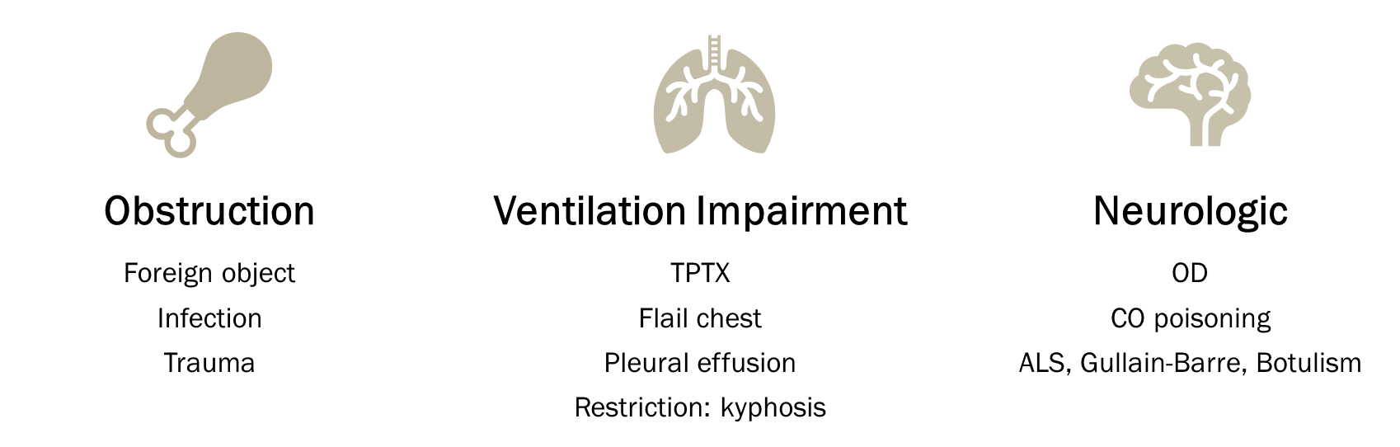
Causes of Hypoventilation
Notes:
Hypoventilation is due to upper or lower airway obstruction, chest wall impairment, neurologic impairment; then carbon dioxide accumulates in the blood when the lungs fail to work properly; with the ultimate manifestation is respiratory arrest followed by cardiac arrest.
Hypoventilation can be from:
Tongue which is the most common airway obstruction, causing snoring respirations, and is corrected with positioning.
Foreign objects may cause partial or full obstruction. Symptoms include choking, gagging, stridor, dyspnea, aphonia (unable to speak), dysphonia (difficulty speaking)
Laryngeal spasm which is spasmodic closure of vocal cords and the glottic opening becomes extremely narrow or totally obstructed. It is most frequently caused by epiglottitis (A Bacterial infection of the epiglottis), anaphylaxis, trauma from over aggressive technique during advanced airway placement, or immediately upon extubation especially when patient is semiconscious. It is relieved by aggressive ventilation, forceful upward pull of the jaw, and ALS use of muscle relaxants.
Trauma may occur in the form of a fractured larynx. Remember airway patency is dependent upon muscle tone and if there is fractured laryngeal tissue this increases airway resistance by decreasing airway size through decreasing muscle tone, laryngeal edema and ventilatory effort.
Tension Pneumothorax (TPTX) causes restrictive ability to ventilate.
Trauma may occur from a flail chest thus causing less chest excursion.
CO levels may cause hypoventilation or be caused by hypoventilation.
Carbon monoxide poisoning- the poison replaces the oxygen in your bloodstream causing cells to be starved of oxygen.
Amyotrophic lateral sclerosis (ALS) is a neurodegenerative condition characterized by progressive muscle weakness and wasting. Breathing difficulties are among the first symptoms of ALS, as the chest muscles and diaphragm that control breathing become affected by the disease.
Guillain-Barre affects the body with weakness of inspiratory and expiratory muscles of respiration leading to poor lung compliance, microatelectasis, hypoxemia, and increased risk of infections due to poor coughing ability.
Botulism is a rare serious illness that affects the nervous system. It occurs when poisonous substances called botulinum toxins produce skeletal muscle paralysis. This paralysis can affect the respiratory muscles. Common botulism are foodborne and wound botulism.
Aspiration significantly increases mortality. It obstructs the airway, destroys delicate bronchiolar tissue, introduces pathogens into the body and results in decreased ability to ventilate.

Slide 18
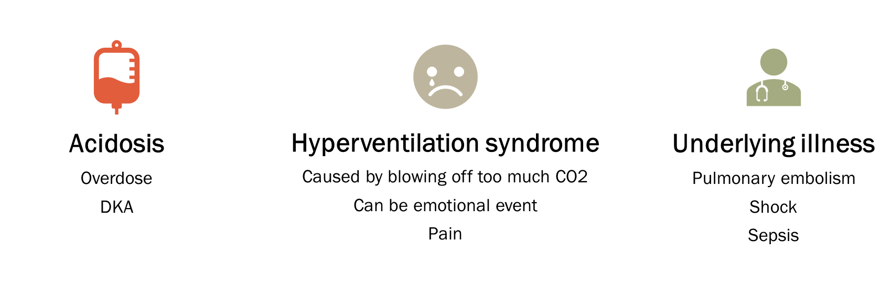
Causes of Hyperventilation
Notes:
Hyperventilation occurs when people breathe in excess by increasing their rate. It can be triggered by emotional distress or a medical emergency.
It causes numbness in hands, feet, and mouth.
Having patient rebreathe carbon dioxide can be dangerous.
Treatment can include physiological support, but you should always look for an underlying medical cause.
Hyperventilation can be from:
Acidosis-
Overdose of aspirin, iron, LSD, cocaine, amphetamines, methamphetamine or asthma medicines can cause hyperventilation.
Diabetic Ketoacidosis (DKA) causes metabolic acidosis resulting in rapid respirations.
Hyperventilation syndrome- this condition occurs as a response to emotional states, such as depression, anxiety, or anger. When hyperventilation is a frequent occurrence, it’s known as hyperventilation syndrome.
Psychogenic - It only occurs as an occasional, panicked response to fear, stress, or a phobia.
Underlying Illnesses causes-
A blood clot, such as a deep vein thrombosis (DVT) or pulmonary embolus.
Asthma and chronic obstructive pulmonary disease (COPD).
Heart failure.
Fluid in the lungs, such as pulmonary edema.
Infection, such as pneumonia.
Scarring of the lungs, such as pulmonary fibrosis.
Thyroid problems, such as Graves' disease and hyperthyroidism.
Shock.
Sepsis.

Slide 19
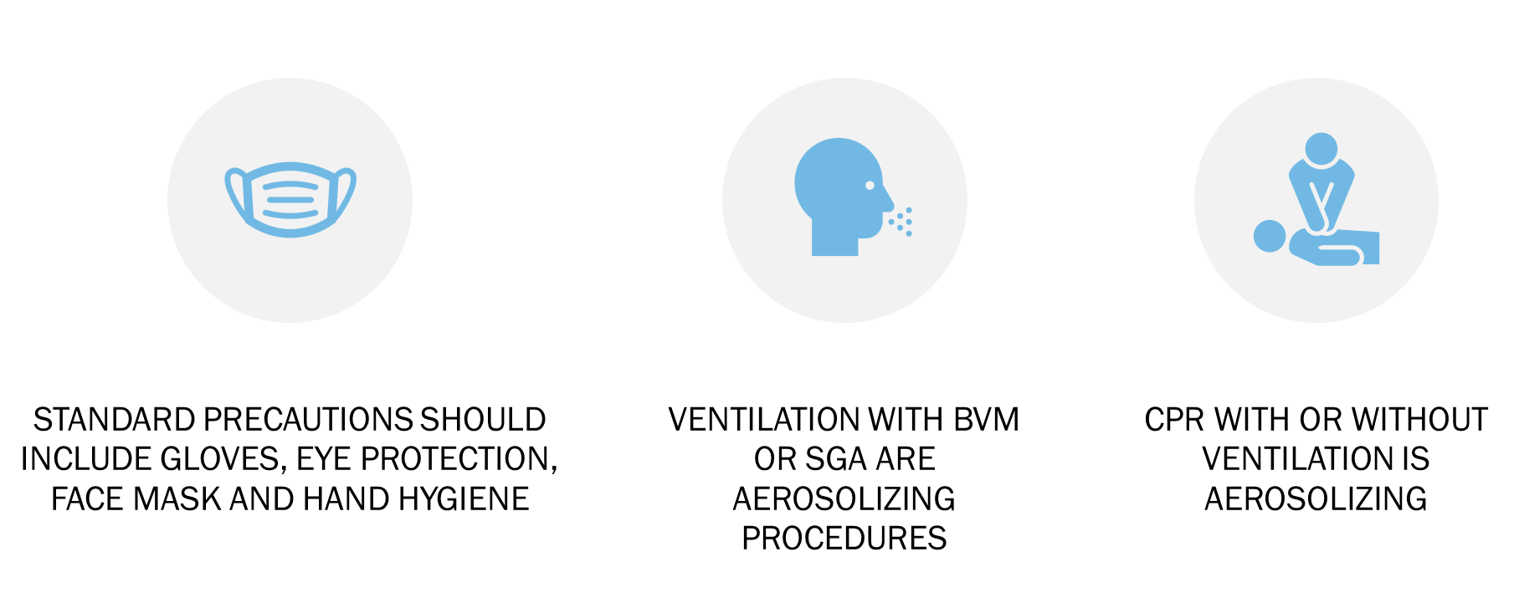
Basic Airway Management
Infectious Disease Considerations
Notes:
Standard Precautions means applying a standard set of protections for EMS personnel coming in contact with germs/pathogens carried by patients.
Personal Protective Equipment (PPE) must be used as a precaution routinely.
Influenza and other diseases can transmit via the ocular surfaces as well as other mucous membranes. Use PPE to protect the mucous membranes of the eyes, nose, and mouth
during procedures and patient care activities that are likely to generate splashes or sprays of blood, body fluids, secretions, and excretions.
Select masks, eye protection/goggles, face shields, and combinations of each according to the need anticipated by the task performed.

Slide 20
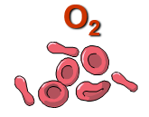
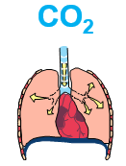
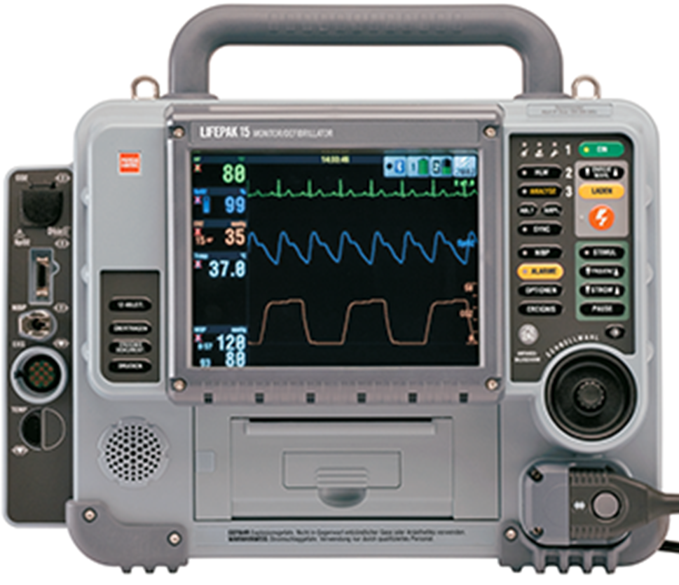
Recognize the Need for Basic Airway Management
Assessment
Measurement
Oxygenation
Measured by Pulse Oximetry
Ventilation
Measured by Capnography
SpO₂ pleth
Waveform ETCO₂
Notes:
Assessment- we discussed in the last section.
Measurement has two completely different and separate functions:
Oxygenation is the transport of O₂ via the bloodstream to the cells.
- Oxygen is required for metabolism.
- is measured by use of the pulse oximeter.
Ventilation is the exhaling of CO₂ via the respiratory tract.
- Carbon dioxide is a byproduct of metabolism.
- is measured by use of end-tidal-CO2 (ETCO₂ ).

Slide 21
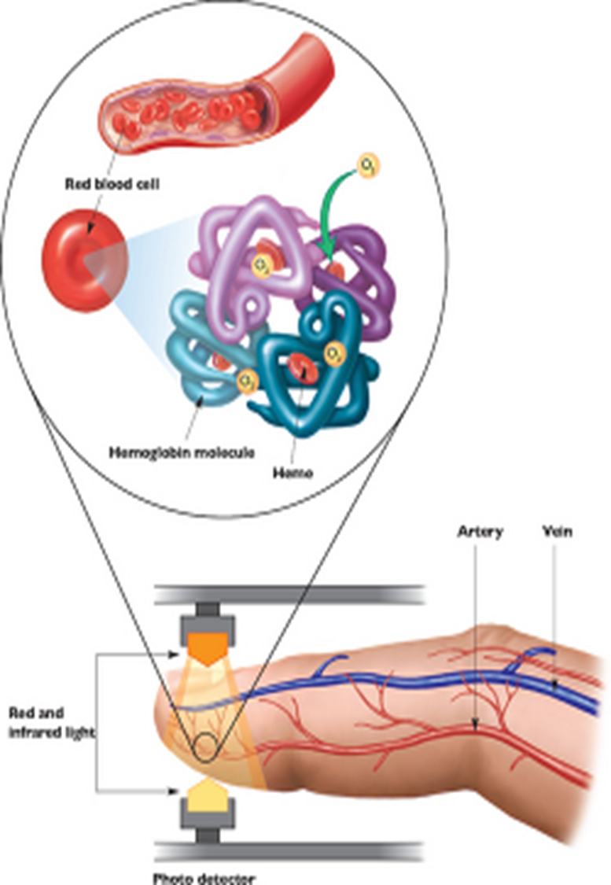
Recognize the Need for Basic Airway Management
Pulse Oximetry
  SpO₂ = % of oxygen saturated hemoglobin
  Goal SpO₂ varies depending on the patient
  Verify waveform!
Notes:
Pulse ox relies on the principle of spectral analysis which is the method of analyzing physiochemical properties
of matter based on their unique light absorption characteristics. For blood absorbance of transmitted light is dependent on the concentration of hemoglobin species. Red and infrared wavelengths are emitted. When positioned to traverse or reflex from a cutaneous vascular bed the opposed photo detector measure light intensity of each transmitted signal. Signal processing exploits the pulsatile nature of arterial blood to isolate arterial saturation. The microprocessor averages the data over several pulse cycles and compares the measured absorption to a reference standard curve to determine hemoglobin saturation which is displayed as a percentage of oxyhemoglobin (SPO2).
Pulse Ox readings should be taken before, during and after any treatment; and ongoing with V/S.
Normal Pulse Ox values are between 94 to 100% on room air. Values below 93 to 94% are abnormal and may suggest acute or chronic hypoxia, i.e., COPD. Reliability deteriorates with progressive hypotension below SBP 80 and severe hypoxemia < 65%.
Signal averaging of 4-20 seconds in most monitors. Delay because of sensor anatomic location and abnormal cardiac performance compound the lag relative to central SaO2. Forehead probes are closer to the heart and respond more quickly than distal extremity probes. Although most sensors loose reliability during hypotension, hypothermia, hypoperfusion, forehead reflectance probes maintain reliability during these conditions. Thus. a forehead probe is often preferred in management of critically ill patients.
It is important to keep a patient’s oxygen saturation in a normal range, because declines in saturation result in a reduction in oxygen content. With 90% saturation, PO2 drops to 60 mm Hg; with 75% saturation, PO2 drops to 40 mm Hg; with 50% saturation, PO2 drops to 27 mm Hg.

Slide 22
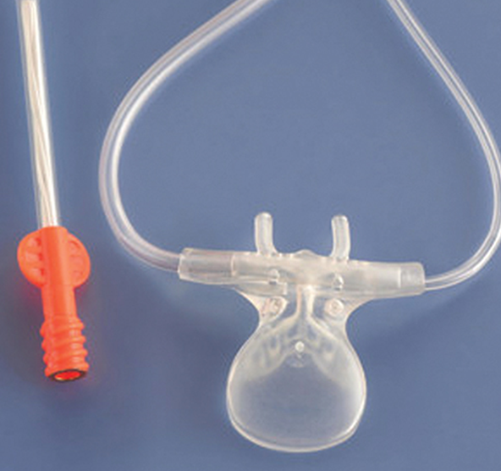
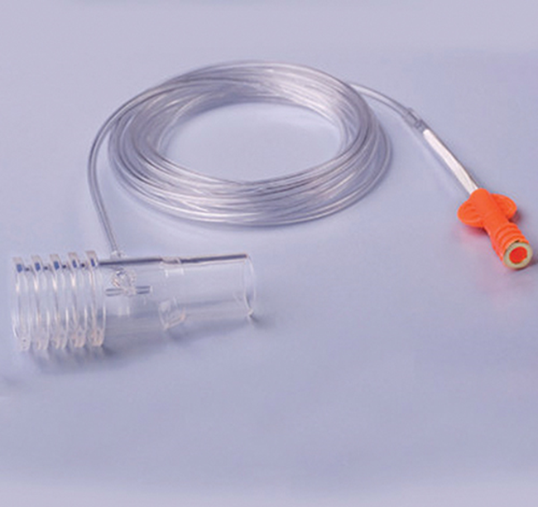
Recognize the Need for Basic Airway Management
Capnography of End-Tidal CO₂
  Is a measurement of ventilation
  Detects exhaled CO₂ concentration in mmHg
  Is not affected by motion artifact, etc
Both photos © 2017 Medtronic. All rights reserved. Used with the permission of Medtronic.
Notes:
Carbon dioxide concentration in exhaled gases closely approximate arterial PaCO₂ levels (normally range between 35 and 45 mm Hg).
Typically, ETCO₂ is approximately 2 to 5 mm Hg lower than arterial PaCO₂.
Top photo is nasal cannula device for monitoring end-tidal carbon dioxide in a spontaneously breathing patient. Those prongs can also be used to administer a small amount of oxygen, or applied underneath a non-rebreather or CPAP mask.
Bottom photo - In patients who require assisted ventilation, another adapter can be attached to a BVM and advanced airway device. Waveform capnography is a useful tool to identify when patients with an altered mental status need assisted ventilation with a bag valve mask. When the brain does not respond appropriately to CO2 changes, such as from overdose, head injury or seizure, excess CO₂ accumulates in the lungs, though the ETCO₂ reading may be low or high. Some causes of respiratory failure present with adequate tidal volume but slow respiratory rate, and in these cases ETCO₂ would be high (above 45 mm Hg) and continue to rise if not addressed. Other causes of respiratory failure present with inadequate respiratory rate and depth, and since little exhaled air would reach the sensor on the capnography circuit, the ETCO₂ reading would be low. Once ventilation is assisted with a bag valve mask, ETCO₂ would spike until the excess CO₂ is washed out of the lungs.
While a rise in CO₂ should stimulate someone to breathe, no effort should be needed to exhale it. Patients with asthma, COPD, CHF, and pneumonia must often exert themselves to exhale with accessory muscles. It is important to understand that patients in respiratory distress may inhale enough oxygen and have a normal pulse-ox reading, but still struggle to get air out, and progress to respiratory failure from fatigue. In this group of patients means that their effort is not effectively eliminating CO₂ (hypercarbia), and ETCO₂ may rise or fall depending on tidal volume.
Correctly diagnosing the cause of respiratory distress can be difficult, and treating the wrong condition may cause harm. A number of conditions can cause diminished breath sounds, wheezing may be heard with both asthma and pulmonary edema, and crackles may be heard with pulmonary edema and pneumonia. Adding waveform capnography to history and physical exam findings can help with treatment decisions.

Slide 23
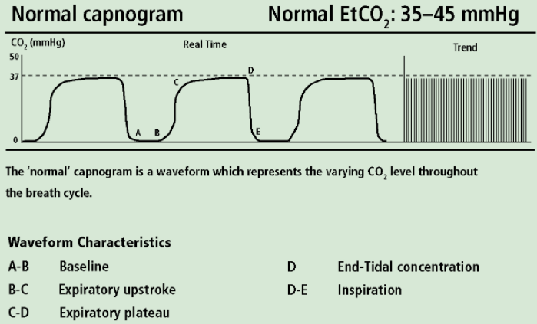
Recognize the Need for Basic Airway Management
Waveform Capnography
Courtesy ZOLL Medical Corporation
Notes:
In healthy patients, a close correlation exists between ETCO₂ and arterial CO₂ such that ETCO₂ is approximately 2-5mmHg less than PaCO₂ . Unfortunately change in ventilation and perfusion alter the alveolar to arterial gradient such that absolute PaCO₂ can be difficult to predict based on capnography.

Slide 24
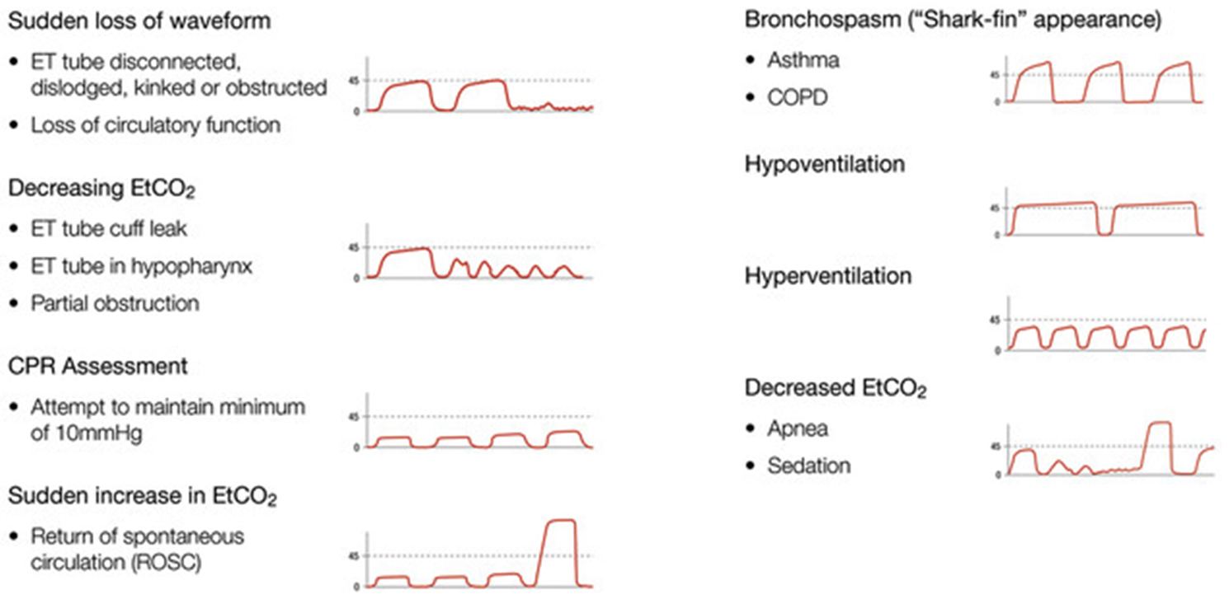
Recognize the Need for Basic Airway Management
Waveform Capnography
Notes:
Abnormal capnographic waveforms:
Shape of the capnographic waveform can provide information about abnormal breathing processes such as hypoventilation, hyperventilation, bronchospasm, and rebreathing; or inadvertent extubation.
Hypoventilation is a condition in which the production of carbon dioxide exceeds elimination. Waveforms are tall and the ETCO₂ value is correspondingly high (greater than 45 mm Hg).
Bradypnea produces a prolonged alveolar plateau (phase III [C-D]) and longer-than-normal intervals between waveforms. Causes of hypoventilation include respiratory depression, or a ventilatory rate that is too slow in an intubated patient.
Hyperventilation is a condition in which the elimination of carbon dioxide exceeds production. Waveforms are small and the ETCO₂ value is correspondingly low (less than 35 mm Hg).
Tachypnea produces a short alveolar plateau (phase III [C-D]) and shorter-than-normal intervals between waveforms. Causes of hyperventilation include anxiety/panic attacks, metabolic acidosis, head injury, pulmonary embolism.

Slide 25
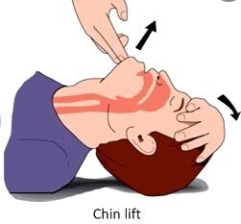
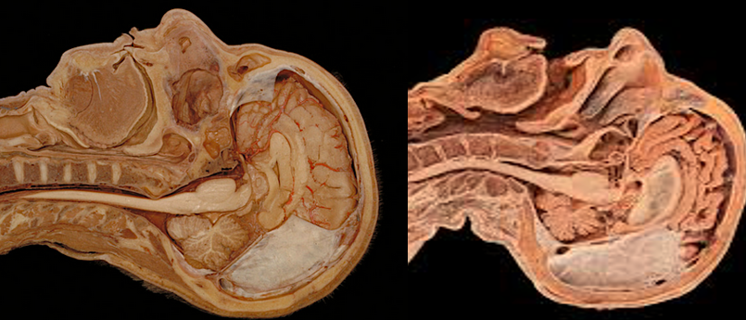
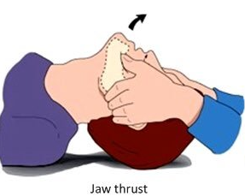
Basic Airway Maneuvers
Opening the mouth/airway
Head-tilt / Chin-lift
Jaw Thrust
Notes:
Head-tilt/chin-lift maneuver-
Most basic airway maneuver:
Tilt head back b) Lift chin forward c) Open mouth.
Indications:
a) Unresponsive patients who:
(i) Do not have mechanism for c-spine injury,
(ii) Unable to protect their own airway.
(3) Contraindications:
a) Awake patients b) Possible c-spine Injury
(4) Advantages:
No equipment required. b) Simple.
Safe. d) Non-invasive.
Disadvantages:
a) Should use second rescuer for Bag Valve Mask ventilation.
b) Does not protect from aspiration.
Jaw-Thrust Maneuver-
Head maintained neutral.
Jaw is displaced forward at mandibular angle.
Indications:
a) Unresponsive. b) Cervical Spine Injury.
c) Unable to protect own airway. d) Resistance to opening mouth.
(3) Contraindications:
a) Awake Patients
(4) Advantages:
a) No special equipment required. b) Simple. c) Safe.
d) Non-invasive. e) May be used with cervical collar in place.
(5) Disadvantages:
a) Difficult to maintain.
b) Requires second rescuer for Bag Valve Mask ventilation.
c) Does not protect from aspiration.

Slide 26
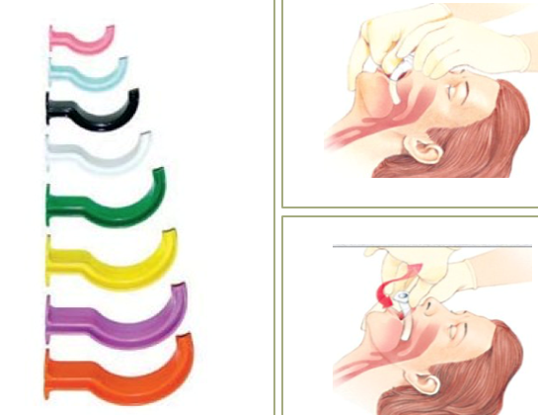
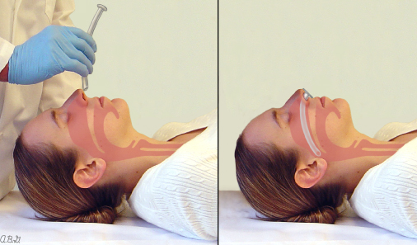
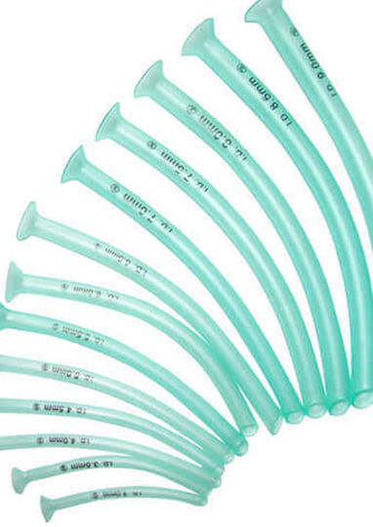
Basic Airway Adjuncts
Insertion of Basic Airway Devices
  Oropharyngeal Airway
  Nasopharyngeal Airway
Courtesy: UpToDate
Notes:
Oropharyngeal (oral) Airway
Purposes: Keep tongue form blocking the upper airway & make it easier to suction the mouth.
Indications: Unresponsive patients without a gag reflex.
Any apneic patient being ventilated with a BVM.
Contraindications: Conscious patients,
Any patient (conscious or unconscious) with an intact gag reflex.
Advantages: Non-invasive & easily placed.
Disadvantages: Does not prevent aspiration.
Complications: Miss-sized adjunct may block airway,
Oropharyngeal, pharyngeal or dental trauma with poor insertion technique,
Unexpected gag may produce vomiting.
Placement: Size from corner of mouth to earlobe,
Open mouth with cross-finger technique ,
Insert airway with tip facing roof of mouth and slide it in until it touches roof of mouth,
Rotate airway 180° and continue to insert until flange rests on patient’s lips/teeth.
Alternate placement method: Depress tongue with tongue depressor,
Insert airway at 90° sideways from corner of mouth,
Rotate airway, insert exerting gentle pressure on the airway until flange rests on patient’s lips/teeth, removing tongue depressor.
Nasopharyngeal (nasal) Airway
Purposes: Provide pathway for air from nose to the lower airway.
Indications: Unresponsive patients with or without a gag reflex who is unable to maintain their airway.
Any apneic patient being ventilated with a BVM.
Contraindications: Patient intolerance,
Use caution in patient with facial injury so as to not enter cranial cavity. (lack of airway maintenance in head injury patients has been demonstrated thus creating hypoxic states
and cerebral edema).
Advantages: Can be suctioned through, can be tolerated by conscious patients, can be safely placed
blindly, does not require mouth to be open.
Disadvantages: Does not prevent aspiration.
Complications: Improper technique may result in severe bleeding which may be difficult to control,
Placement: Size from tip of nostril to earlobe, and diameter roughly equal to patient’s little finger, coat with
water soluble lubricant. Insert into larger nostril with bevel toward septum (may need to rotate
if using left nostril). Gently advance airway until flange rests against nostril. If resistance is felt
you may need to use the other nostril.

Slide 27
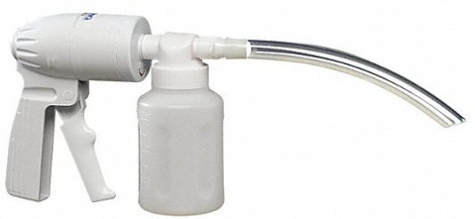
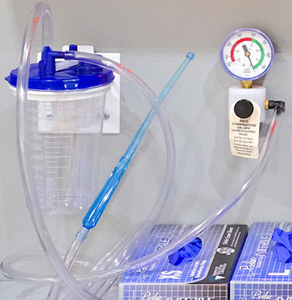
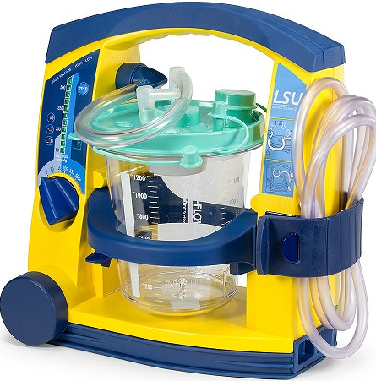
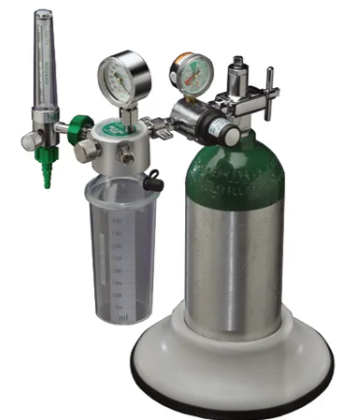
Suctioning
Purpose: To clear a path for gas exchange while preventing aspiration
  A totally obstructed airway will provide no air exchange >>
    Be aggressive!
Types of Suction Devices
Notes:
You must keep the airway clear so that proper ventilation can be accomplished.
One of the most significant complications of suctioning is that suctioning for prolonged periods can cause hypoxemia. If you have a totally obstructed airway, you must be aggressive with suctioning to clear a path, even partially cleared so that hyperoxygenation may be accomplished followed by repeated suctioning.
Portable units, either hand-operated or battery (ac/dc) must provide enough vacuum pressure and flow to effectively suction the mouth and/or nose. Fixed suctioning units should generate airflow of more than 40 L/minute and a vacuum of more than 300 mmHg when the tubing is occluded.
There are different types of suction devices so make sure you are familiar with all of your agency’s devices so that suction is not delayed:
Hand-powered,
Ambulance wall- mounted vacuum-powered,
Battery or ac/dc powered,
Oxygen-powered.

Slide 28
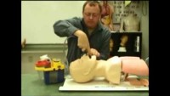
Suctioning
Techniques with the rigid tip and catheter tip
Notes:
https://youtu.be/f755uAQIqM0 - show credits at the end.
Do not apply suction for more than 15 seconds for an adult, 10 for a child, 5 for an infant.
You may need to preoxygenate before you suction and/or hyperoxygenate after suctioning with high-
flow oxygen via NRM / BVM with hi-flow oxygen to achieve an oxygen saturation at or above 95%.
Types of suctioning catheters:
a) Hard or rigid catheters:
(1) AKA: "Yankauer" or "Tonsil Tip“,
(2) Suction large volumes of fluid rapidly,
(3) Standard Size.
b) Soft catheters:
(1) Can be placed in Oropharynx, Nasopharynx, or down advanced airways,
(2) Various Sizes,
(3) Smaller inside diameter than hard tip catheters.
Suctioning the upper airway is critical to prevention of aspirate. Mortality increases significantly if
aspiration occurs.
When suctioning trachea with Multi-Lumen Airway in place may necessitate injection of 3 to 5 cc's of
sterile water down advanced airway to loosen secretions.

Slide 29
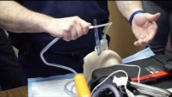
Suctioning
Techniques with SGA in place
Notes:
Suction Assisted Laryngoscopy and Airway Decontamination (SALAD)
https://youtu.be/qRT1ncS1d28
Dr. James DuCanto developed his SALAD technique to quickly clear the airway, eliminating the most common source of intubation failure and reducing the mortality rate associated with aspiration.
The SALAD technique uses aggressive suction to quickly clear the airway, allowing a first responder or other provider to intubate the patient. The catheter can be left in place during intubation, providing an easy route for removing blood or other contaminants during and after intubation. The technique offers easy access to the trachea, even when patients are continuously vomiting or bleeding.

Slide 30
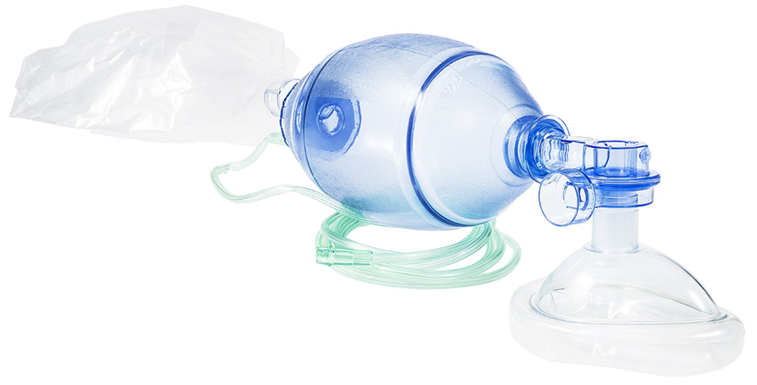
Bag-Valve-Mask (BVM)
  Best If:
    You have a good seal
    Used with a PEEP valve
    SQUEEZE the bag as some bags don’t deliver O2 unless squeezed
  Use When:
    Patient is not breathing spontaneously
    Patient is breathing too slow
    Tidal volume is low
Notes:
When to use the BVM:
Apnea,
Hypoventilation,
Pulmonary edema,
Severe SOB if they will let you,
If Spo2 drops below 94% during the apneic period of Rapid Sequence Intubation (RSI).
Use two rescuers to ensure adequate seal of the BVM whenever possible.
Use disposable PEEP valve if you can get your hands on them.
Remember oxygen is not flowing to the patient if you are not squeezing the bag (this is not an airline face mask).
Caution: Gastric Distention occurs when air becomes trapped in the stomach.
Very common when ventilating non-intubated patients:
(1) Stomach diameter increases,
(2) Pushes against diaphragm,
(3) Interferes with lung expansion: (a) Abdomen becomes increasingly distended,
(b) Resistance to Bag Valve Mask Ventilation.
Prevention:
(1) Ensure patient’s airway is properly positioned.
(2) Ensure you ventilate at proper rate 1 q 5-6 seconds for adult.
(3) Ventilate only to see chest begin to rise.
Management:
(1) May be reduced by increasing Bag Valve Mask Ventilation time:
(a) Adults: 1.5-2 seconds,
(b) Peds: 1-1.5 seconds.
(2) Prepare for large volume suction.

Slide 31
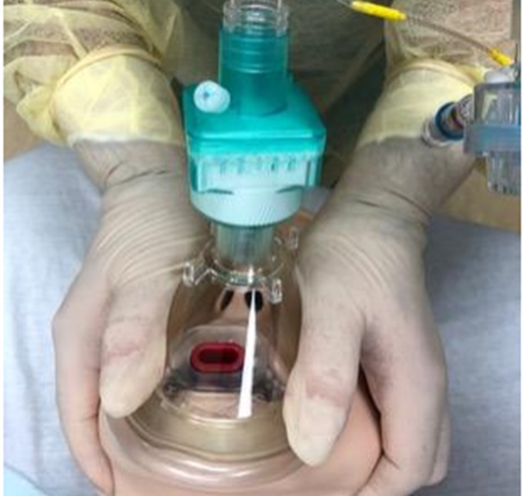
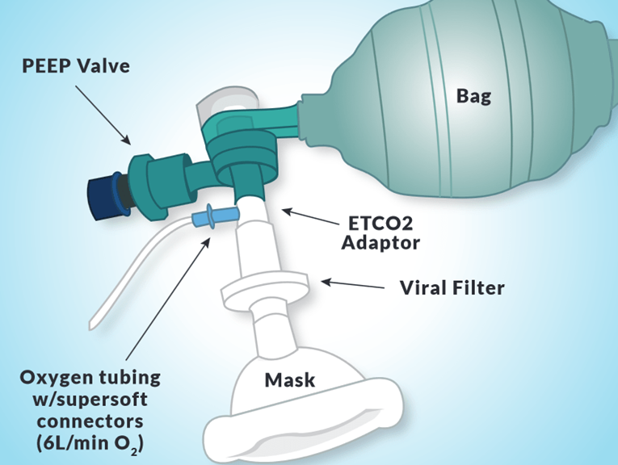
Viral Filter for BVM
  A good seal with a viral filter can help reduce aerosolization of infectious diseases
Notes:
In addition to appropriate personal protection equipment, HEPA viral filtration to reduce aerosolization with BVM or SGA placement is recommended.
When performing BVM ventilation, the HEPA viral filter is attached directly to the mask, with the bag attached on the opposite side.

Slide 32
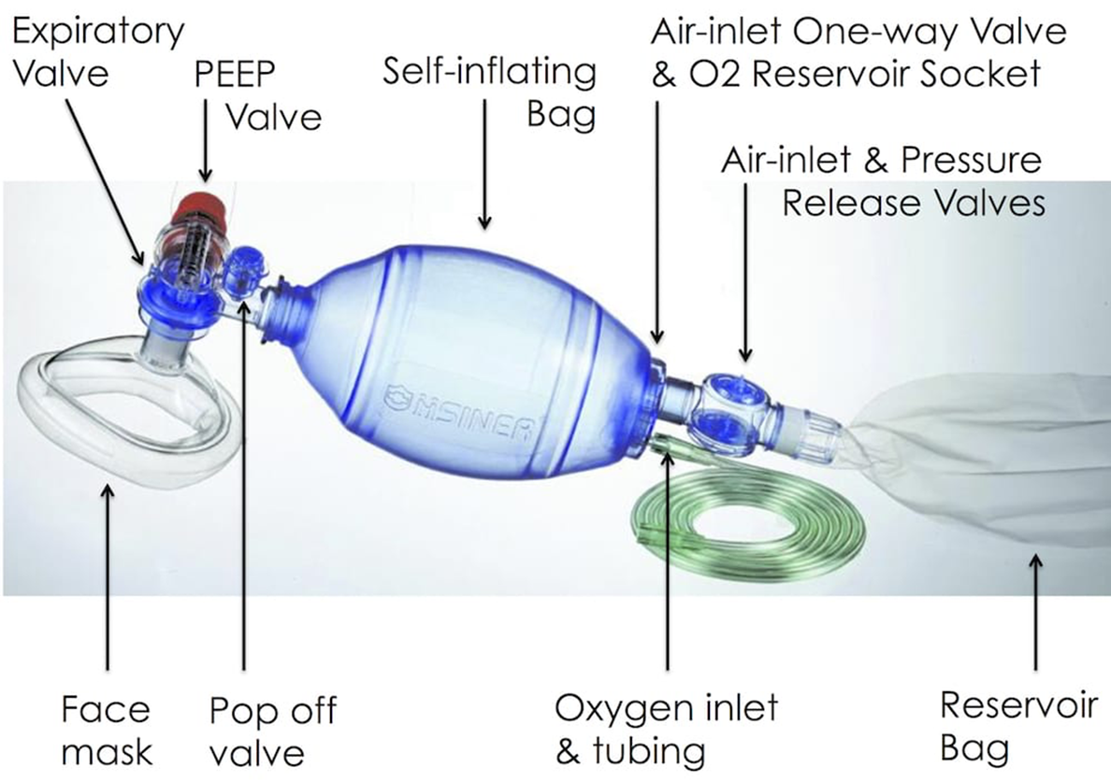
Anatomy of the Bag-Valve-Mask
Notes:
Check that the bag is working properly.
Check exhalation valve.
Check pop-off valve and disable if needed.
Use PEEP when available.

Slide 33
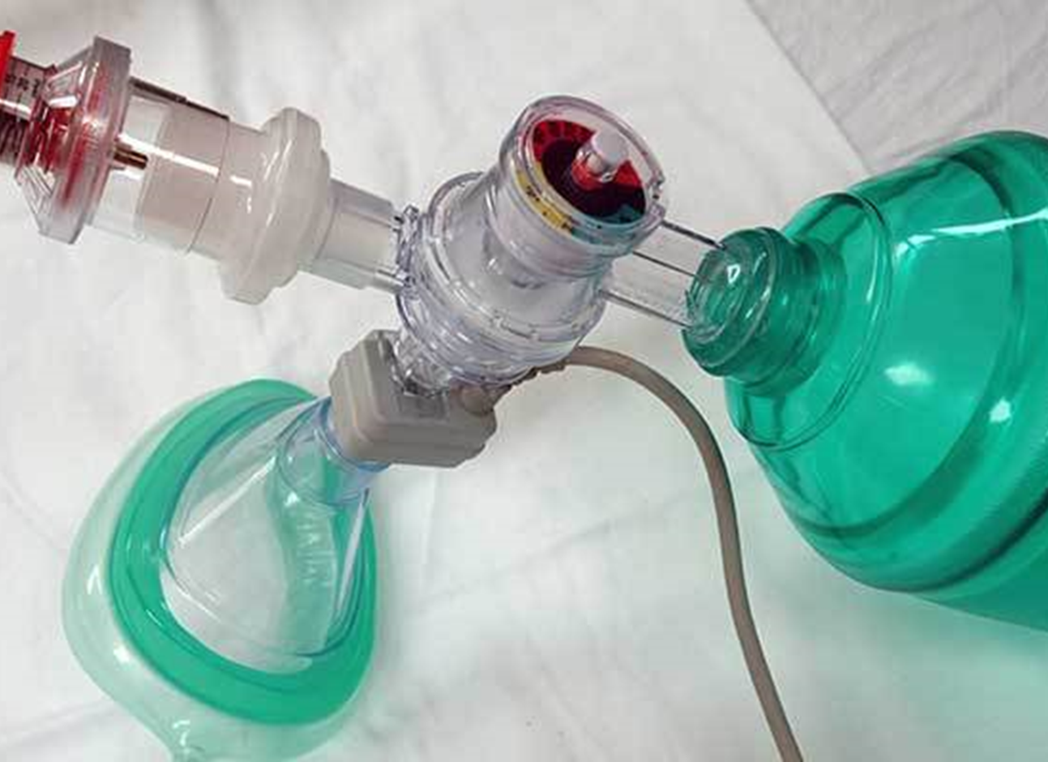
Positive-End-Expiratory-Pressure (PEEP)
Increases end
expiratory
pressures
Physiologic PEEP
is 5 cm of water
(cm H₂O)
Increases alveolar
recruitment in
patients with
shunting
Notes:
Increases alveolar recruitment in patients with shunting as in pneumonia, pulmonary edema, etc.
PEEP should initially be set at 5 cm of water which is the amount of PEEP that is normally present in the airway prior to intubation. Once intubated this pressure is taken away.
Normal PEEP values range from 5 to 10 cm water.
Use care with any PEEP increases as there can be adverse complications:
Decreased BP due to decreased venous return.
Increased intracranial pressure.
Increased intrathoracic pressure leading to pneumothorax or tension
pneumothorax.

Slide 34
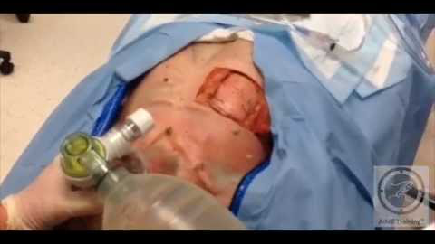
Positive-End-Expiratory-Pressure (PEEP)

Slide 35
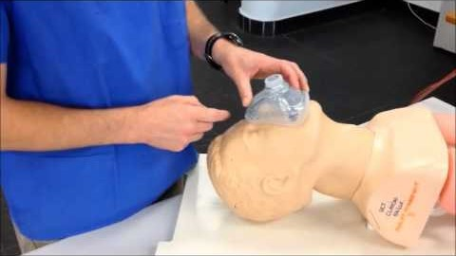
Bag-Valve-Mask Ventilation
Mask seal - for best seal place the face mask on the face before you attach the bag, pull the mask apart and roll it on to the face
Notes:
Ensure you use the proper size mask and bag for the patient.
Watch for symmetrical rise and fall of the chest.

Slide 36
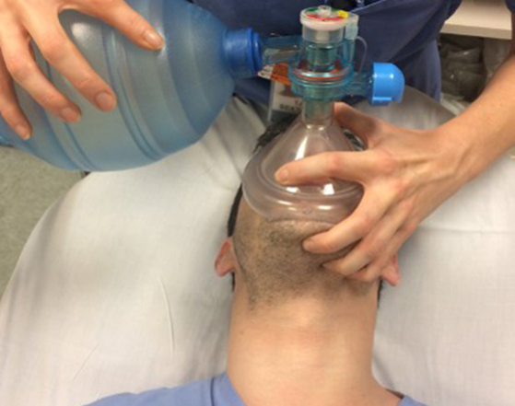
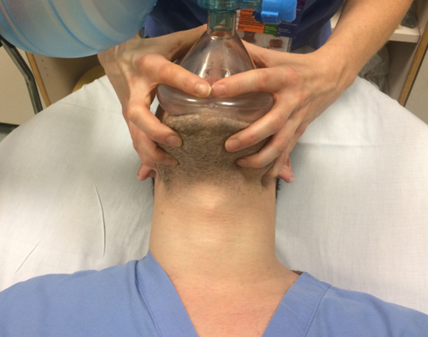
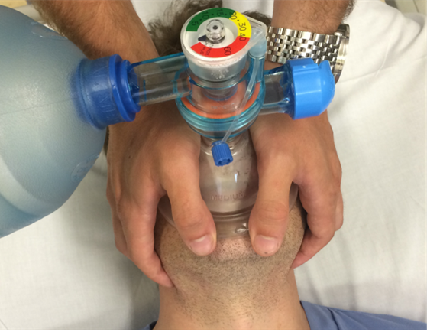
Best
Bag-Valve-Mask Ventilation
Two handed grip is the best way to perform BVM ventilation
Classic
Better

Slide 37
Assess Difficult BVM Ventilation
Radiation/Restriction
Obesity/ Obstruction/ Obstructive Sleep Apnea
Mask seal/ Mallampati/ Male gender
Age
No teeth
Notes:
Explained in coming slides.

Slide 38
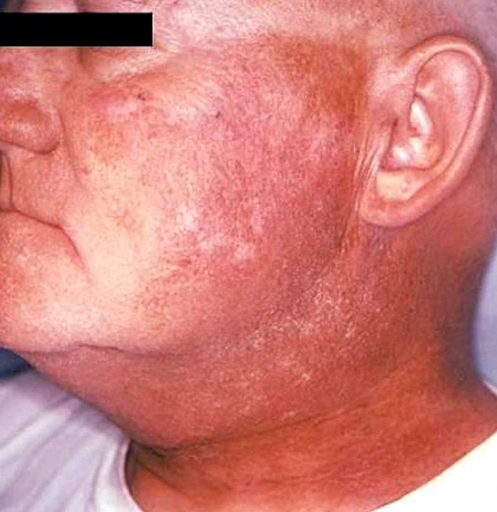
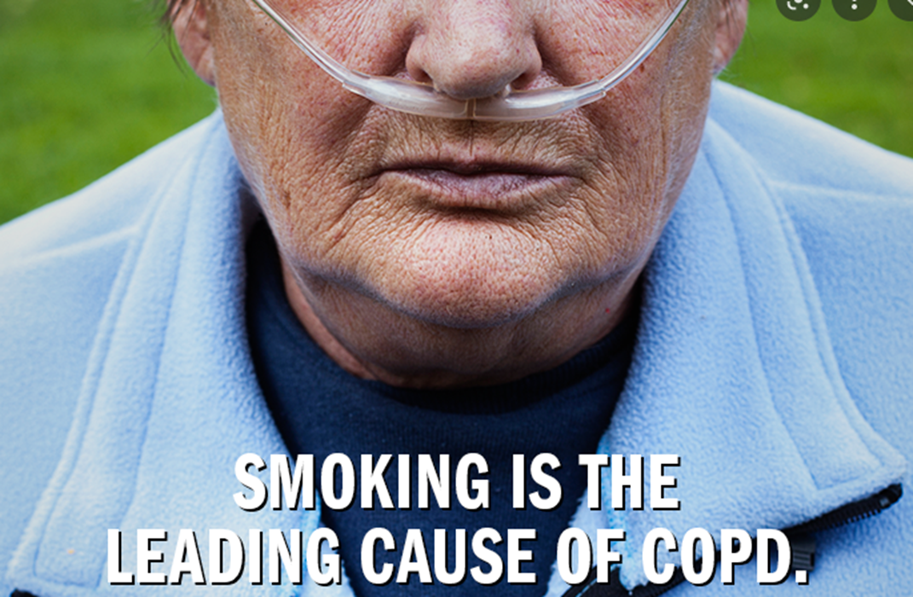
Radiation / Restriction
Neck radiation is one of the strongest predictors of difficult ventilation
Restriction refers to lungs that require higher pressures to ventilate
Notes:
Radiation therapy to the nasopharynx and neck could cause changes in the stability of the airway and the function of the upper airway dilator musculature, which in turn affect upper airway compliance and resistance.
Restriction refers to lungs that require higher pressures to ventilate:
COPD,
ARDS,
Reactive airway with medium and small airway obstructions.

Slide 39
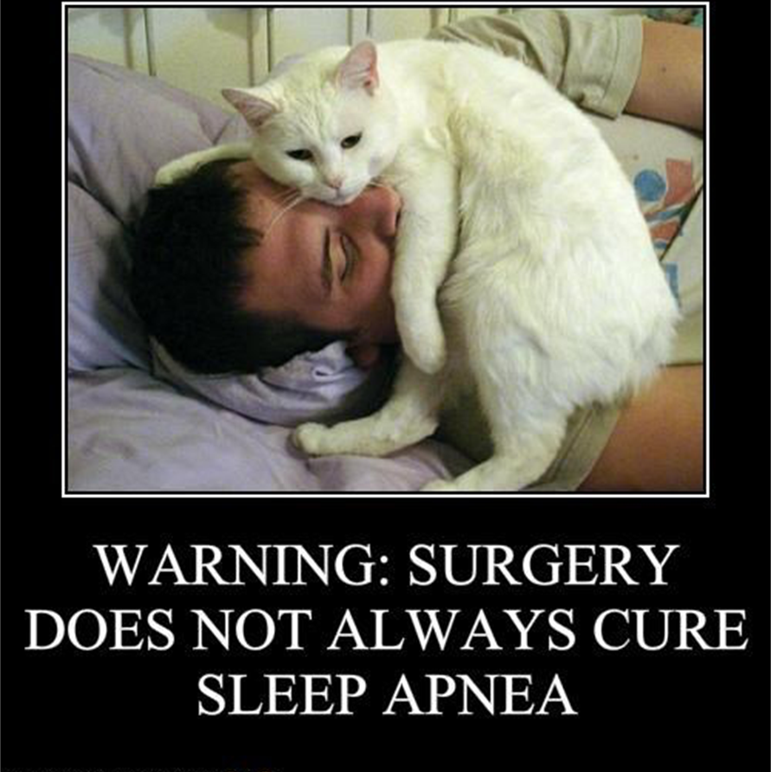
Triple ‘Os’
Obesity
Obstruction
Obstructive sleep apnea
Notes:
Obesity- BMI > 26 kg/m2, also in 3rd trimester pregnancy.
Results in: Rapid desaturation,
Resistance from the weight of chest and abdomen,
Redundant tissue causes airflow resistance.
Obstruction- Angioedema. Ludwig’s, croup, laryngospasm, cancer, hematoma, foreign objects.
Obstructive sleep apnea (OSA) - Strong association with obesity due to redundant tissue.
Occurs when the muscles that support the soft tissues in your throat, such as your tongue and soft palate, temporarily relax. When these muscles relax, your airway is narrowed or closed, and breathing is momentarily cut off. Obstructive sleep apnea (OSA) is a breathing disorder during sleep that has implications beyond disrupted sleep. It is increasingly recognized as an independent risk factor for cardiac, neurologic, and perioperative morbidities.

Slide 40
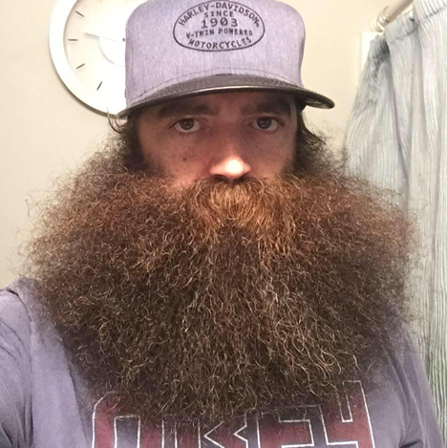


Triple ‘Ms’
Mask Seal
Male gender
Mallampati
Notes:
Bushy beards can prevent good mask seal, you may try lubricating gel on face to improve seal.
Disruption of facial continuity.
Male gender.
Mallampati of 3 or 4– EMTs do not necessarily need to commit this to memory as it mainly pertains to ET placement.

Slide 41

Age
Age over 55 is
associated with
higher risk of
difficult BVM
Loss of
musculature and
upper airway
tissues
Loss of elasticity
of tissues

Slide 42

No teeth
Leave dentures in
during BVM
Remove dentures for
intubation
May insert gauze in
cheek to improve
mask seal
Roll lower lip down
towards the chin and
seal mask against
inner mucosal
surface

Slide 43



Airway Management with SGAs (& other Adjuncts)
Some adjuncts authorized in the WA DOH/EMS
‘Scope of Practice’ for EMTs are not true ‘SGAs’
i-gel
King LTS-D
LMA Supreme
Notes:
Supraglottic airway devices primarily designed to enter the oropharyngeal space, above the glottis (note SUPRA-GLOTTIC) . Examples of these are the i-gel, King LT-D/LTS-D, LMA.
Per the WA DOH/EMS Approved Skills and Procedures for Certified EMS Providers Guidance also lists ‘Airways not intended for insertion into the trachea’ which technically includes devices such as the Pharyngo-Tracheal Lumen airway and the Combitube which may inadvertently enter the trachea,…which is ok but will not be discussed here.

Slide 44
Airway Management with SGAs (& other Adjuncts)
Indications
  Failure to protect the airway
  Cardiac arrest
Contraindications
  Awake patient
  Intact airway reflexes
  Caustic substance ingestion
  Esophageal trauma or disease
Complications
  Aspiration
Limitations
  Airway swelling
  Airway obstruction
  High airway pressures
Notes:
Other indications/advantages:
Tracheal intubation indicated, but unsuccessful or unavailable.
Access to the patient is limited (e.g., vehicle entrapment).
Difficult or emergent airways, in which other options may not be feasible.
Other contraindications: Height restriction based on device guidelines.
Complications:
These devices are designed to isolate the trachea from the esophagus, however these may
not provide a complete seal of the trachea. While the risk of aspiration is lessened, it is
not completely eliminated.
Limitations:
High airway pressures with COPD/Asthma.
Reports of failure to adequately seat device/ventilate with some devices in the presence of
copious secretions, vomitus, bleeding, etc.

Slide 45

NREMT SGA General Insertion Technique

Slide 46

i-gel®
Notes:
https://www.intersurgical.com/products/airway-management/i-gel-supraglottic-airway#downloads
The i-gel® accurately and naturally positions itself over the laryngeal framework, providing a reliable perilaryngeal seal without the need for an inflatable cuff.
It provides high seal pressures and reduced trauma, plus incorporates a gastric channel to give additional protection against aspiration.
The i-gel O₂ Resus Pack contains an i-gel O₂, a sachet of lubricant, airway support strap and gastric tube, all packaged in a specially designed clear, sterile, rigid pack. This unique design ensures protection of the contents, both in transit and in storage.
The color–coded protective cradle ensures the i-gel O₂ is maintained in the correct flexion prior to use. The protective cradle also acts as a base for lubrication.

Slide 47


i-gel®
Notes:
Sizes 1 (neonate) to Size 5 (large adult) 1, 1.5, 2, 2.5, 3, 4, 5.

Slide 48



i-gel®
Remove the i-gel from the protective cradle or cage pack. Grasp the lubricated i-gel firmly along the integral bite block. Position the device
so that the i-gel cuff outlet is facing towards the chin of the patient. The patient should be in the ‘sniffing the morning air’ position with head extended and neck flexed. The chin should be gently pressed down before proceeding. Introduce the leading soft tip into the mouth of the patient in a direction towards the hard palate. Glide the device downwards and backwards along the hard palate with a
continuous but gentle push until a definitive resistance is felt.
The tip of the airway should be located into the upper esophageal opening (a).
The cuff should be located against the laryngeal framework (b).
The incisors should be resting on the integral bite block (c).

Slide 49

King LTS-DTM
Notes:
https://www.ambuusa.com/airway-management-and-anaesthesia/laryngeal-tubes/product/ambu-king-lts-d-disposable-laryngeal-tube
The Ambu King LTS-D laryngeal tube is a disposable, simple to use alternative airway device that provides superior patient ventilation. The King LTS-D allows the passage of the gastric tube through a separate channel.
The King LTS-D is designed with a straightened, beveled distal tip that assists in directing the airway posterior to the larynx and into the upper esophagus. Due to this unique configuration, there is minimal risk of the device entering the trachea.
A single port inflates both proximal and distal cuffs. The proximal cuff stabilizes the King LTS-D and seals the oropharynx. The distal cuff blocks entry of the esophagus, reducing the possibility of gastric insufflation.
Ventilatory seal pressures of 30cm H2O or more are achievable with the King LTS-D. Multiple distal ventilatory openings and bilateral ventilation eyelets facilitate air flow.
Benefits:
Seals in the esophagus and oropharynx to provide positive pressure ventilation,
Single inflation port,
Drain tube for gastric and suction catheters,
Phthalate and latex free material,
Color-coded full range of sizes.

Slide 50


King LTS-DTM
Notes:
Sizes 0 (neonate) to Size 5 (large adult) 0, 1, 2, 2.5, 3, 4, 5.

Slide 51









King LTS-DTM

Slide 52

King LTS-DTM

Slide 53

LMA Supreme
Notes:
https://www.lmaco.com/products/lma%C2%AE-supreme%E2%84%A2-airway
LMA Supreme™ is a single use, second generation, gastric access device which forms an effective First Seal™ with the oropharynx (oropharyngeal seal) and an innovative Second Seal™ with the upper esophageal sphincter (the esophageal seal).
The importance of the Second Seal™ (esophageal seal) is significant: it can minimize gastric insufflation and reduce the risk of aspiration.
It has a soft, elongated cuff designed to support an effective First Seal™ and Second Seal™.
It has an elliptical and anatomically shaped LMA Evolution Curve™ (airway tube) facilitates insertion success.
It has a fixation tab and integral bite block.

Slide 54


LMA Supreme
Notes:
Sizes 1 (neonate) to Size 5 (large adult) 1, 1.5, 2, 2.5, 3, 4, 5.

Slide 55


LMA Supreme

Slide 56

LMA Supreme
1. The LMA™ airway, together with the recommended bite-block, should be left in place until the return of consciousness. Oxygen should be administered using a “T” piece system and standard monitoring should be in place. Before attempting to remove or deflate the device, it is essential to leave the patient completely undisturbed until protective reflexes have fully returned. Do not remove the device until the patient can open the mouth on command.
2. Look for the onset of swallowing which indicates reflexes are almost restored. It is usually unnecessary to perform suction because the correctly used LMA™ airway protects the larynx from oral secretions. Patients will swallow secretions on removal. Suction equipment should however be available at all times.
3. Deflate the cuff completely just prior to removal, although partial deflation can be recommended in order to assist in the removal of secretions. Fully deflate the cuff and simultaneously remove the device ONLY when the patient can open the mouth on command.

Slide 57




Confirm Placement
Listen over the epigastrium for the absence of breath sounds
Listen for presence of bilateral lung sounds
Attach Easy Cap end-tidal CO₂ and assess color
Notes:
Don’t relay just on chest rise & fall to confirm SGA placement/function.
Listen with a stethoscope over the stomach and both lungs to ensure proper placement.
After confirming placement, insert an Easy Cap II CO₂ Detector between the tube and the Bag Valve. If end-tidal CO₂ is at an appropriate level color changes to ‘yellow’ = (Yes) ‘gold’ = Good !
End-tidal carbon dioxide (ETCO₂) is the maximum concentration of carbon dioxide at the end of an exhaled breath. ETCO₂ is expressed in percent or in mmHg (partial pressure in millimeters of mercury) 5% - 6% or 35 mmHg - 45 mmHg.
Colorimetry indicates ETCO₂ through color change.

Slide 58

Confirm Placement and Evaluate

Slide 59
Evaluation & Ongoing Monitoring
Reassessment is a continuous process
Measurement
  Oxygenation
    Measured by Pulse Oximetry
  Ventilation
    Measured by Capnography
SpO₂ pleth
Waveform ETCO₂
Notes:
This was previously discussed in the Assessment section Recognize the Need for Basic Airway Management.
The use of continuous waveform capnography is a must to ensure the SGA is still in place and functioning correctly.
Measurement has two completely different and separate functions:
Oxygenation is the transport of O₂ via the bloodstream to the cells.
- Oxygen is required for metabolism.
- is measured by use of the pulse oximeter.
Ventilation is the exhaling of CO₂ via the respiratory tract.
- Carbon dioxide is a byproduct of metabolism.
- is measured by use of end-tidal-CO2.

Slide 60



Pulse Oximetry
Evaluation & Ongoing Monitoring
Notes:
Pulse Oximetry-
Measures saturation of hemoglobin in the blood.
Representative of saturation of heme binding sites (moiety) with oxygen molecules.
Each RBC has 4 binding spots for oxygen.
If only 3 binding spots are filling the SPO2 would be 75%.
Patients near an SpO₂ of 90% are at risk for precipitous desaturation, as demonstrated by the desaturation the curve.
Saturations in the high 90s drop relatively slowly, once the patient hits 88-90 they drop fast and the blood oxygen levels start to cause damage that may be irreversible.
Hypoxia: low tissue O2
Hypoxemia: low blood O2
SpO2 below 90% drop quickly

Slide 61

Evaluation & Ongoing Monitoring
Pulse Oximetry
Notes:
The waveform is called a plethysmograph or “pleth” and should match the pulse.
A good pleth makes the number reading more reliable .
A poor pleth should make you question the number.
It is important to make sure that a waveform is seen on the PO screen and that it coincides with the patient’s pulse. Without a well defined SpO2 waveform, there is no way for the machine to accurately perform a reading.
If waveform is present, you most likely have a pulse.
If it is not present, it means absolutely nothing (unless you had a great reading a second ago).
Multiple things can affect waveform (poor circulation, cold temperature, carbon monoxide poisoning)
If waveform is present, you most likely have a pulse
If it is not present, it means absolutely nothing (unless you had a great reading a second ago)
Limitations:
Poor peripheral circulation and hypothermia are the most common cause of false
low readings.
Movement – including shivering - and poor placement can also affect the reading.
Black, Blue and Green nail varnish can present inaccurate readings. Acrylic nails do
not appear to interfere.
Bright lights, especially fluorescent lights can affect the readings.
Carbon Monoxide has an affinity to hemoglobin 210 greater than oxygen; as such a casualty
with Carbon Monoxide poisoning may show falsely high Sp02 readings as the Pulse
Oximeter interprets the hemoglobin to be saturated with oxygen when they are saturated
with Carbon Monoxide.

Slide 62


End Tidal CO₂ capnography
Evaluation & Ongoing Monitoring
Notes:
ETCO2 matches ventilation rate
Measures CO2 at the end of exhalation
Normal number is 35-45 mmHg
Normal box shape as seen in slide

Slide 63


End Tidal CO₂ capnography
Evaluation & Ongoing Monitoring
Notes:
https://asiapac.medtronic.com/content/dam/covidien/library/anz/en/product/capnography-monitoring/etco2-waveform-poster.pdf
https://www.grepmed.com/images/429

Slide 64

End Tidal CO₂ capnography
Evaluation & Ongoing Monitoring

Slide 65

Troubleshooting the SGA
Evaluation & Ongoing Monitoring
Notes:
These are device dependent as well.
Pulmonary edema, infiltrated and high line pressures seen in COPD you may need higher leak pressures than the SGA can provide.

Slide 66

Case review
Evaluation & Ongoing Monitoring
Notes:
Tracheal Misplacement of the King LT Airway May Be an Important Cause of Prehospital Device Failure
A 51-year-old unhelmeted motorcyclist collided with a freeway median and was obtunded when EMS arrived. After bag mask ventilation, a King airway was placed uneventfully, and the patient was transported to the emergency department. Because of the concern for an unstable cervical spine injury, a lateral cervical spine radiograph was obtained on arrival. No cervical injury was seen, but the King airway was noted to be misplaced; the King airway passed through the laryngeal inlet and became lodged on the anterior trachea, creating an acute kink between the two balloons. After reviewing the radiograph, ventilations were reassessed and remained adequate. Both balloons were deflated, and the King airway was removed; the patient was orotracheally intubated without complication.

Slide 67



Courtesy of Impact Instrumentation, Inc.
Automatic Transport Ventilators
Have bag-mask device available in case ATV malfunctions
Most models have adjustments for respiratory rate and tidal volume
Notes:
Frees hands to perform non–airway-related tasks.
Bag-mask device should always be readily available in case of malfunction.
Most models have adjustments for:
a. Respiratory rate, in most cases, is set at the midpoint or average for the patient’s age.
b. Tidal volume is estimated using a formula based on 6 to 7 mL/kg.
Deliver a preset volume at a preset ventilatory rate, but it does not guarantee that all of the volume is delivered to the lungs, unless the patient is intubated.
Generally oxygen powered, but some models may require an external power source.
Generally consumes 5 L/min of oxygen; bag-mask device uses 15 to 25 L/min.
Pressure-relief valve can lead to:
a. Hypoventilation in patients with inadequate lung compliance.
b. Increased airway resistance.
c. Airway obstruction.
Possibility of barotrauma if relief valve fails or ventilation is overzealous.
Always monitor for proper placement: EtCO2, SpO2, Chest rise and fall.
Consider aspiration risks; Gastric tube insertion if allowed by MPD.
Consider leak pressures: COPD/Asthma, Air Trapping, Auto PEEP.
Contraindications:
- Airway obstruction,
–Resistance,
–Poor lung compliance,
–Pneumothorax - tension pneumothorax,
–Pulmonary over-pressurization (blast injury, water ascent injury, etc.) ,
–Children less than 5 years of age (check manufacturer’s recommendations).
Steps for using ATV:
a. Attach to oxygen source.
b. Set tidal volume and ventilatory rate per patient’s age and condition.
c. Connect to the 15/22-mm fitting on the ET tube or other advanced airway device.
d. Auscultate the patient’s breath sounds; observe for equal chest rise.

Slide 68


Questions

Slide 69
To request this document in another format, call 1-800-525-0127. Deaf or hard of hearing customers, please call 711 (Washington Relay) or email civil.rights@doh.wa.gov.
Notes:
AAOS-Nancy Caroline’s Emergency Care in the Streets- Jones & Bartlett
AAOS-Nancy Caroline’s Emergency Care & Transport of the Sick and Injured- Jones & Bartlett
AIME Training
Ambu
American Heart Association
Benjamin Cummings, imprint of Addison Wesley Longman,Inc
BMJ Learning
C.A.M.P. Hilton Head; Jim DuCanto MD, Robert Barrix, Gene Benoit
Capnography.com
Division of Emergency Medicine, Cape Town, South Africa- University of Cape Town; University Stellerbosch
Elsevier, Drake et al: Grey’s Anatomy for Students
EMTPrep.com
Impact Instrumentation
Intersurgical, Ltd
Lee Wittmann, Stephanie Fraccola, Vanessa Johnson Cash, Chris Dragotta
Masimo
Medtronic
Melissa Stoddard- MPH, SEI, PM
Missy Carter- PA, PM
NAEMT- PHTLS 9th Edition, Jones & Bartlett
NAEMT- AMLS 3rd Edition, Jones & Bartlett
Norma Pancake- BS, SEI, PM
Randy White- MTSU EMT Program
Real First images
Ryan Gerecht, MD
Stryker- Physio Control
Teleflex Medical Europe Ltd.
The McGraw-Hill Companies, Inc
UpToDate
Wendy Moffatt- SEI, PM
WISH-UW Medicine; Rosemary Adamson, MB BS
You-Tube
Zoll Medical Corporation
123RF, LLC

Slide 70
Acknowledgements/Credits/Resources
We want to acknowledge and give credit to the innumerable sources & resources used in the development of this
not-for-profit WA DOH
SGA training aid.
Notes:
AAOS-Nancy Caroline’s Emergency Care in the Streets- Jones & Bartlett
AAOS-Nancy Caroline’s Emergency Care & Transport of the Sick and Injured- Jones & Bartlett
AIME Training
Ambu
American Heart Association
Benjamin Cummings, imprint of Addison Wesley Longman,Inc
BMJ Learning
C.A.M.P. Hilton Head; Jim DuCanto MD, Robert Barrix, Gene Benoit
Capnography.com
Division of Emergency Medicine, Cape Town, South Africa- University of Cape Town; University Stellerbosch
Elsevier, Drake et al: Grey’s Anatomy for Students
EMTPrep.com
Impact Instrumentation
Intersurgical, Ltd
Lee Wittmann, Stephanie Fraccola, Vanessa Johnson Cash, Chris Dragotta
Masimo
Medtronic
Melissa Stoddard- MPH, SEI, PM
Missy Carter- PA, PM
NAEMT- PHTLS 9th Edition, Jones & Bartlett
NAEMT- AMLS 3rd Edition, Jones & Bartlett
Norma Pancake- BS, SEI, PM
Randy White- MTSU EMT Program
Real First images
Ryan Gerecht, MD
Stryker- Physio Control
Teleflex Medical Europe Ltd.
The McGraw-Hill Companies, Inc
UpToDate
Wendy Moffatt- SEI, PM
WISH-UW Medicine; Rosemary Adamson, MB BS
You-Tube
Zoll Medical Corporation
123RF, LLC

