Slide 1
Intravenous Therapy
EMT Special Skill Endorsement

Slide 2
Introduction
Background / Scope:
The IV therapy endorsement was created to provide specific, limited life-saving skills to rural areas that are unable to develop or maintain full ALS level service.
The EMT IV endorsement is not a substitute for ILS or ALS level care in existing services.
People who successfully complete the training are allowed to use the skills when the endorsement is added to the EMTs credential and upon approval of the County Medical Program Director (MPD).
Refer to local department and MPD approved protocol regarding use of IV therapy skill.
Notes:
The IV therapy endorsement created to provide specific, limited life-saving skills to rural areas that are unable to develop or maintain full ALS level service. This EMT- IV Therapy Special Skill Curriculum represents the minimum required information to be presented within a course leading to endorsement for EMT-IV Therapy. The EMT IV endorsement is not a substitute for ILS or ALS level care in existing services.
People who successfully complete the training are allowed to use the skills when the endorsement is added to the EMTs credential and upon approval of the County Medical Program Director (MPD). Refer to local department and MPD approved protocol regarding use of IV therapy skill.
The curriculum is designed with four lessons of instruction content. Each unit has terminal objective represents the desired outcome of completion of the block of instruction. In most cases it is a very high- level objective, which can make it difficult to evaluate. This global objective represents the desired competency following completion of the section. Although this objective may be viewed as the aggregate of lower level objectives, in many cases, the whole is greater than the sum of the parts.

Slide 3
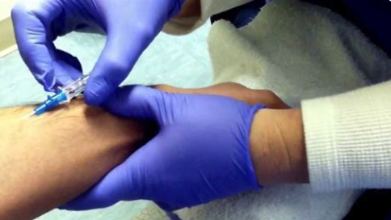
Objectives
The objectives are divided into three categories:
Cognitive
Affective
Psychomotor
Notes:
These are the individual objectives of the curriculum. Mastery of each of these objectives provides the foundation for the higher order learning that is expected of the entry level provider. The instructor and student should strive to understand the complex interrelationships between the objectives. These objectives are not discrete, disconnected bits of knowledge, but rather fit together in a mosaic that is inherently interdependent. The objectives are divided into three categories: Cognitive, Affective, and Psychomotor.

Slide 4

Participant Requirements
To take this endorsement course an emergency medical technician (EMT) must have:
Completed one year of certification as an EMT with a licensed EMS service
Have an EMS agency recommendation
MPD approval
Notes:
To take this endorsement course an emergency medical technician (EMT) must have completed one year of certification as an EMT with a licensed EMS service, have an EMS agency recommendation, and MPD approval.

Slide 5
Course Length
Based on the competency of the individual and not the length of the training
The time involved in educating an EMT-IV endorsed provider to an acceptable level of competence depends on many factors
It is expected that the average program, with average students, will achieve results that meet the standard in approximately 42 hours
Notes:
EMT with IV training should be based on the competency of the individual and not the length of the training. The time involved in educating an EMT-IV endorsed provider to an acceptable level of competence depends on many factors. It is expected that the average program, with average students, will achieve results that meet the standard in approximately 42 hours.

Slide 6
Course Completion Requirements
Required Lessons
  Lesson 1: Patient Assessment & Clinical Decision Making
  Lesson 2: Overview of Human Systems
  Lesson 3: Assessment and Management of Shock
  Lesson 4: Intravenous & Intraosseous Line Placement and Infusion
Clinical Internship Requirements
  Successful completion of 10 IV insertions on humans. At the option of the MPD, 5 may be performed on training aids.
  Lab skill proficiency required in: IO line placement
Field internship
  Competency determined by the County Medical Program Director.
Evaluations/Examinations
  Practical Skill Evaluations as identified in Appendix B
  Written course completion examination approved by the MPD.
Notes:
NOTE: It is recommended that some IV insertions be accomplished during the field internship. The County Medical Program Director determines competency for all skills. In addition to the hours of instruction and practical skill evaluations, this course requires that the student successfully complete patient interactions in a clinical/prehospital setting. Any combination of the resources listed in the EMS Training Program and Instructor Manual may be used to meet the requirements. The Washington State Department of Health requires specific evaluation of knowledge and psychomotor performance prior to course completion to obtain official endorsement as an EMT-IV provider. These evaluations are conducted throughout the course and as a final course comprehensive practical evaluation, prior to course completion.

Slide 7
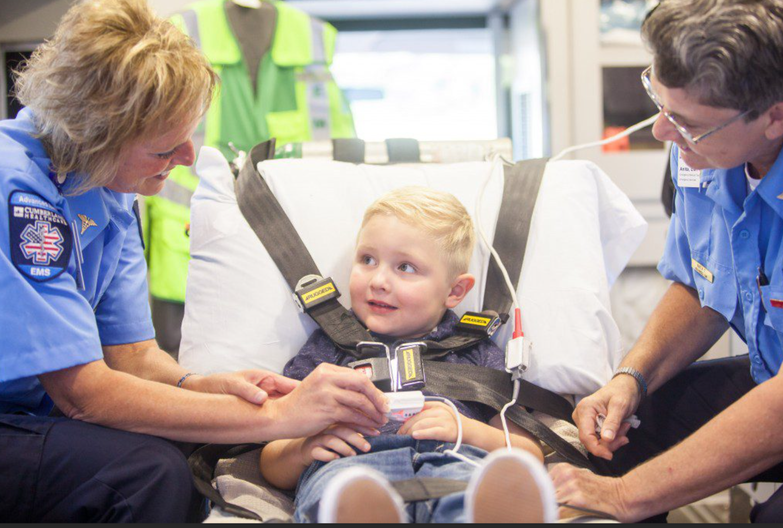
Education / Training Maintenance
This curriculum is intended to prepare a medically competent EMT-IV Therapy provider to operate in the field
Continuing education is required to maintain an EMT-IV Therapy provider’s endorsement and continued MPD approval to use the skill
Notes:
Education / Training Maintenance Requirements
This curriculum is intended to prepare a medically competent EMT-IV Therapy provider to operate in the field. Continuing education is required to maintain an EMT-IV Therapy provider’s endorsement and continued MPD approval to use the skill.

Slide 8
Patient Assessment & Clinical Decision Making
Lesson 1 Cognitive Objectives:
At the completion of this topic, the EMT-IV student will be able to:
Explain and demonstrate critical thinking skills
Explain and demonstrate decision-making skills
Explain and demonstrate assessment Based Patient Care
Notes:
Cognitive Objectives
At the completion of this topic, the EMT-IV student will be able to:
Explain and demonstrate critical thinking skills
Explain and demonstrate decision-making skills
Explain and demonstrate assessment Based Patient Care

Slide 9
Patient Assessment & Clinical Decision Making
Lesson 1 Introduction & Key Concepts:
The cornerstones of effective EMT-IV practice:
    Gathering, evaluating, and synthesizing information
    Developing and implementing appropriate patient management plans
    Apply judgment and exercise independent decision-making
    Thinking and working effectively under pressure
Notes:
The cornerstones of effective EMT-IV practice
Gathering, evaluating, and synthesizing information
Developing and implementing appropriate patient management plans
Apply judgment and exercise independent decision-making
Thinking and working effectively under pressure

Slide 10
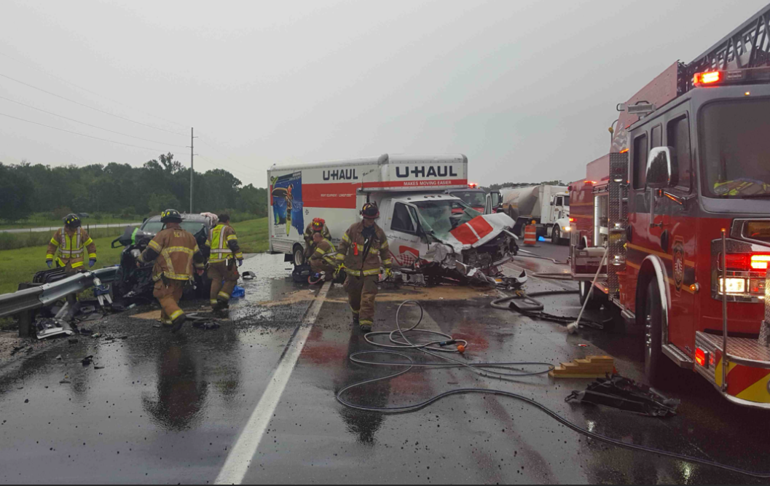
Patient Assessment & Clinical Decision Making
The pre-hospital environment:
    Unlike other environments where medical care is traditionally rendered
    Unique - heavily influenced by factors that do not exist in other medical settings.
Notes:
The pre-hospital environment
Unlike other environments where medical care is traditionally rendered
Unique - heavily influenced by factors that do not exist in other medical settings.

Slide 11

Patient Assessment & Clinical Decision Making
The spectrum of patient care in pre-hospital care:
    Obvious, critical life threats
    Potential life threats
    Non-life-threatening presentations
Notes:
The spectrum of patient care in pre-hospital care
Obvious, critical life threats
Major, multi-system trauma
Devastating single system trauma
End stage disease presentations
Acute presentations of chronic conditions
Potential life threats
Serious, multi-system trauma
Multiple disease etiologies
Non-life-threatening presentations

Slide 12

Patient Assessment & Clinical Decision Making
Providing guidance and authority for EMT-IV action and treatments:
    Protocols, standing orders, & patient care algorithms
    Limitations of protocols, standing orders & patient care algorithms
Notes:
Providing guidance and authority for EMT-IV action and treatments
Protocols, standing orders, and patient care algorithms
Can clearly define and outline performance parameters
Promote a standardized approach
Limitations of protocols, standing orders & patient care algorithms
Only addresses “classic” patient presentations
Non-specific patient complaints do not follow model
Limited clarity of presenting patient problems
Don’t speak to multiple disease etiologies
Don’t speak to multiple treatment modalities
Promotes linear thinking, “cookbook medicine” providers

Slide 13
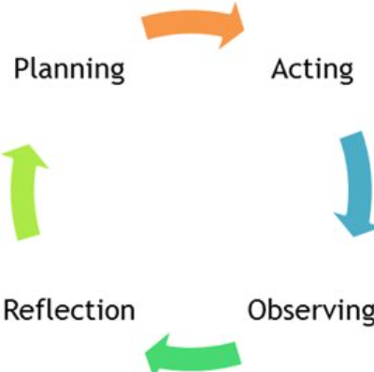
Patient Assessment & Clinical Decision Making
Components, stages, and sequence of critical thinking process:
    Concept formation
    Data interpretation
    Application of principle
    Evaluation
    Reflection on action
Notes:
Concept Formation
Mechanism of injury (MOI)/scene assessment
Primary assessment
Chief complaint
Patient history and secondary assessment
Patient affect
Diagnostic tests
Data interpretation
Data gathered
EMT-IV knowledge of Anatomy, Physiology, and pathophysiology
EMT-IV attitude
Previous experience base of EMT-IV
Application of principle
Field impression/working diagnosis
Protocols/standing orders
Treatment/intervention
Evaluation
Reassessment of patient
Reflection in action
Revision of impression
Protocol/standing orders
Revision of treatment/intervention
Reflection on action
1. Run critique
2. Addition to/ modification of experience base of EMT-IV

Slide 14

Patient Assessment & Clinical Decision Making
Fundamental elements of critical thinking for EMT-IVs:
Adequate fund of knowledge
Ability to pay attention
Ability to gather and organize data and form concepts
Ability to identify and deal with medical ambiguity
Notes:
Adequate fund of knowledge
Ability to pay attention
Ability to gather and organize data and form concepts
Ability to identify and deal with medical ambiguity

Slide 15
Patient Assessment & Clinical Decision Making
Fundamental elements of critical thinking for EMT-IVs:
Ability to differentiate between relevant and irrelevant data
Ability to analyze and compare similar situations
Ability to recall contrary situations
Ability to articulate decision making reasoning and construct arguments
Notes:
Ability to differentiate between relevant and irrelevant data
Ability to analyze and compare similar situations
Ability to recall contrary situations
Ability to articulate decision making reasoning and construct arguments

Slide 16
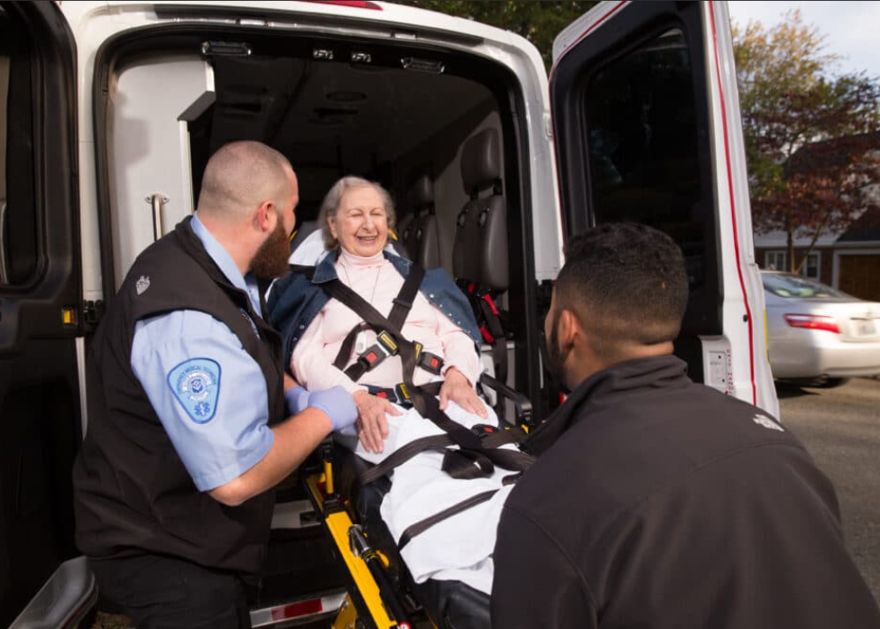
Patient Assessment & Clinical Decision Making
Considerations with field application of assessment-based patient management:
  The Patient Acuity Spectrum
    EMS is activated for countless reasons
    Few pre-hospital calls constitute true life-threatening emergencies
Notes:
The Patient Acuity Spectrum
EMS is activated for countless reasons
Few pre-hospital calls constitute true life-threatening emergencies
Minor medical and traumatic events require little critical thinking and have relatively easy decision making
Patient’s with obvious life threats pose limited critical thinking challenges
Patients who fall on the acuity spectrum between minor and life threatening pose the greatest critical thinking challenge

Slide 17
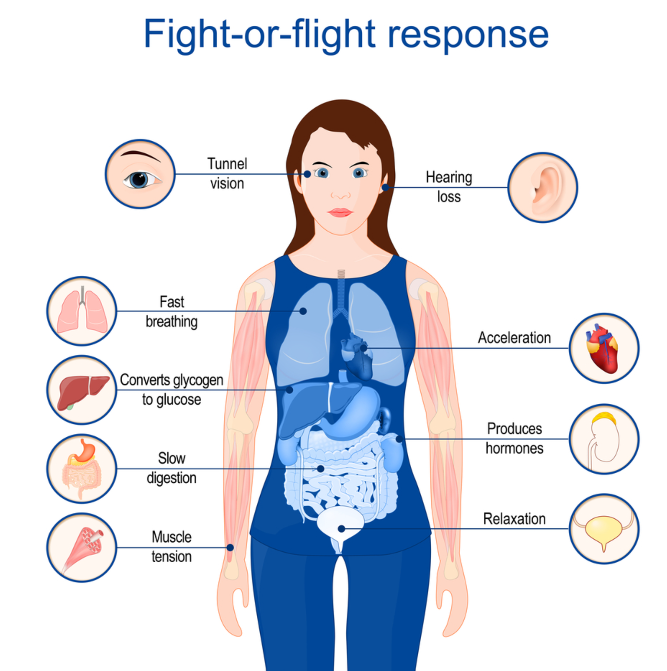
Patient Assessment & Clinical Decision Making
Considerations with field application of assessment-based patient management:
Thinking under pressure
Hormonal influence
i.e., "fight or flight” response
Mental conditioning is the key to
effective performance under pressure
Notes:
Thinking under pressure
Hormonal influence i.e. “fight or flight” response impacts EMT-IV decision making both positively and negatively
Enhanced visual and auditory acuity
Improved reflexes and muscle strength
Impaired critical thinking skills
Diminished concentration and assessment ability
Mental conditioning is the key to effective performance under pressure
Skills learned at a pseudo-instinctive performance level
Automatic response for technical treatment requirements

Slide 18
Patient Assessment & Clinical Decision Making
Considerations with field application of assessment-based patient management:
  Mental checklist for thinking under pressure
    Stop and think
    Scan the situation
    Decide and act
    Maintain clear, concise control
    Regularly and continually reevaluate the patient
Notes:
Mental checklist for thinking under pressure
Stop and think
Scan the situation
Decide and act
Maintain clear, concise control
Regularly and continually reevaluate the patient

Slide 19

Patient Assessment & Clinical Decision Making
Considerations with field application of assessment-based patient management:
  Facilitating behaviors
    Stay calm, don’t panic
    Assume and plan for the worst; err on the side of the patient
    Maintain a systematic assessment pattern
Notes:
Facilitating behaviors
Stay calm, don’t panic
Assume and plan for the worst; err on the side of the patient
Maintain a systematic assessment pattern

Slide 20
Patient Assessment & Clinical Decision Making
Considerations with field application of assessment-based patient management:
  Facilitating behaviors
    Balance analysis, data processing and decision-making styles
      Situation analysis styles: reflective vs. impulsive
      Data processing styles: divergent vs. convergent
      Decision making styles: anticipatory vs. reactive
Notes:
Facilitating behaviors
Balance analysis, data processing and decision-making styles
Situation analysis styles: reflective vs. impulsive
Data processing styles: divergent vs. convergent
Decision making styles: anticipatory vs. reactive

Slide 21

Patient Assessment & Clinical Decision Making
Considerations with field application of assessment-based patient management:
  Situation awareness
    Reading the scene
    Reading the patient
Notes:
Situation awareness
Reading the scene
Reading the patient

Slide 22

Patient Assessment & Clinical Decision Making
Considerations with field application of assessment-based patient management:
  Putting it all together - “The Six R’s”
  1. Read the patient
    Observe the patient
    Talk to the patient
    Touch the patient
    Auscultate the patient
    Status of ABC’s-identifying life threats
    Complete an accurate set of vital signs
Notes:
Read the patient
Observe the patient
Level of responsiveness/consciousness
Skin color
Position and location of patient - obvious deformity or asymmetry
Talk to the patient
Determine the chief complaint
New problem or worsening of preexisting condition?
Touch the patient
Skin temperature and moisture
Pulse rate, strength, and regularity
Auscultate the patient
Identify problems with the lower airway
Status of ABC’s-identifying life threats
Complete and accurate set of vital signs
Use as triage tool to estimate severity
Can assist in identifying the majority of life-threatening conditions
Influenced by patient age, underlying physical and medical conditions, and current medications

Slide 23
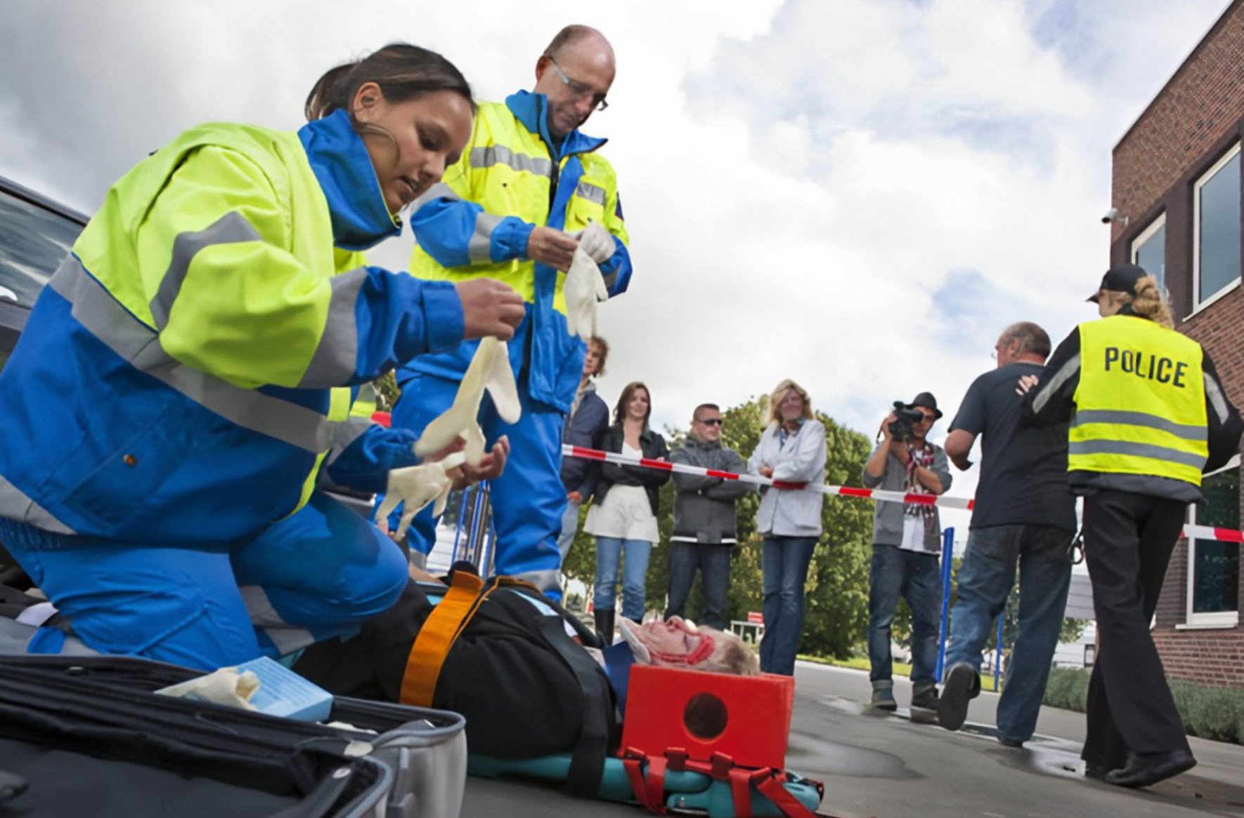
Patient Assessment & Clinical Decision Making
Considerations with field application of assessment-based patient management:
  Putting it all together - “The Six R’s”
  2. Read the scene
  General environmental conditions
  Evaluate immediate surroundings
  Mechanism of injury
Notes:
2. Read the scene
General environmental conditions
Evaluate immediate surroundings
Mechanism of injury

Slide 24
Patient Assessment & Clinical Decision Making
Considerations with field application of assessment-based patient management:
  Putting it all together - “The Six R’s”
  3. React
      Address life threats in the order they are found
      Determine the most common and statistically probable that fits the patient’s initial presentation
      Consider the most serious condition that fits the patient’s initial presentation
      If a clear medical problem is elusive, treat based on presenting signs and symptoms
Notes:
3. React
Address life threats in the order they are found
Determine the most common and statistically probable that fits the patient’s initial presentation
Consider the most serious condition that fits the patient’s initial presentation
If a clear medical problem is elusive, treat based on presenting signs and symptoms

Slide 25

Patient Assessment & Clinical Decision Making
Considerations with field application of assessment-based patient management:
  Putting it all together - “The Six R’s”
  4. Reevaluate
Focused and detailed assessment
Response to initial management/interventions
Discovery of less obvious problems
Notes:
4. Reevaluate
Focused and detailed assessment
Response to initial management/interventions
Discovery of less obvious problems

Slide 26

Patient Assessment & Clinical Decision Making
Considerations with field application of assessment-based patient management:
  Putting it all together - “The Six R’s”
5. Revise management plan
6. Review performance at run critique
Notes:
5. Revise management plan
6. Review performance at run critique

Slide 27
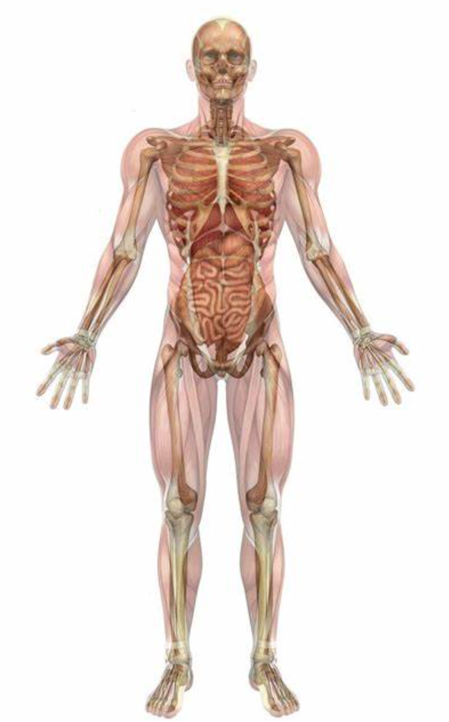
Overview of Human Systems
Lesson 2 Cognitive Objectives:
  At the end of this lesson the EMT-IV student will be able to explain how the anatomy and physiology of each body system relates and provides the foundation for the clinical practice of out of hospital emergency medicine.
Notes:
Cognitive Objectives
At the completion of this lesson, the EMT-IV student will be able to:
Organization and General Plan of the Body
Define homeostasis and use an example to explain.
The Integumentary System
The Nervous System
The Senses
Blood
The Heart
The Vascular System
The Respiratory System

Slide 28
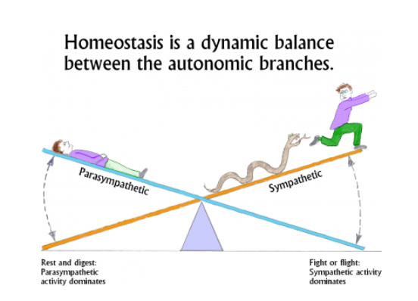
Overview of Human Systems
Organization and General Plan of the Body:
  Define homeostasis
Notes:
Organization and General Plan of the Body
Define homeostasis and use an example to explain.

Slide 29
Overview of Human Systems
Organization and General Plan of the Body:
  The Integumentary System
  Name the two major layers of the skin and the tissue of which each is made.
  Describe how the arterioles in the dermis respond to heat, cold, and stress.
  Name the tissues that make up the subcutaneous tissue and describe their functions.
Notes:
The Integumentary System
Name the two major layers of the skin and the tissue of which each is made.
Describe how the arterioles in the dermis respond to heat, cold, and stress.
Name the tissues that make up the subcutaneous tissue and describe their functions.

Slide 30
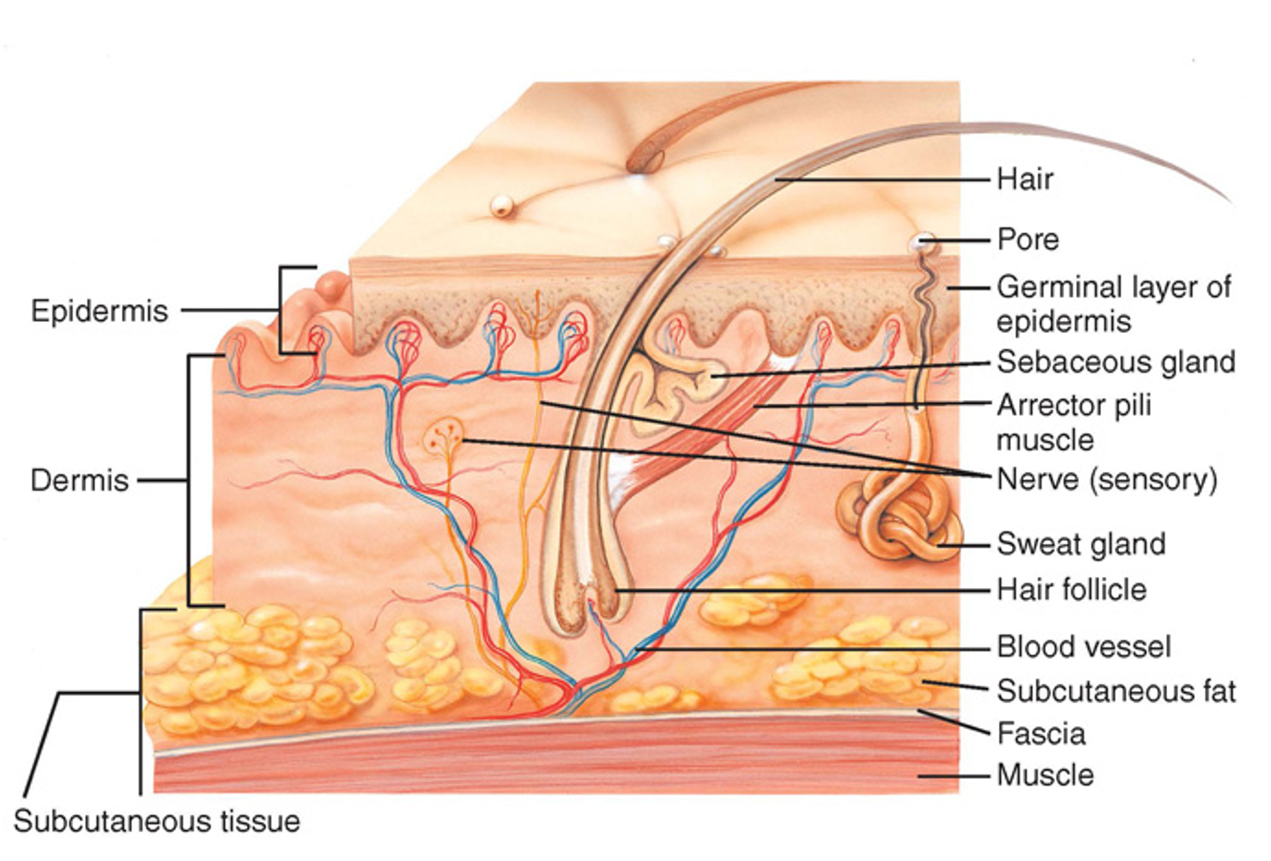
Overview of Human Systems
Organization and General Plan of the Body:
Tissues
  Epithelial tissue and glands
  Connective tissue
    Blood
    Plasma
Notes:
Tissues
Epithelial tissue and glands
Connective tissue
Blood
Plasma

Slide 31
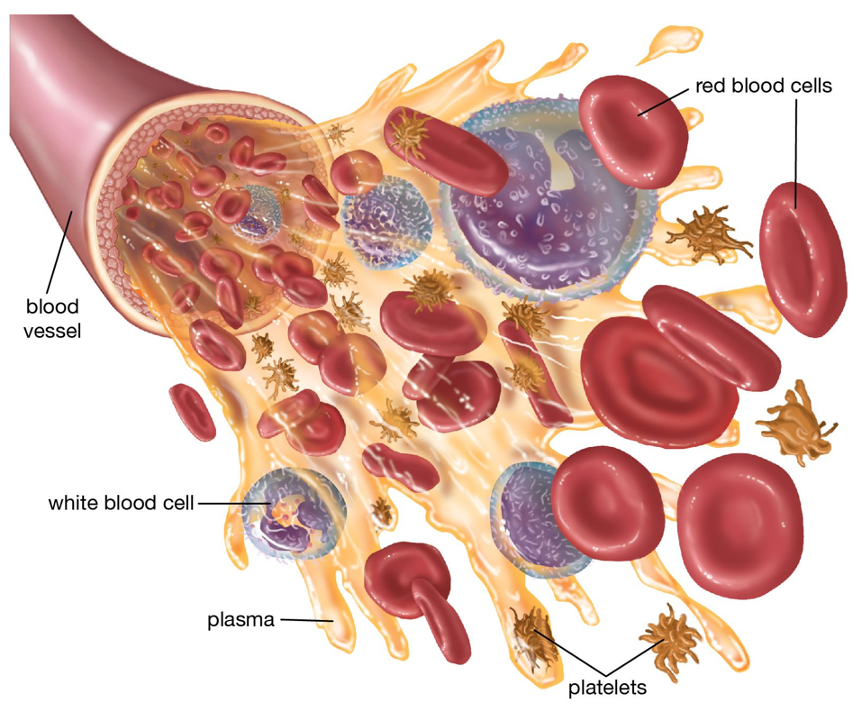
Overview of Human Systems
Organization and General Plan of the Body:
Tissues
  Blood cells
    Red blood cells
    White blood cells
    Platelet
Notes:
Tissues
Blood cells
Red blood cells
White blood cells
Platelet

Slide 32
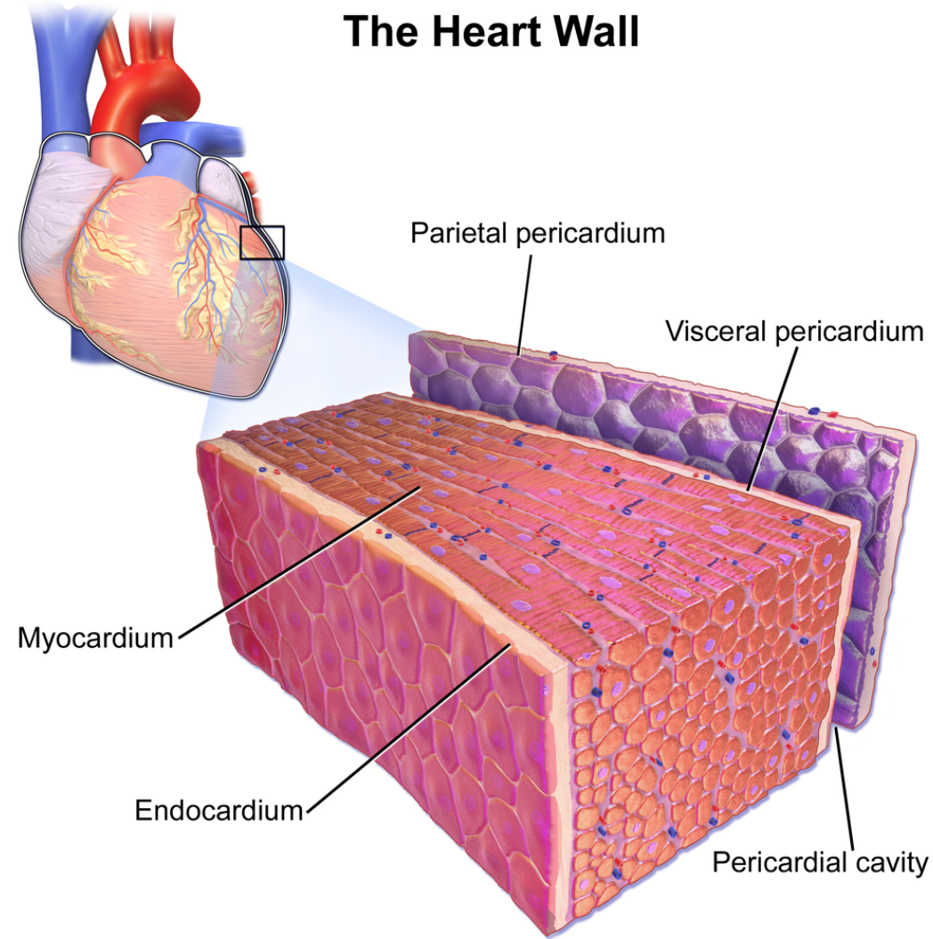
Overview of Human Systems
Organization and General Plan of the Body:
Tissues
Cardiac muscle tissue
    Involuntary muscle
Notes:
Tissues
Cardiac muscles
Involuntary muscle

Slide 33
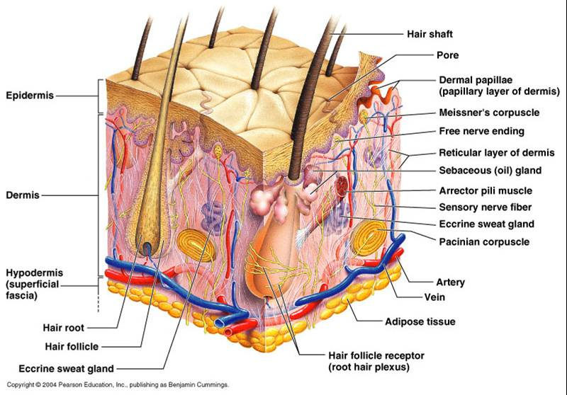
Overview of Human Systems
Organization and General Plan of the Body:
Integumentary system
  Epidermis
Notes:
Integumentary system
Epidermis

Slide 34
Overview of Human Systems
Organization and General Plan of the Body:
Integumentary system
  Dermis
    Receptors
    Glands
    Blood vessels
Notes:
Dermis
Receptors
Glands
Blood vessels

Slide 35
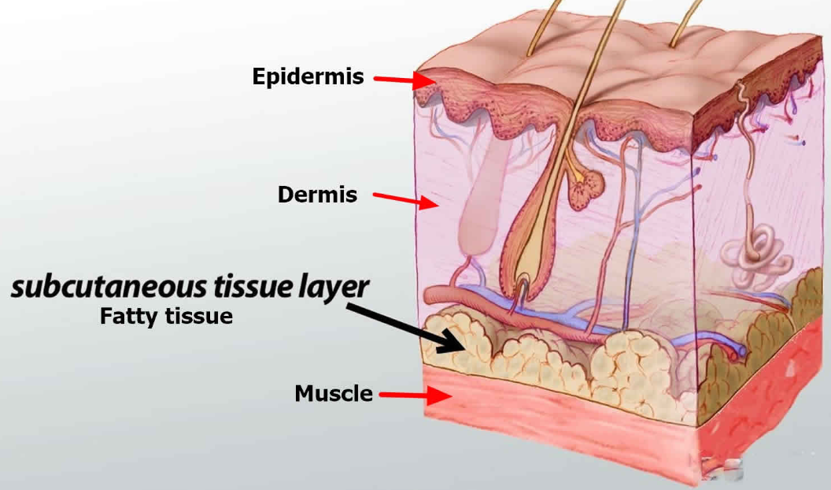
Overview of Human Systems
Organization and General Plan of the Body:
Integumentary system
  Subcutaneous tissue
Notes:
Subcutaneous tissue

Slide 36
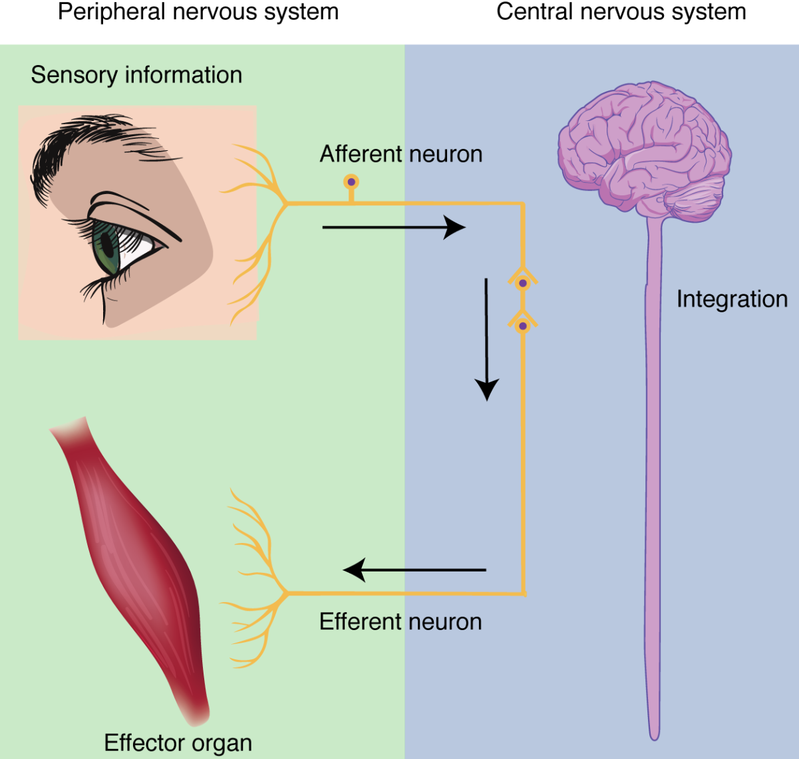
Overview of Human Systems
Organization and General Plan of the Body:
Nervous system
  Afferent impulses
  Efferent impulses
Notes:
Nervous system
Afferent impulses
Efferent impulses

Slide 37
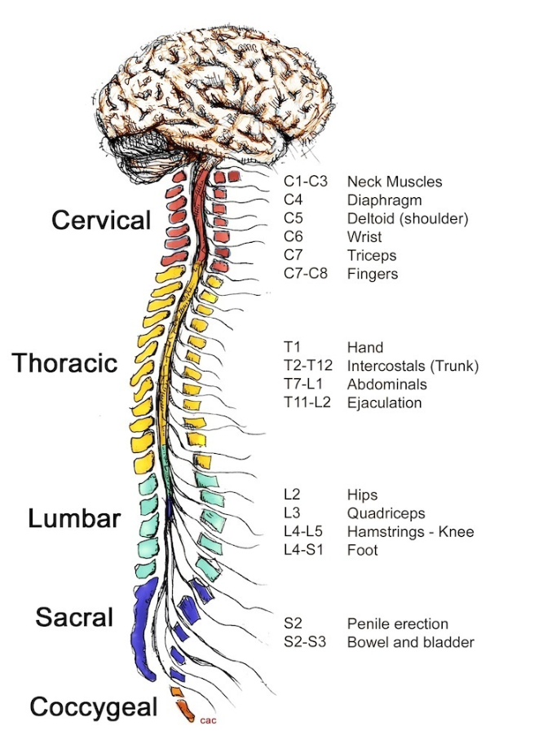
Overview of Human Systems
Organization and General Plan of the Body:
Nervous system
  Divisions of the spinal cord
    Cervical
    Thoracic
    Lumbar
Notes:
Divisions of the spinal cord
Cervical
Thoracic
Lumbar

Slide 38
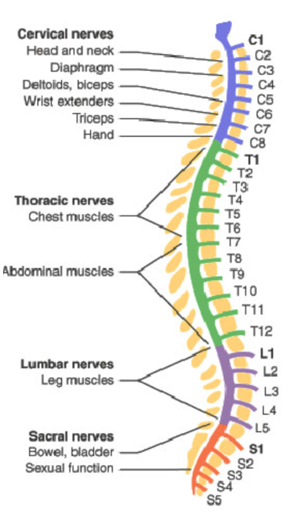
Overview of Human Systems
Organization and General Plan of the Body:
Nervous system
  Level of injury or disease of spinal cord
    More serious the closer to the brain stem
    Dynamics of neurogenic shock
Notes:
Nervous system
Level of injury or disease of spinal cord
More serious the closer to the brain stem they occur
Dynamics of neurogenic shock

Slide 39
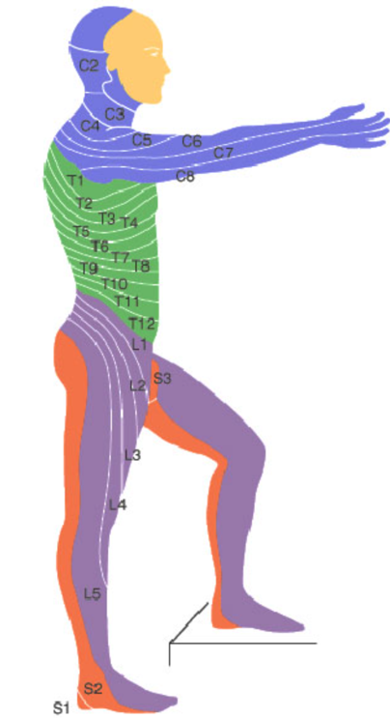
Overview of Human Systems
Organization and General Plan of the Body:
Nervous system
  Nerve root control
    Cervical (shoulder girdle C5)
    Thoracic
      Sensation at nipple level (T4)
      Sensation at the umbilicus level (T10)
    Lumbar
    Sacral
Notes:
Nervous system
Nerve root control
Cervical (shoulder girdle C5)
Thoracic
Sensation at nipple level (T4)
Sensation at the umbilicus level (T10)
Lumbar
Sacral

Slide 40
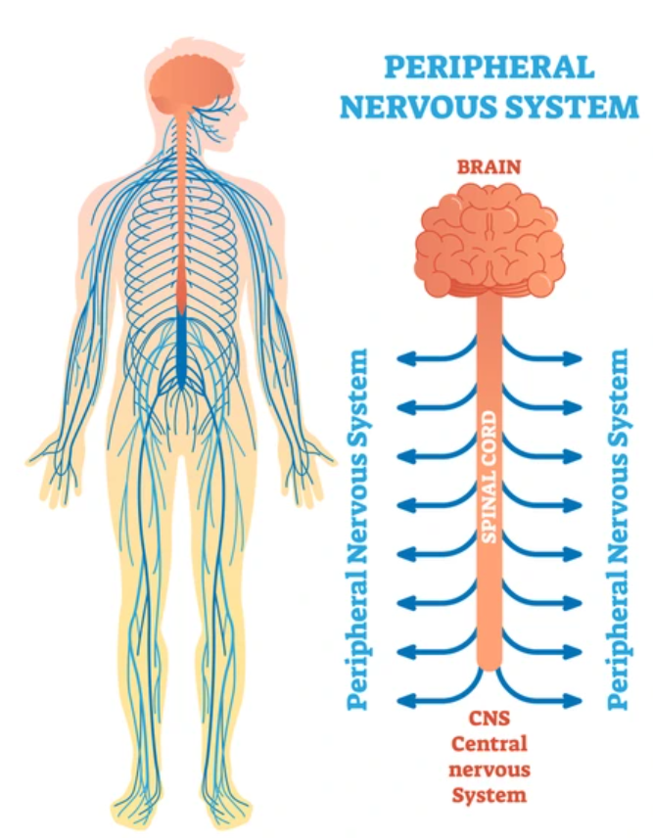
Overview of Human Systems
Organization and General Plan of the Body:
Peripheral nervous system
  Categories
    Somatic sensory
      Pain
      Temperature
      Touch
      Pressure
      Position or muscle sense
  Somatic motor
Notes:
Peripheral nervous system
Categories
Somatic sensory
Pain
Temperature
Touch
Pressure
Position or muscle sense
Somatic motor

Slide 41
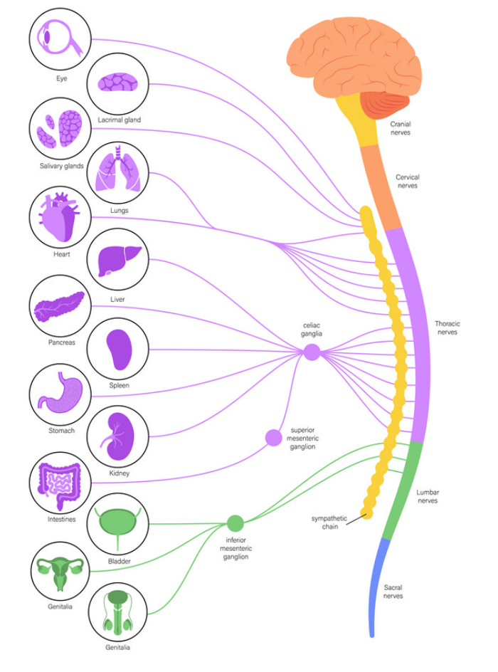
Overview of Human Systems
Organization and General Plan of the Body:
Peripheral nervous system
  Categories
  Visceral sensory
  Visceral motor
Notes:
Peripheral nervous system
Categories
Visceral sensory - from glands and structures composed of somatic or cardiac muscle
Visceral motor

Slide 42
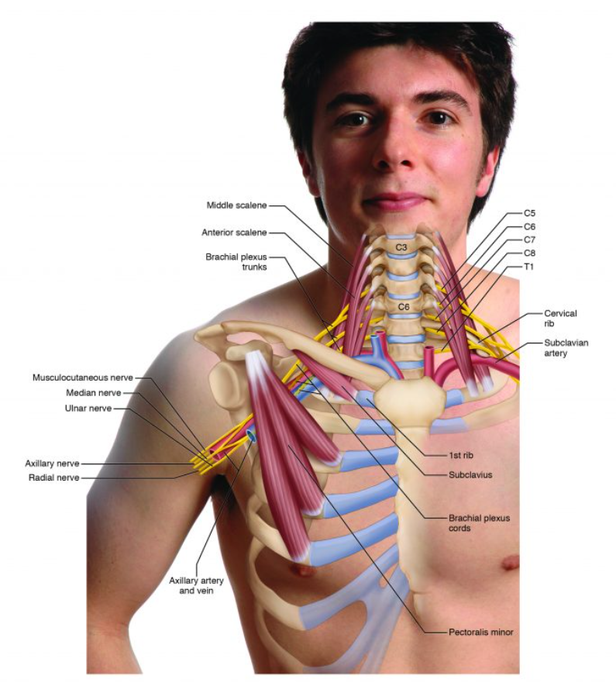
Overview of Human Systems
Organization and General Plan of the Body:
Peripheral nervous system
  Brachial plexus
  Collection of nerves at
  the posterior triangle of the neck
  May be injured at birth, or in
  injuries causing permanent disability
  Major nerves
Notes:
Peripheral nervous system
Brachial plexus
Collection of nerves at the posterior triangle of the neck
May be injured at birth, or in injuries causing permanent disability
Major nerves

Slide 43
Overview of Human Systems
Organization and General Plan of the Body:
Autonomic nervous system- Function beyond conscious control
  Divisions
    Sympathetic
      More widespread effects
      Stimulation causes increased heart rate, increased BP, rise in blood sugar, bronchodilation
      “Fight or flight”
Notes:
Autonomic nervous system- Function beyond conscious control
Divisions
Sympathetic
More widespread effects
Stimulation causes increased heart rate, increased BP, rise in blood sugar, bronchodilation
“Fight or flight”

Slide 44
Overview of Human Systems
Organization and General Plan of the Body:
Autonomic nervous system- Function beyond conscious control
  Divisions
    Parasympathetic
      Effects more apparent in quiet state
      Body conservation processes, i.e., digestion and storage of materials for well-being
      Complementary effects
Notes:
Autonomic nervous system- Function beyond conscious control
Divisions
Parasympathetic
Effects more apparent in quiet state
Body conservation processes, i.e., digestion and storage of materials for well-being
Complementary effects

Slide 45
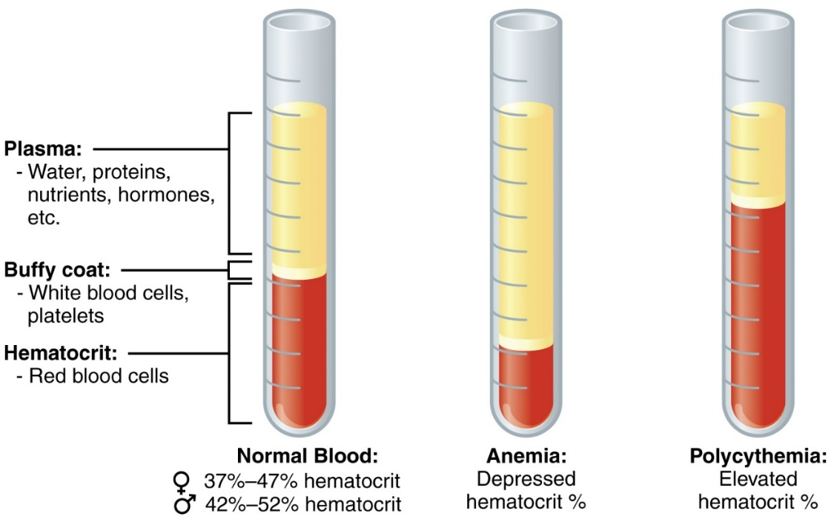
Overview of Human Systems
Organization and General Plan of the Body:
Blood
  Characteristics of blood
    Amount
    Color
  Plasma
Notes:
Blood
Characteristics of blood
Amount
Color
Plasma

Slide 46
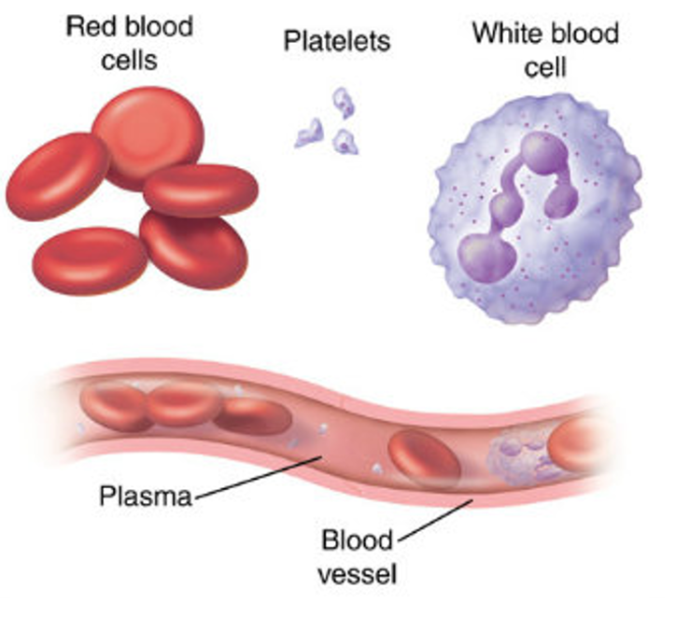
Overview of Human Systems
Organization and General Plan of the Body:
Blood cells
  Red blood cells
    Function
    Production and maturation
    Blood types
Notes:
Blood cells
Red blood cells
Function
Production and maturation
Blood types

Slide 47
Overview of Human Systems
Organization and General Plan of the Body:
Blood cells
  White blood cells
    Functions
Notes:
Blood cells
White blood cells
Functions

Slide 48
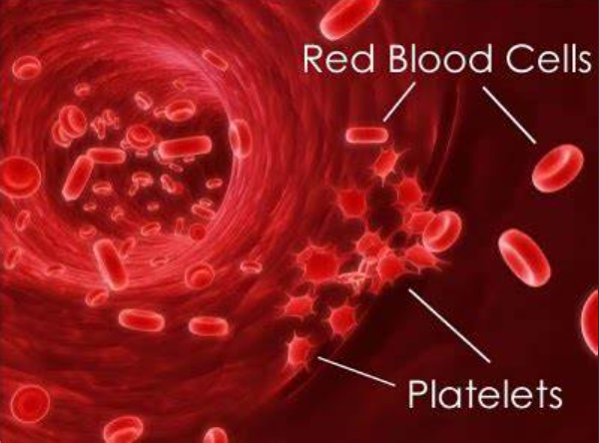
Overview of Human Systems
Organization and General Plan of the Body:
Blood cells
  Platelets
    Functions
    Blood clotting
Notes:
Blood cells
Platelets
Functions
Blood clotting

Slide 49
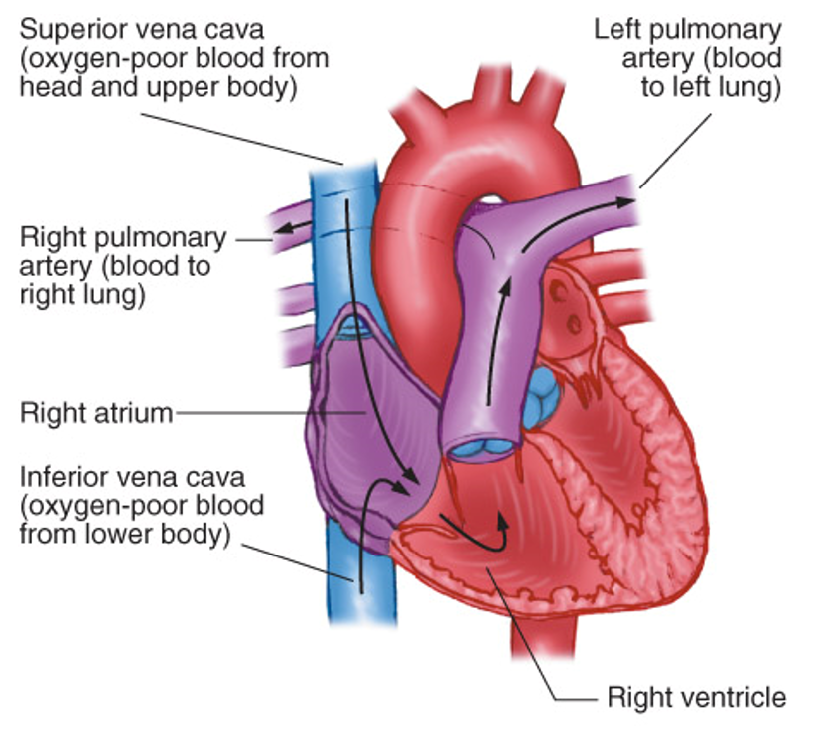
Overview of Human Systems
Organization and General Plan of the Body:
The Heart- Chambers, vessels, and valves
  Right atrium
    Superior vena cava
    Inferior vena cava
    Tricuspid valve
Notes:
The Heart- Chambers, vessels, and valves
Right atrium
Superior vena cava
Inferior vena cava
Tricuspid valve

Slide 50
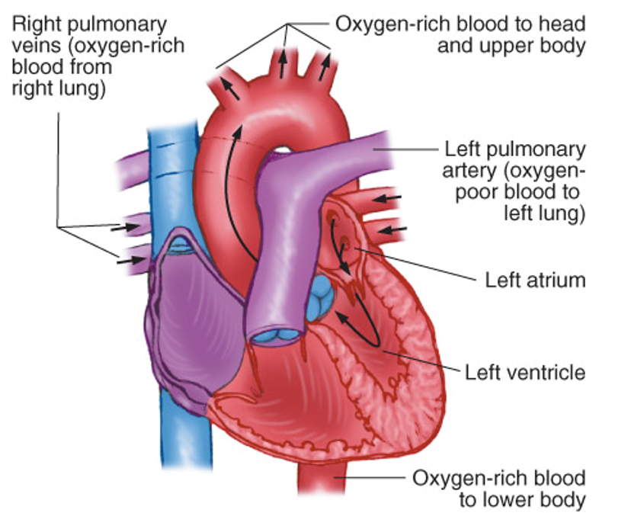
Overview of Human Systems
Organization and General Plan of the Body:
The Heart- Chambers, vessels, and valves
  Left atrium
    Pulmonary veins
    Mitral valve / bicuspid
Notes:
The Heart- Chambers, vessels, and valves
Left atrium
Pulmonary veins
Mitral valve / bicuspid

Slide 51
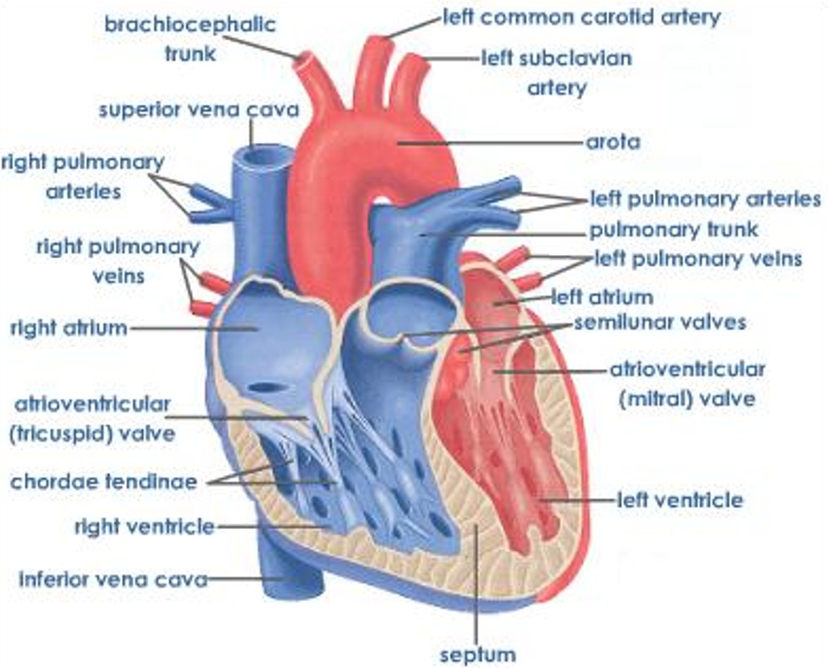
Overview of Human Systems
Organization and General Plan of the Body:
The Heart- Chambers, vessels, and valves
  Right ventricle
    Pulmonary artery
    Pulmonary semilunar valve
Notes:
The Heart- Chambers, vessels, and valves
Right ventricle
Pulmonary artery
Pulmonary semilunar valve

Slide 52
Overview of Human Systems
Organization and General Plan of the Body:
The Heart- Chambers, vessels, and valves
  Left ventricle
    Aorta
    Aortic semilunar valve
Notes:
The Heart- Chambers, vessels, and valves
Left ventricle
Aorta
Aortic semilunar valve

Slide 53
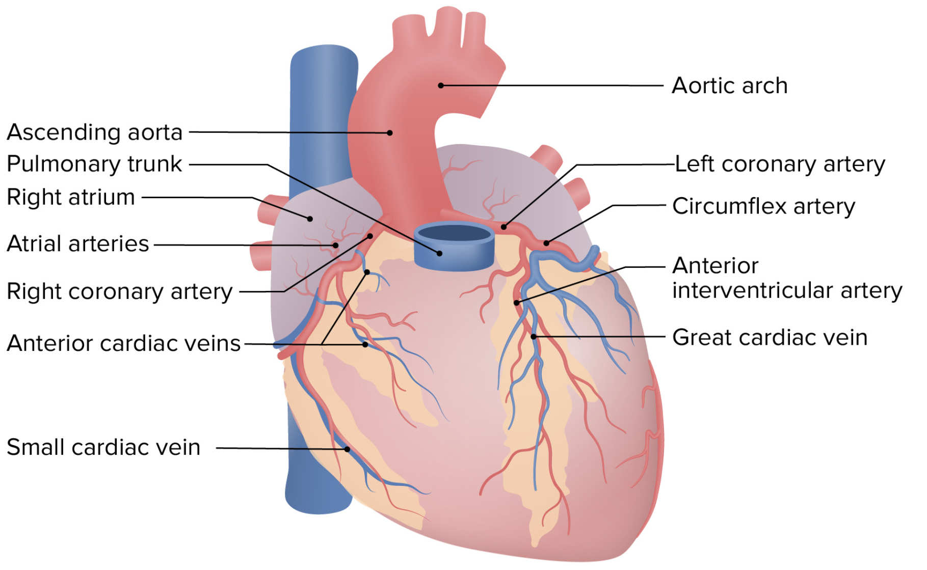
Overview of Human Systems
Organization and General Plan of the Body:
The Heart- Chambers, vessels, and valves
  Coronary vessels
Notes:
The Heart- Chambers, vessels, and valves
Coronary vessels

Slide 54
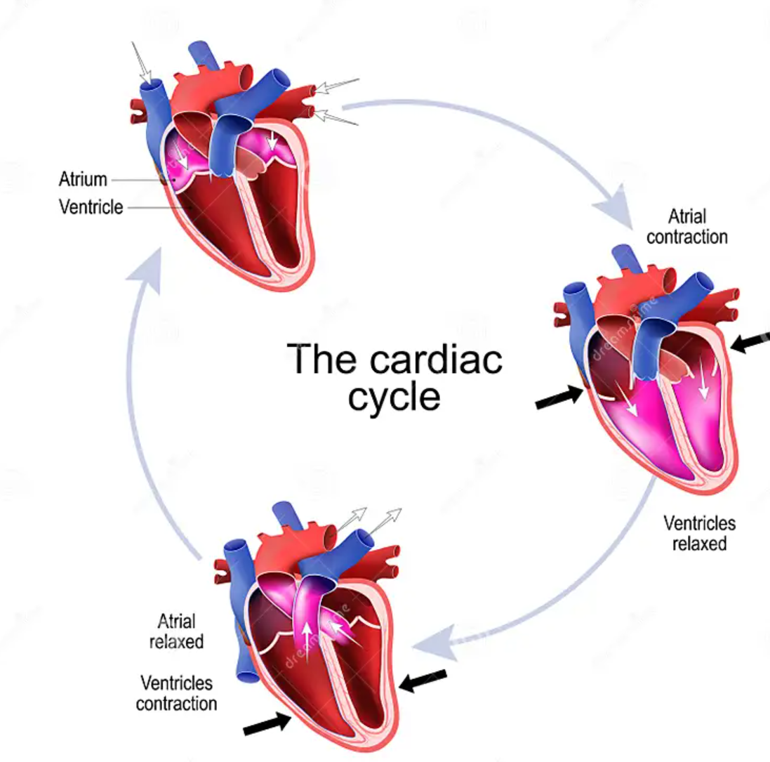
Overview of Human Systems
Organization and General Plan of the Body:
The heart- Cardiac cycle
  Systole
  Diastole
Notes:
Cardiac cycle
Systole
Diastole

Slide 55
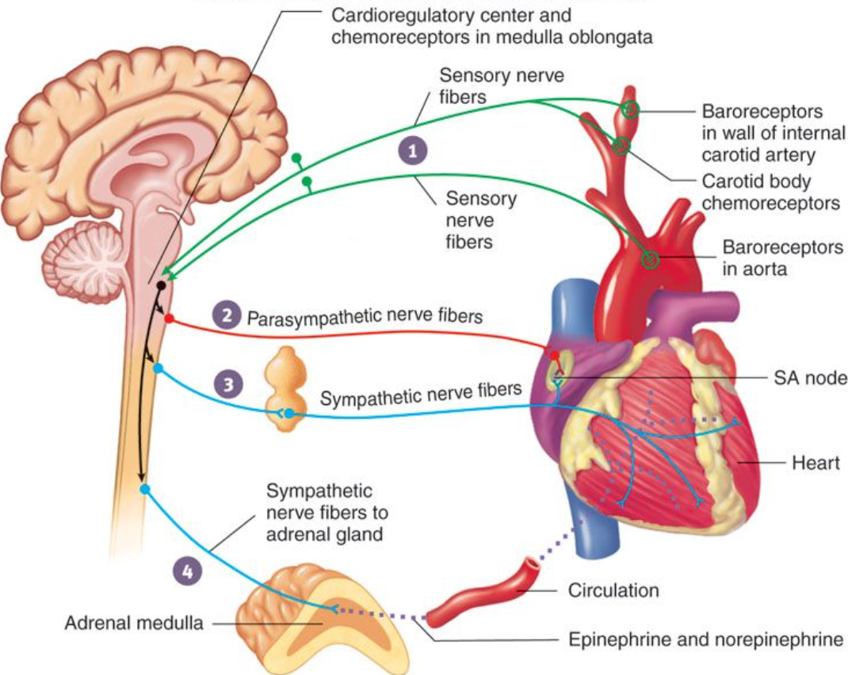
Overview of Human Systems
Organization and General Plan of the Body:
The heart- Cardiac output
  Heart rate
    Baroreceptors
Notes:
Cardiac output
Heart rate
Baroreceptor - sensory nerve endings that adjust blood pressure as a result of vasodilation or vasoconstriction

Slide 56
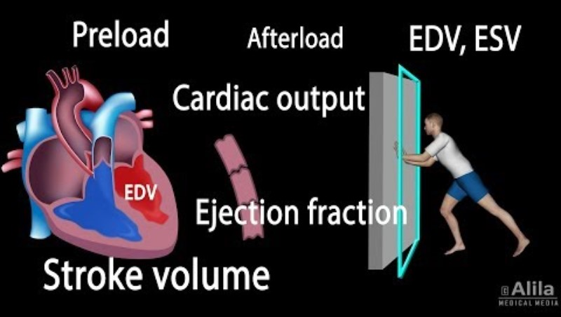
Overview of Human Systems
Organization and General Plan of the Body:
The heart- Cardiac output
  Stroke volume
Notes:
Cardiac output
Stroke volume- The amount of blood pumped into the cardiovascular system as a result of one contraction

Slide 57
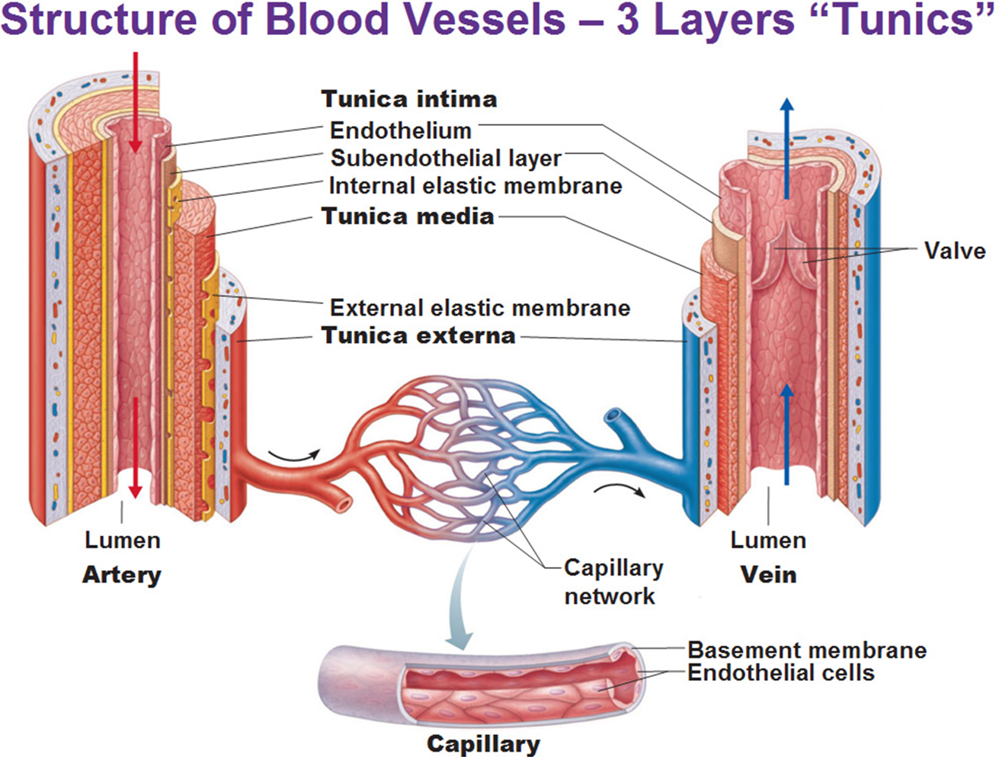
Overview of Human Systems
Organization and General Plan of the Body:
The vascular system
  Layers of blood vessels
    Tunica intima/endothelium
    Tunica media
    Tunica externa
Notes:
The vascular system
Layers of blood vessels
Tunica intima/endothelium
Tunica media
Tunica externa

Slide 58
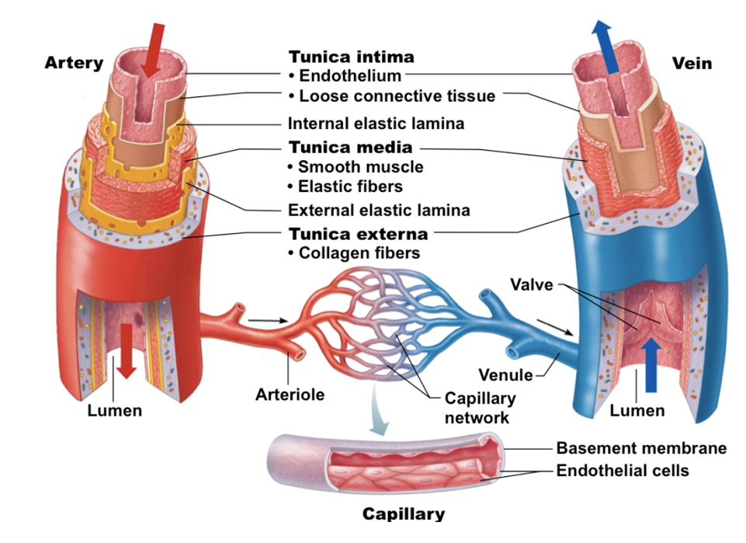
Overview of Human Systems
Organization and General Plan of the Body:
The vascular system
  Arteries
  Veins
  Valves
  Capillaries
Notes:
The vascular system
Arteries
Veins
Valves
Capillaries

Slide 59
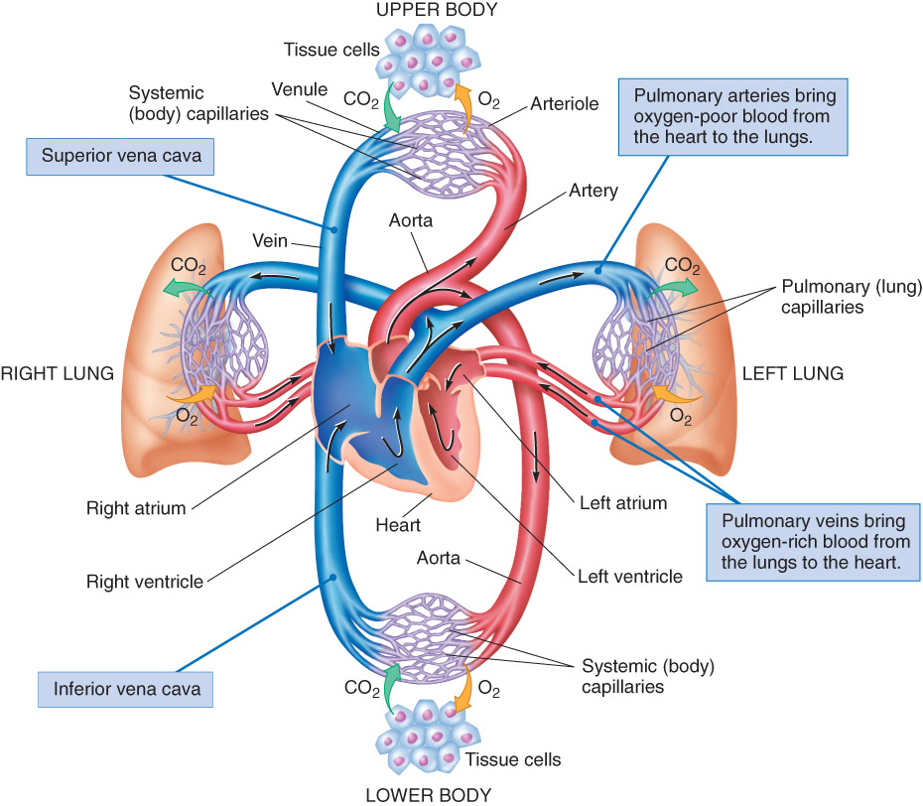
Overview of Human Systems
Organization and General Plan of the Body:
Exchange in the capillaries
  Gas exchange
  Fluid exchange
Notes:
Exchange in the capillaries
Gas exchange
Fluid exchange

Slide 60
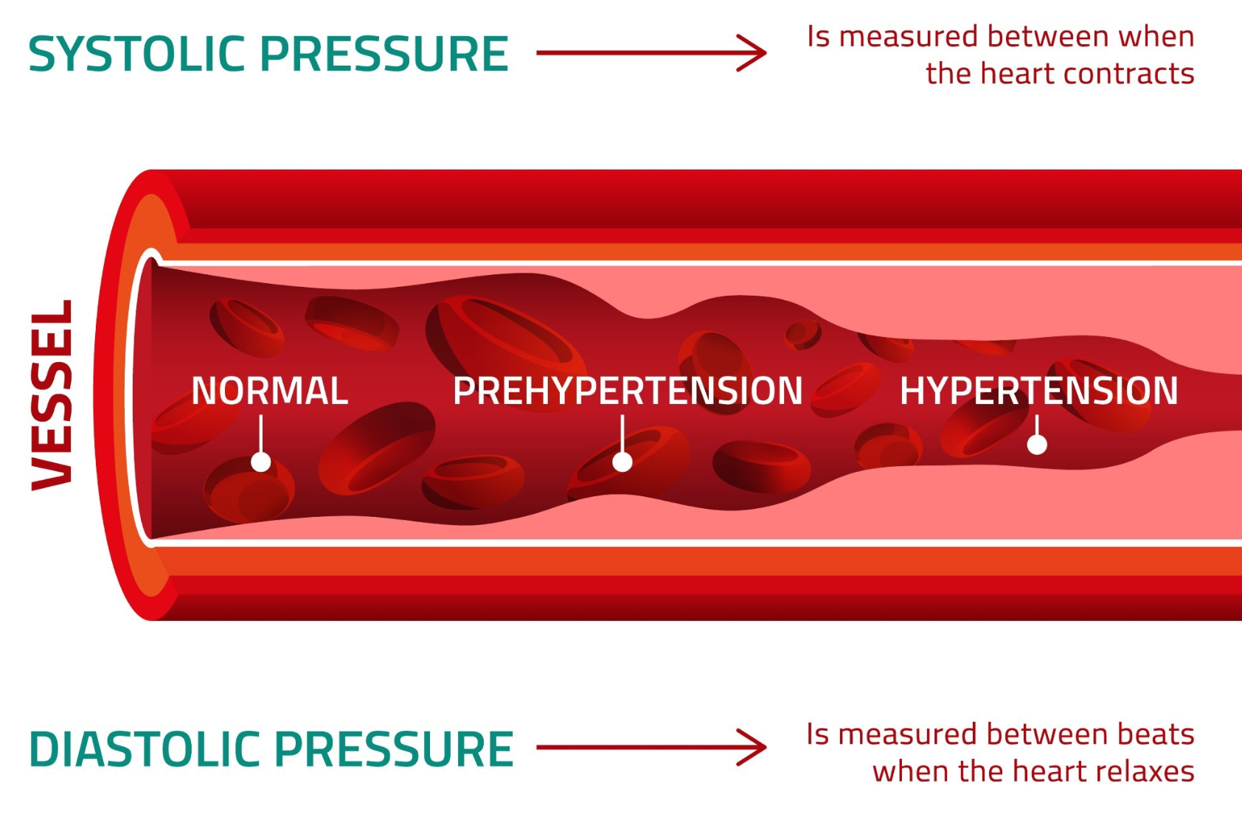
Overview of Human Systems
Organization and General Plan of the Body:
Blood pressure
Notes:
Blood pressure
Systolic & diastolic

Slide 61
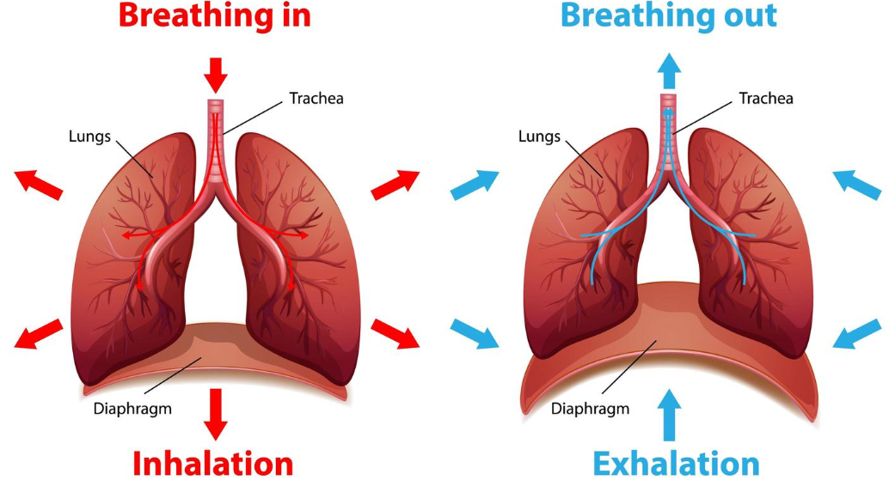
Overview of Human Systems
Organization and General Plan of the Body:
Respiratory system
  Breathing mechanics
    Inhalation
    Exhalation
Notes:
Respiratory system
The mechanics of breathing
Inhalation
Exhalation

Slide 62
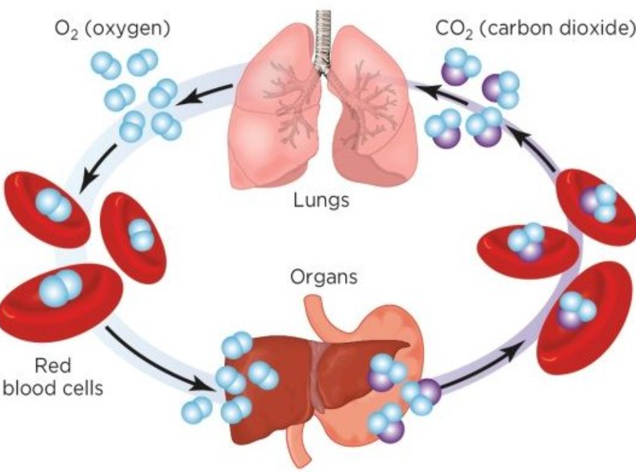
Overview of Human Systems
Organization and General Plan of the Body:
Respiratory system
  Exchange of gasses
    Diffusion of gasses
    Transportation of gases
Notes:
Respiratory system
Exchange of gasses
Diffusion of gasses
Transportation of gases in the blood

Slide 63
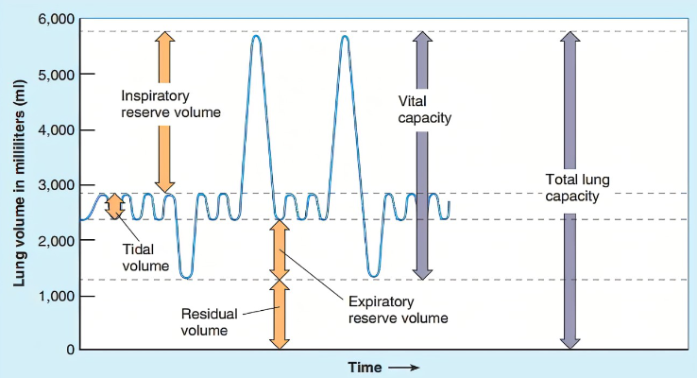
Overview of Human Systems
Organization and General Plan of the Body:
Respiratory system- Pulmonary volumes
  Tidal volume
  Minute respiratory volume
  Inspiratory reserve
  Expiratory reserve
  Vital capacity
  Residual air
Notes:
Respiratory system- Pulmonary volumes
Tidal volume
Minute respiratory volume
Inspiratory reserve
Expiratory reserve
Vital capacity
Residual air

Slide 64
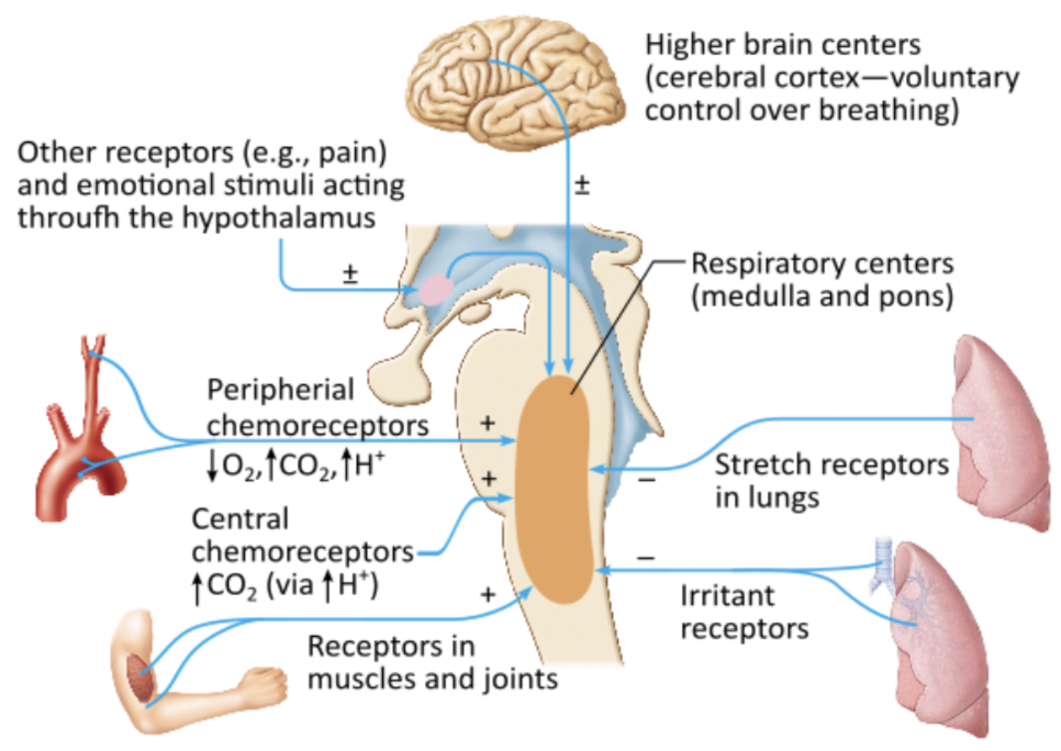
Overview of Human Systems
Organization and General Plan of the Body:
Respiratory system
  Regulation of respiration
    Nervous control
    Chemical control
Notes:
Respiratory system
Regulation of respiration
Nervous control
Chemical control

Slide 65
Assessment & Management of Shock
Lesson 3 Cognitive Objectives:
  At the end of this lesson, the EMT-IV student will be able to utilize the assessment findings to formulate a field impression and implement the treatment plan for the bleeding patient or the patient in shock.
Notes:
At the end of this lesson, the EMT-IV student will be able to utilize the assessment findings to formulate a field impression and implement the treatment plan for the bleeding patient or the patient in shock.

Slide 66
Assessment & Management of Shock
Lesson 3 Cognitive Objectives:
Describe the epidemiology, including the morbidity/mortality and prevention strategies, for shock and hemorrhage.
Discuss the anatomy and physiology of the cardiovascular system.
Predict shock and hemorrhage based on mechanism of injury.
Discuss the various types and degrees of shock and hemorrhage.
Emphasize that placing an IV should not delay transport of the patient.
Notes:
Describe the epidemiology, including the morbidity/mortality and prevention strategies, for shock and hemorrhage.
Discuss the anatomy and physiology of the cardiovascular system.
Predict shock and hemorrhage based on mechanism of injury.
Discuss the various types and degrees of shock and hemorrhage.
Emphasize that placing an IV should not delay transport of the patient.

Slide 67

Assessment & Management of Shock
Pathophysiology, Assessment, and Management of Hemorrhage:
Hemorrhage- Epidemiology
  Incidence
  Mortality/morbidity
  Prevention strategies
Notes:
Pathophysiology, Assessment, and Management of Hemorrhage:
Hemorrhage
Epidemiology
Incidence
Mortality/morbidity
Prevention strategies

Slide 68
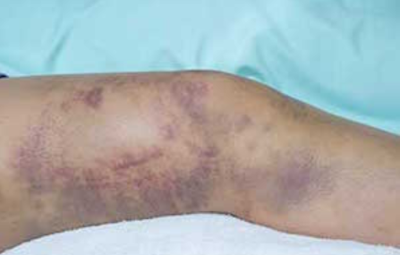
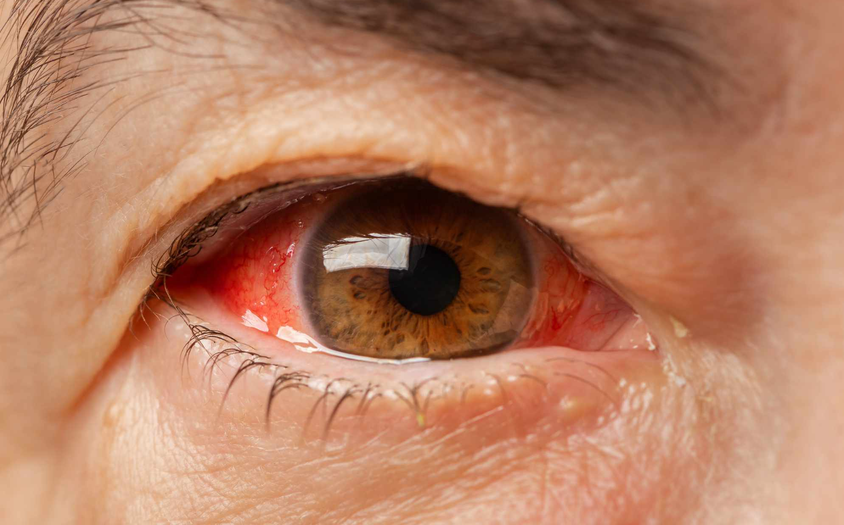
Assessment & Management of Shock
Pathophysiology, Assessment, and Management of Hemorrhage:
Hemorrhage- Pathophysiology
Location
  External
  Internal
  Trauma
  Non- trauma
  Common sites
  Uncommon Sites
Notes:
Pathophysiology, Assessment, and Management of Hemorrhage:
Hemorrhage- Pathophysiology
Location
External
Internal
Trauma
Non- trauma
Common sites
Uncommon Sites

Slide 69
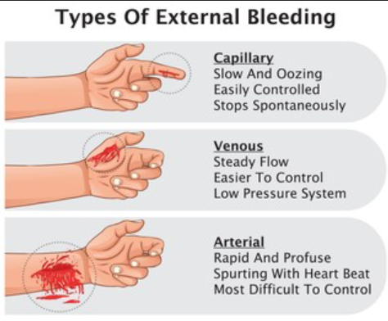
Assessment & Management of Shock
Pathophysiology, Assessment, and Management of Hemorrhage:
Hemorrhage- Anatomical type
Capillary
Venous
Arterial
Notes:
Pathophysiology, Assessment, and Management of Hemorrhage:
Hemorrhage- Anatomical type
Arterial
Venous
Capillary

Slide 70
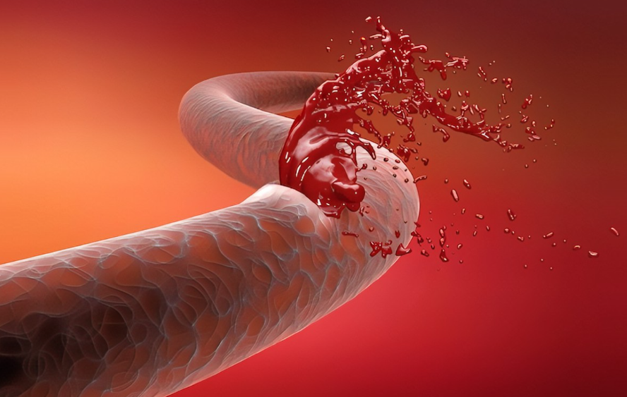
Assessment & Management of Shock
Pathophysiology, Assessment, and Management of Hemorrhage:
Hemorrhage
Timing
  Acute
  Chronic
Severity
  Amounts of blood loss tolerated
Notes:
Pathophysiology, Assessment, and Management of Hemorrhage:
Hemorrhage
Timing
Acute
Chronic
Severity
Amounts of blood loss adults, children and infants can tolerate

Slide 71
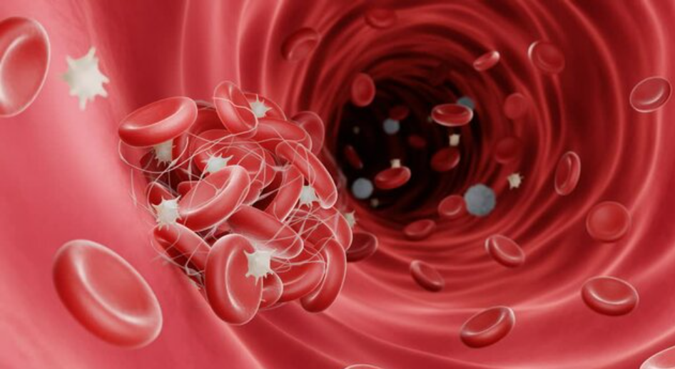
Assessment & Management of Shock
Pathophysiology, Assessment, and Management of Hemorrhage:
Hemorrhage
Physiological response to hemorrhage
  Clotting
  Localized vasoconstriction
Notes:
Pathophysiology, Assessment, and Management of Hemorrhage:
Hemorrhage
Physiological response to hemorrhage
Clotting
Localized vasoconstriction

Slide 72
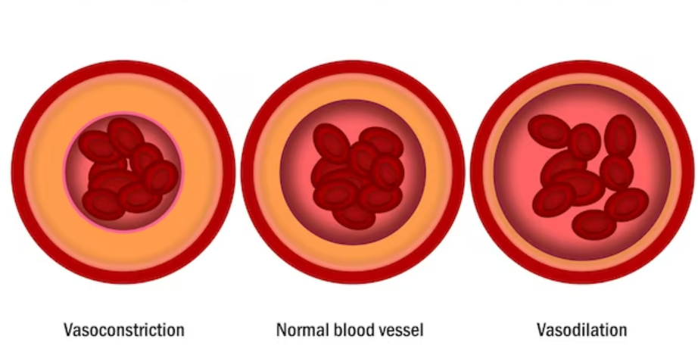
Assessment & Management of Shock
Pathophysiology, Assessment, and Management of Hemorrhage:
Stages of hemorrhage
Stage 1
        Up to 15% intravascular loss
        Compensated by constriction of vascular bed
        Blood pressure maintained
Notes:
Pathophysiology, Assessment, and Management of Hemorrhage:
Hemorrhage
Stages of hemorrhage
Stage 1
Up to 15% intravascular loss
Compensated by constriction of vascular bed
Blood pressure maintained

Slide 73
Assessment & Management of Shock
Pathophysiology, Assessment, and Management of Hemorrhage:
Stages of hemorrhage
Stage 1
        Normal pulse pressure, respiratory rate, and renal output
        Pallor of the skin
        Central venous pressure low to normal
Notes:
Pathophysiology, Assessment, and Management of Hemorrhage:
Hemorrhage
Stages of hemorrhage
Stage 1
Normal pulse pressure, respiratory rate, and renal output
Pallor of the skin
Central venous pressure low to normal

Slide 74
Assessment & Management of Shock
Pathophysiology, Assessment, and Management of Hemorrhage:
Stages of hemorrhage
Stage 2
        15-25% intravascular loss
        Cardiac output cannot be maintained by arteriolar constriction
        Reflex tachycardia
        Increased respiratory rate
        Blood pressure maintained
Notes:
Pathophysiology, Assessment, and Management of Hemorrhage:
Hemorrhage
Stages of hemorrhage
Stage 2
15-25% intravascular loss
Cardiac output cannot be maintained by arteriolar constriction
Reflex tachycardia
Increased respiratory rate
Blood pressure maintained

Slide 75
Assessment & Management of Shock
Pathophysiology, Assessment, and Management of Hemorrhage:
Stages of hemorrhage
Stage 2
        Catecholamines increase peripheral resistance
        Increased diastolic pressure
        Narrow pulse pressure
        Diaphoresis from sympathetic stimulation
        Renal output almost normal
Notes:
Pathophysiology, Assessment, and Management of Hemorrhage:
Hemorrhage
Stages of hemorrhage
Stage 2
Catecholamines increase peripheral resistance
Increased diastolic pressure
Narrow pulse pressure
Diaphoresis from sympathetic stimulation
Renal output almost normal

Slide 76
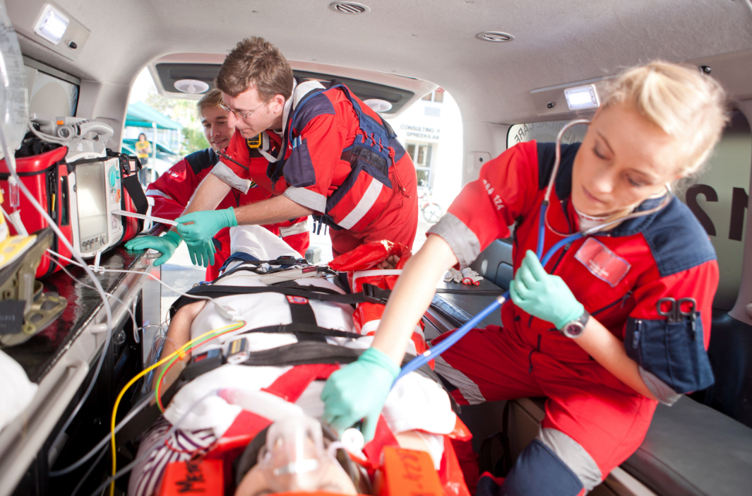
Assessment & Management of Shock
Pathophysiology, Assessment, and Management of Hemorrhage:
Stages of hemorrhage
Stage 3
  25-35% intravascular loss
  Marked tachycardia
  Marked tachypnea
  Decreased systolic pressure
  5-15 ml per hour urine output
  Alteration in mental status
  Diaphoresis with cool, pale skin
Notes:
Pathophysiology, Assessment, and Management of Hemorrhage:
Hemorrhage
Stages of hemorrhage
Stage 3
25-35% intravascular loss
Classic signs of hypovolemic shock
Marked tachycardia
Marked tachypnea
Decreased systolic pressure
5-15 ml per hour urine output
Alteration in mental status
Diaphoresis with cool, pale skin

Slide 77
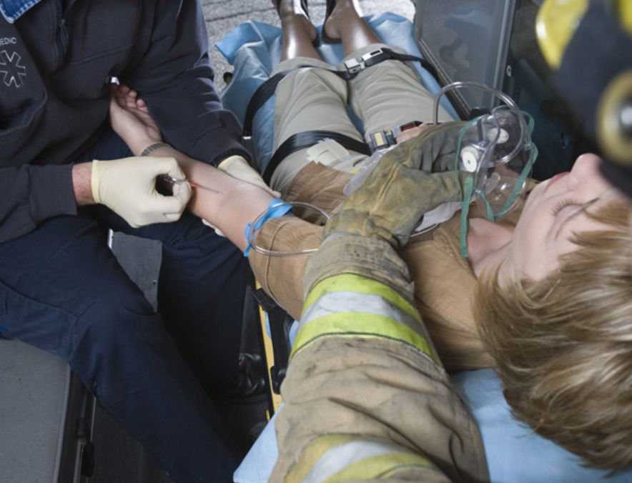
Assessment & Management of Shock
Pathophysiology, Assessment, and Management of Hemorrhage:
Stages of hemorrhage
Stage 4
        Loss greater than 35%
        Extreme tachycardia
        Pronounced tachypnea
        Significantly decreased systolic BP
        Confusion and lethargy
        Skin is diaphoretic, cool, & extremely pale
Notes:
Pathophysiology, Assessment, and Management of Hemorrhage:
Hemorrhage
Stages of hemorrhage
Stage 4
Loss greater than 35%
Extreme tachycardia
Pronounced tachypnea
Significantly decreased systolic blood pressure
Confusion and lethargy
Skin is diaphoretic, cool, and extremely pale

Slide 78
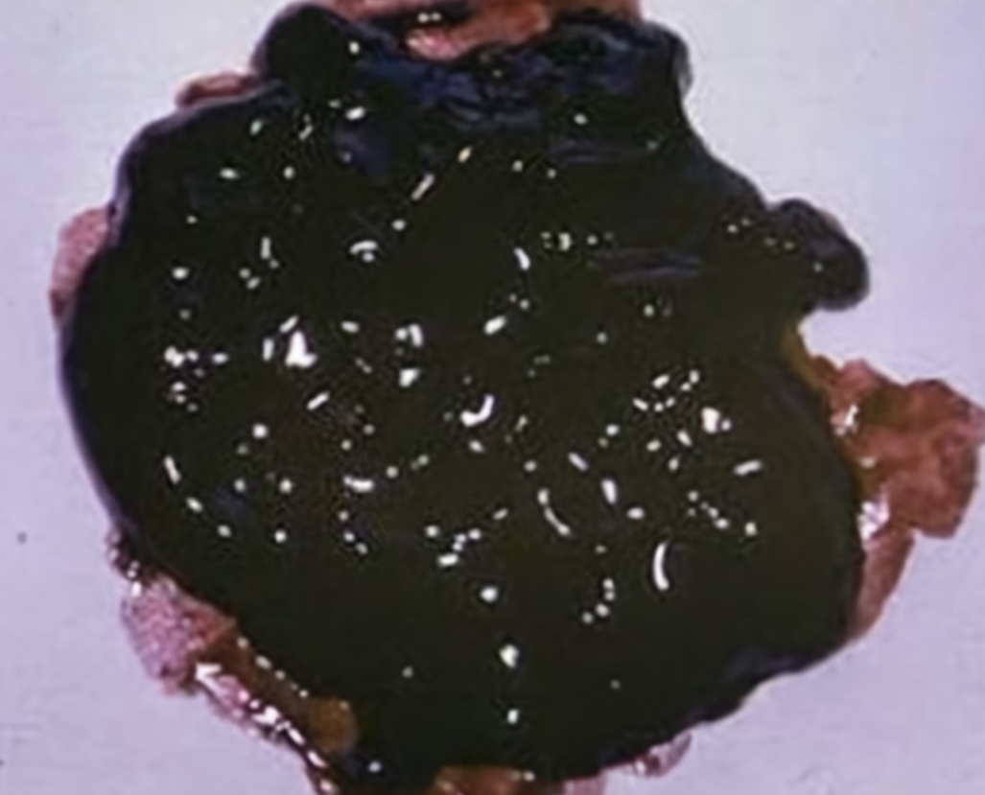
Assessment & Management of Shock
Pathophysiology, Assessment, and Management of Hemorrhage:
Hemorrhage- Assessment
Bright red blood from wound, mouth, rectum or another orifice
Coffee ground appearance of vomitus
Melena and hematochezia
Dizziness or syncope on sitting or standing
Orthostatic hypotension
Signs and symptoms of hypovolemic shock
Notes:
Pathophysiology, Assessment, and Management of Hemorrhage:
Hemorrhage
Hemorrhage- Assessment
Bright red blood from wound, mouth, rectum or another orifice
Coffee ground appearance of vomitus
Melena and hematochezia
Dizziness or syncope on sitting or standing
Orthostatic hypotension
Signs and symptoms of hypovolemic shock

Slide 79

Assessment & Management of Shock
Pathophysiology, Assessment, and Management of Hemorrhage:
Hemorrhage- Management
Airway and ventilatory support
Circulatory support
  Bleeding from nose or ears after head trauma
      Refrain from applying pressure
      Apply loose sterile dressing
Notes:
Pathophysiology, Assessment, and Management of Hemorrhage:
Hemorrhage
Hemorrhage- Management
Airway and ventilatory support
Circulatory support
Bleeding from nose or ears after head trauma
Refrain from applying pressure
Apply loose sterile dressing to protect from infection

Slide 80
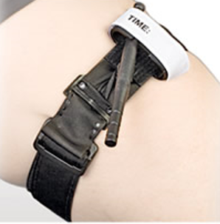
Assessment & Management of Shock
Pathophysiology, Assessment, and Management of Hemorrhage:
Hemorrhage management- Bleeding from other areas
    Control bleeding
        Direct pressure
        Tourniquet- Recognize characteristics of MAJOR bleeding and the need to possibly apply a tourniquet as a first intervention in some cases.
        Packing of large gaping wounds with sterile dressings
        Splinting
Notes:
Pathophysiology, Assessment, and Management of Hemorrhage:
Hemorrhage
Hemorrhage- Management
Bleeding from other areas
Control bleeding
Direct pressure
Tourniquet- Recognize characteristics of MAJOR bleeding and the need to possibly apply a tourniquet as a first intervention in some cases.
Packing of large gaping wounds with sterile dressings
Splinting

Slide 81
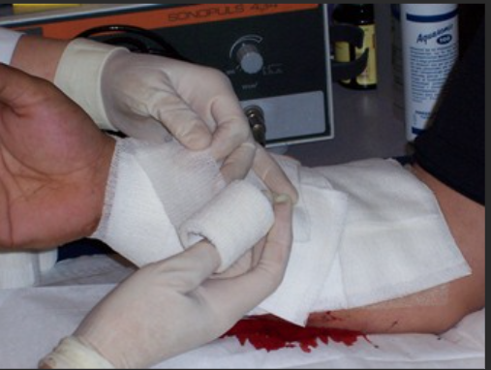
Assessment & Management of Shock
Pathophysiology, Assessment, and Management of Hemorrhage:
Hemorrhage management- Bleeding from other areas
    Apply sterile dressing and pressure bandage
    Transport considerations
    Psychological support
    Communication strategies
Notes:
Pathophysiology, Assessment, and Management of Hemorrhage:
Hemorrhage
Hemorrhage- Management
Bleeding from other areas
Apply sterile dressing and pressure bandage
Transport considerations
Psychological support / communication strategies

Slide 82

Assessment & Management of Shock
Shock:
Epidemiology
Mortality/morbidity
Prevention strategies
Notes:
Shock
Epidemiology
Mortality/morbidity
Prevention strategies

Slide 83
Assessment & Management of Shock
Shock:
Pathophysiology- Stages of shock
Compensated or nonprogressive
  Characterized by signs and symptoms of early shock
  Arterial blood pressure is normal or high
  Treatment at this stage will typically result in recovery
Notes:
Pathophysiology- Stages of shock
Compensated or nonprogressive
Characterized by signs and symptoms of early shock
Arterial blood pressure is normal or high
Treatment at this stage will typically result in recovery

Slide 84
Assessment & Management of Shock
Shock:
Pathophysiology- Stages of shock
Decompensated or progressive
  Characterized by signs and symptoms of late shock
  Arterial blood pressure is abnormally low
  Treatment at this stage will sometimes result in recovery
Notes:
Pathophysiology- Stages of shock
Decompensated or progressive
Characterized by signs and symptoms of late shock
Arterial blood pressure is abnormally low
Treatment at this stage will sometimes result in recovery

Slide 85
Assessment & Management of Shock
Shock:
Pathophysiology- Stages of shock
Irreversible
  Characterized by signs and symptoms of late shock
  Arterial blood pressure is abnormally low
  Even aggressive treatment at this stage does not result in recovery
Notes:
Pathophysiology- Stages of shock
Irreversible
Characterized by signs and symptoms of late shock
Arterial blood pressure is abnormally low
Even aggressive treatment at this stage does not result in recovery

Slide 86

Assessment & Management of Shock
Shock:
Pathophysiology- Etiologic classifications
Hypovolemic
  Hemorrhage
  Plasma loss
  Fluid and
  electrolyte loss
  Endocrine
Notes:
Pathophysiology- Etiologic classifications
Hypovolemic
Hemorrhage
Plasma loss
Fluid and electrolyte loss
Endocrine

Slide 87

Assessment & Management of Shock
Shock:
Pathophysiology- Etiologic classifications
Distributive (Vasogenic)
  Increased venous capacitance
  Low resistance, vasodilatation
Notes:
Pathophysiology- Etiologic classifications
Distributive (Vasogenic)
Increased venous capacitance
Low resistance, vasodilatation

Slide 88

Assessment & Management of Shock
Shock:
Pathophysiology- Etiologic classifications
Cardiogenic
Myocardial insufficiency
Filling or
outflow obstruction (obstructive)
Notes:
Pathophysiology- Etiologic classifications
Cardiogenic
Myocardial insufficiency
Filling or outflow obstruction (obstructive)

Slide 89

Assessment & Management of Shock
Shock:
Assessment- Hypovolemic shock due to hemorrhage
Early or Compensated Shock
  Tachycardia
  Pale, cool skin
  Diaphoresis
  Level of consciousness- normal
  or anxious
  Blood pressure maintained
Notes:
Assessment- Hypovolemic shock due to hemorrhage
Early or Compensated Shock
Tachycardia
Pale, cool skin
Diaphoresis
Level of consciousness
Blood pressure maintained

Slide 90

Assessment & Management of Shock
Shock:
Assessment- Hypovolemic shock due to hemorrhage
Early or Compensated Shock
      Narrow pulse pressure
      Orthostatic hypotension
      Dry mucosa
      Complaints of thirst
      Weakness
      Possible delay of capillary refill
Notes:
Assessment- Hypovolemic shock due to hemorrhage
Early or Compensated Shock
Narrow pulse pressure
Pulse pressure is the difference between the systolic and diastolic pressures, i.e., Pulse pressure = systolic – diastolic
Pulse pressure reflects the tone of the arterial system and is more sensitive to changes in perfusion than the systolic or diastolic alone
Orthostatic hypotension
Dry mucosa
Complaints of thirst
Weakness
Possible delay of capillary refill

Slide 91

Assessment & Management of Shock
Shock:
Assessment- Hypovolemic shock due to hemorrhage
Late or Progressive Shock
  Extreme tachycardia
  Extremely pale, cool skin
  Diaphoresis
  Significant decrease in
  level of consciousness
  Hypotension
  Dry mucosa
  Nausea
  Cyanosis with white waxy looking skin
Notes:
Assessment- Hypovolemic shock due to hemorrhage
Late or Progressive Shock
Extreme tachycardia
Extremely pale, cool skin
Diaphoresis
Significant decrease in level of consciousness
Hypotension
Dry mucosa
Nausea
Cyanosis with white waxy looking skin

Slide 92
Assessment & Management of Shock
Shock:
Differential shock assessment findings
    Shock is assumed to be hypovolemic until proven otherwise
    Cardiogenic shock is differentiated from hypovolemic shock by one or more of following
      Chief complaint- Chest pain, dyspnea, tachycardia
      Heart rate- Bradycardia or excessive tachycardia
      Signs of congestive heart failure- Jugular vein distention (JVD), rales
      Dysrhythmias
Notes:
Differential shock assessment findings
Shock is assumed to be hypovolemic until proven otherwise
Cardiogenic shock is differentiated from hypovolemic shock by one or more of following
Chief complaint, e.g., Chest pain, dyspnea, tachycardia
Heart rate, i.e., Bradycardia or excessive tachycardia
Signs of congestive heart failure, i.e., Jugular vein distention (JVD), rales
Dysrhythmias

Slide 93

Assessment & Management of Shock
Shock:
Differential shock assessment findings
Obstructive shock (filling or outflow obstruction) is differentiated from hypovolemic shock by presence of signs and symptoms suggestive of-
    Cardiac tamponade
    Tension pneumothorax
    Pulmonary Embolism
Notes:
Differential shock assessment findings
Obstructive shock (filling or outflow obstruction) is differentiated from hypovolemic shock by presence of signs and symptoms suggestive of-
Cardiac tamponade
Tension pneumothorax
Pulmonary Embolism

Slide 94
Assessment & Management of Shock
Shock:
Differential shock assessment findings
    Distributive shock (Vasogenic) is differentiated from hypovolemic shock by presence of one or more of following-
      Mechanism that suggests vasodilatation
      Warm, flushed skin, especially in dependent areas – and possibly normal to “Shocky” skin findings in areas not affected by the spinal cord injury.
      Lack of tachycardia response
Notes:
Differential shock assessment findings
Distributive shock (Vasogenic) is differentiated from hypovolemic shock by presence of one or more of following-
Mechanism that suggests vasodilatation, e.g., Spinal cord injury, drug overdose, sepsis, anaphylaxis
Warm, flushed skin, especially in dependent areas – and possibly normal to “Shocky” skin findings in areas not affected by the spinal cord injury.
Lack of tachycardia response (not reliable, though, since significant number of hypovolemic patients never become tachycardic)

Slide 95

Assessment & Management of Shock
Shock:
Management / Treatment Plan
  Airway and ventilatory support
    Ventilate and suction as necessary
    Administer high concentration oxygen
Notes:
Management / Treatment Plan
Airway and ventilatory support
Ventilate and suction as necessary
Administer high concentration oxygen

Slide 96

Assessment & Management of Shock
Shock:
Circulatory support
  Hemorrhage control
  Intravenous volume expanders
    Types
    Rate of administration
Notes:
Circulatory support
Hemorrhage control
Intravenous volume expanders
Types- Isotonic solutions
Rate of administration-
External hemorrhage that can be controlled
External hemorrhage that cannot be controlled
Internal hemorrhage
Blunt trauma
Penetrating trauma

Slide 97

Assessment & Management of Shock
Shock:
Fluid replacement
  Hypovolemic shock, Cardiogenic shock, Distributive shock, Obstructive shock
      Volume expanders
Notes:
Fluid replacement
Hypovolemic shock, Cardiogenic shock, Distributive shock, Obstructive shock
Volume expanders

Slide 98

Assessment & Management of Shock
Shock:
  Psychological support & Communication strategies
Notes:
Psychological support & Communication strategies

Slide 99

Assessment & Management of Shock
Shock:
  Transport considerations
    Indications for rapid transport
    Indications for transport to a Trauma Center
Notes:
Shock:
Transport considerations
Indications for rapid transport
Indications for transport to a Trauma Center

Slide 100
IV & IO Line Placement & Infusion
Lesson 4 Intravenous Cannulation:
  Definition:
    The placement of a catheter into a vein. It is used to administer fluids, or medications directly into the circulatory system. It can also be used to obtain venous blood specimens for laboratory determinations.
    Because IV fluids are drugs, on-line medical direction/control or standing orders are required for the EMT-IV to administer IV fluids.
Notes:
Definition:
The placement of a catheter into a vein. It is used to administer fluids, or medications directly into the circulatory system. It can also be used to obtain venous blood specimens for laboratory determinations.
Because IV fluids are drugs, on-line medical direction/control or standing orders are required for the EMT-IV to administer IV fluids.

Slide 101

IV & IO Line Placement & Infusion
Lesson 4 Intravenous Cannulation:
  Indications:
    Replacement of circulatory volume
    To establish a medication administration route
  Contraindications - Cannulation of a particular site is contraindicated in:
    Sclerotic veins
    Burned extremities
Notes:
Indications:
Replacement of circulatory volume
To establish a medication administration route
Contraindications - Cannulation of a particular site is contraindicated in:
Sclerotic veins
Burned extremities

Slide 102

IV & IO Line Placement & Infusion
Lesson 4 Intravenous Cannulation:
  Universal precautions & body substance isolation (BSI) in medication administration
Notes:
Universal precautions & body substance isolation (BSI) in medication administration

Slide 103

IV & IO Line Placement & Infusion
Lesson 4 Intravenous Cannulation:
  Equipment- Intravenous (IV) solutions
    Types of solutions
      Crystalloids
      Colloids - Informational only
    Types of containers
    Variety of volumes
Notes:
Equipment- Intravenous (IV) solutions
Types of solutions
Crystalloids
Colloids - Informational only - not for field use
Types of containers
Variety of volumes

Slide 104

IV & IO Line Placement & Infusion
Lesson 4 Intravenous Cannulation:
  Equipment- Intravenous (IV) administration sets
  Components
  Piercing spike
  Drip Chamber
  Macro drip chamber-type
  Micro drip chamber-type
Notes:
Equipment- Intravenous (IV) administration sets
Components
Piercing spike
Drip Chamber
Macro drip chamber-type
Micro drip chamber-type

Slide 105

IV & IO Line Placement & Infusion
Lesson 4 Intravenous Cannulation:
  Equipment- Intravenous (IV) administration sets
    Components
      Flow clamp
      Drug administration port
      Connector end
      Variety of extensions
Notes:
Equipment- Intravenous (IV) administration sets
Components
Flow clamp
Drug administration port
Connector end
Variety of extensions and other pieces of equipment
Some IV administration sets are manufacturer specific – aren’t they all? What does this mean?

Slide 106


IV & IO Line Placement & Infusion
Lesson 4 Intravenous Cannulation:
  Equipment- Needles / Catheters
    Types
      Over the needle
    IV catheter size
Notes:
Equipment- Needles / Catheters
Types
Over the needle
IV catheter size

Slide 107

IV & IO Line Placement & Infusion
Lesson 4 Intravenous Cannulation:
  Equipment- Supplies & materials
    Personal protective equipment to maintain BSI
    Tourniquet
    Chlorhexidine /Alcohol/Povidone/Iodine
    Sterile dressings
    Tape
    Arm boards – if necessary
    Vacutainer holder and assorted blood collection tubes for blood samples
Notes:
Equipment- Supplies & materials
Personal protective equipment to maintain BSI
Tourniquet
Chlorhexidine /Alcohol/povidone/iodine:
Sterile dressings
Tape
Arm boards – if necessary
Vacutainer holder and assorted blood collection tubes for blood samples – protocol/area dependent.

Slide 108

IV & IO Line Placement & Infusion
Lesson 4 Intravenous Cannulation:
  Procedure for performing IV cannulation
  Explain the need for IV cannulation and describe the procedure to the patient.
  Ask if the patient has any allergies (especially to iodine if using iodine pads to cleanse the skin).
Notes:
Procedure for performing IV cannulation
Explain the need for IV cannulation and describe the procedure to the patient.
Ask if the patient has any allergies (especially to iodine if using iodine pads to cleanse the skin).

Slide 109

IV & IO Line Placement & Infusion
Lesson 4 Intravenous Cannulation:
  Procedure for performing IV cannulation
  Select IV solution to be used and check to make sure it is:
    The proper solution
    Clean, without particulate matter
    Not outdated
    Not leaking
    Warmed or cooled as indicated
Notes:
Procedure for performing IV cannulation
Select IV solution to be used and check to make sure it is:
The proper solution
Clean, without particulate matter
Not outdated
Not leaking
Warmed or cooled as indicated

Slide 110

IV & IO Line Placement & Infusion
Lesson 4 Intravenous Cannulation:
  Procedure for performing IV cannulation
  Select an appropriate size catheter
    14 to 16 gauge for trauma, volume replacement, or cardiac arrest
    18 to 20 gauge for medical conditions
    22 to 24 gauge for pediatrics and geriatrics
Notes:
Procedure for performing IV cannulation
Select an appropriate size catheter
14 to 16 gauge for trauma, volume replacement, or cardiac arrest
18 to 20 gauge for medical conditions
22 to 24 gauge for pediatrics and geriatrics

Slide 111

IV & IO Line Placement & Infusion
Lesson 4 Intravenous Cannulation:
  Procedure for performing IV cannulation
  Select the proper administration set
    Macro for trauma
    Micro for medical conditions & drug administration
Notes:
Procedure for performing IV cannulation
Select the proper administration set
Macro for trauma
Micro for medical conditions & drug administration

Slide 112
IV & IO Line Placement & Infusion
Lesson 4 Intravenous Cannulation :
  Instructor- Consider inserting a video here in conjunction with the following placement instruction slides

Slide 113
IV & IO Line Placement & Infusion
Lesson 4 Intravenous Cannulation:
  Procedure for performing IV cannulation
  Prepare the IV bag and administration set
    Remove IV bag from its protective envelope & gently squeeze to detect any leakage
    Steady the port of the IV bag with one hand and remove the protective cap
    Remove the administration set from its protective wrapping
    Slide the flow control valve close to the drip chamber
    Close off the flow control valve
Notes:
Prepare the IV bag and administration set using an aseptic technique to prevent contamination.
Remove IV bag from its protective envelope and gently squeeze to detect any punctures or leakage.
Steady the port of the IV bag with one hand and remove the protective cap by pulling smoothly.
Remove the administration set from its protective wrapping or box
Slide the flow control valve close to the drip chamber.
Close off the flow control valve.

Slide 114
IV & IO Line Placement & Infusion
Lesson 4 Intravenous Cannulation:
  Procedure for performing IV cannulation
  Prepare the IV bag and administration set
    Remove the protective cap from the spike
    Invert the IV bag
    Insert the spiked end of the administration set into the tubing insertion port
    Turn the IV bag right side up and squeeze the drip chamber to fill it half- way.
    Open the control valve to flush IV solution through the entire tubing
Notes:
Remove the protective cap from the spiked piercing end of the administration set.
Invert the IV bag.
Using sterile technique, insert the spiked end of the administration set into the tubing insertion port of the IV bag. Use one quick, smooth motion. Careful not to side-puncture the insertion port.
Turn the IV bag right side up and squeeze the drip chamber two or three times to fill it half- way.
Open the control valve to flush IV solution through the entire tubing, which should force out all the air.

Slide 115

IV & IO Line Placement & Infusion
Lesson 4 Intravenous Cannulation:
  Procedure for performing IV cannulation
  Cut or tear several pieces of tape of different lengths.
  Employ Standard Precautions
  Carefully inform the patient
  Use the correct IV solution, correct gauge needle, and the correct location
Notes:
Procedure for performing IV cannulation
Cut or tear several pieces of tape of different lengths.
Employ Standard Precautions
Talk to the patient, let them know what you are doing and what to expect
Make sure you are using the correct IV solution, correct gauge needle, and the correct location

Slide 116

IV & IO Line Placement & Infusion
Lesson 4 Intravenous Cannulation:
  Procedure for performing IV cannulation
  If possible, place the patient into a suitable position with the selected extremity lower than the heart
  Apply a tourniquet
    Use caution when applying and removing the tourniquet
Notes:
Procedure for performing IV cannulation
If possible, place the patient into a suitable position with the selected extremity lower than the heart
Apply a tourniquet
Use caution when applying and removing the tourniquet
Many elderly patients and patients on prednisone have very delicate skin

Slide 117
IV & IO Line Placement & Infusion
Lesson 4 Intravenous Cannulation:
  Procedure for performing IV cannulation
  Select a suitable vein by palpation and sight
    Avoid areas of the veins where a valve is situated.
    Avoid using Fistulas, shunts or graphs
    Standard practice is to look at distal (hand) veins first and work your way up the arm. If you are using a hand vein, place the tourniquet near the hand.
    If the vein rolls, or feels hard or rope-like, select another vein.
Notes:
Select a suitable vein by palpation and sight.
Avoid areas of the veins where a valve is situated.
Avoid using Fistulas, shunts or graphs. Keep in mind, that these may be used at last resort...
Standard practice is to look at distal (hand) veins first and work your way up the arm. If you are using a hand vein, place the tourniquet near the hand.
If the vein rolls, or feels hard or rope-like, select another vein.
Veins can be distended for easier cannulation by:
Having the patient open and close their fist tightly five or six times.
Flicking the skin over the vein with one or two sharp snaps of the fingers.
Rubbing or stroking the skin upward toward the tourniquet.
If a suitable vein cannot be found, or if the vein still feels small and uniform, release the tourniquet and apply it closer to the IV site.
IF you are not seeing a vein that you are confident you can cannulate, don’t hesitate to look at the other arm.

Slide 118

IV & IO Line Placement & Infusion
Lesson 4 Intravenous Cannulation:
  Procedure for performing IV cannulation
  Stabilize the vein by anchoring it with the thumb and stretching the skin downward
Notes:
Procedure for performing IV cannulation
Stabilize the vein by anchoring it with the thumb and stretching the skin downward.

Slide 119
IV & IO Line Placement & Infusion
Lesson 4 Intravenous Cannulation:
  Perform the venipuncture without contamination
    Advise patient there will be a poke or pinch as the needle enters
    Hold the end of the venipuncture device between thumb and the index/middle fingers:
      Maintain visualization of the flashback chamber.
      Avoid touching any portion of the catheter, because a contaminated device is not usable.
Notes:
Perform the venipuncture without contaminating the equipment or site.
Tell the patient there will be a small poke or pinch as the needle enters the skin.
Hold the end of the venipuncture device between thumb and the index/middle fingers:
Maintain visualization of the flashback chamber.
Avoid touching any portion of the catheter, because a contaminated device is not usable.

Slide 120
IV & IO Line Placement & Infusion
Lesson 4 Intravenous Cannulation:
    Depending on manufacturer recommendations, hold the needle at a 15, 30- or 45-degree angle to the skin
    Penetrate the skin with the bevel of the needle pointed up
      If significant resistance is felt, do not force the catheter
      Instead, withdraw the needle and catheter together as a unit
    If possible, penetrate the vein at its junction or bifurcation with another vein
Notes:
Depending on the type of venipuncture device and manufacturer recommendations, hold the needle at a 15, 30- or 45-degree angle to the skin.
Penetrate the skin with the bevel of the needle pointed up.
If significant resistance is felt, do not force the catheter.
Instead, withdraw the needle and catheter together as a unit.
If possible, penetrate the vein at its junction or bifurcation with another vein, because it is more stable at this location.

Slide 121

IV & IO Line Placement & Infusion
Lesson 4 Intravenous Cannulation:
  Enter the vein with the needle from either the top or side
    Normally, a slight “pop” or “give” is felt as the needle passes through the wall of the vein
Be careful not to enter too fast or too deeply, because the needle can go through the back wall of the vein
    Note when blood fills the flashback chamber
Notes:
Enter the vein with the needle from either the top or side
Normally, a slight “pop” or “give” is felt as the needle passes through the wall of the vein
Be careful not to enter too fast or too deeply, because the needle can go through the back wall of the vein.
Note when blood fills the flashback chamber.

Slide 122

IV & IO Line Placement & Infusion
Lesson 4 Intravenous Cannulation:
    Lower the venipuncture device and advance it another 1 to 2 mm until the tip of the catheter is well within the vein
    Advance the catheter into the vein following the manufacturer’s recommendations
    Once the catheter is within the vein, apply pressure to the vein beyond the catheter tip with a finger to prevent blood from leaking out of the catheter hub once the needle is completely withdrawn
Notes:
Lower the venipuncture device and advance it another 1 to 2 mm until the tip of the catheter is well within the vein.
Advance the catheter into the vein following the manufacturer’s recommendations.
Once the catheter is within the vein, apply pressure to the vein beyond the catheter tip with a finger to prevent blood from leaking out of the catheter hub once the needle is completely withdrawn
If using a valved catheter – pushing on the vein to prevent bleeding from the hub may be unnecessary.
It may be necessary to use the drawback technique to determine patency.

Slide 123

IV & IO Line Placement & Infusion
Lesson 4 Intravenous Cannulation:
  To draw a blood sample:
    Stabilize the catheter with one hand and attach a Vacutainer holder with a multi-sample IV Luer-lock adapter or a syringe to the hub
    If using a Vacutainer device, insert the blood collection tube fully into the holder and allow its internal vacuum to draw blood out of the vein
Notes:
If necessary or directed by protocol you may need to draw a blood sample. The tourniquet should be left in place while drawing blood samples.
Stabilize the catheter with one hand and attach a Vacutainer holder with a multi-sample IV Luer-lock adapter or a syringe to the hub.
Be careful not to disrupt the catheter placement while connecting the Vacutainer or syringe.
Once the device is connected, release the finger pressure at the distal tip of the catheter
If using a Vacutainer device, insert the blood collection tube fully into the holder and allow its internal vacuum to draw blood out of the vein.
If using a syringe, slowly withdraw the plunger to fill the syringe with blood.
If blood flow into the syringe stops, it usually means that the sucking pressure of the syringe is collapsing the vein
Also, pulling back to forcefully may cause cellular lysis and negate the benefit of collecting the sample to begin with.
To correct this problem, slow the rate at which the plunger is being withdrawn.

Slide 124
IV & IO Line Placement & Infusion
Lesson 4 Intravenous Cannulation:
  To draw a blood sample:
  Once enough blood collection tubes have been filled or the syringe is completely full, release the tourniquet from the patient’s arm
  Reapply pressure to the vein beyond the catheter tip with a finger to prevent blood from leaking out of the catheter hub once the blood drawing device is disconnected
  Disconnect the syringe or Vacutainer device from the hub of the catheter by holding the hub between the first finger and thumb and pulling the device free with the other hand
Notes:
To draw a blood sample:
Once enough blood collection tubes have been filled or the syringe is completely full, release the tourniquet from the patient’s arm
Reapply pressure to the vein beyond the catheter tip with a finger to prevent blood from leaking out of the catheter hub once the blood drawing device is disconnected
Disconnect the syringe or Vacutainer device from the hub of the catheter by holding the hub between the first finger and thumb and pulling the device free with the other hand

Slide 125

IV & IO Line Placement & Infusion
  Connect the IV tubing to the catheter hub. Be careful not to contaminate either the hub or connector prior to insertion
  Open the IV flow control valve and run the IV for a brief period of time to ensure the line is patent. To ensure proper IV flow rates, the IV fluid container must hang at least 30 to 36 inches above the insertion site
  Cover the IV site with a sterile dressing or a bandage – preferably one that is transparent.
Notes:
Connect the IV tubing to the catheter hub. Be careful not to contaminate either the hub or connector prior to insertion
Open the IV flow control valve and run the IV for a brief period of time to ensure the line is patent. To ensure proper IV flow rates, the IV fluid container must hang at least 30 to 36 inches above the insertion site.
Cover the IV site with a sterile dressing or a bandage – preferably one that is transparent.

Slide 126

IV & IO Line Placement & Infusion
  Secure the catheter, administration set tubing, and sterile dressing in place with tape.
    Tubing should be looped and secured with tape above the IV cannulation site.
    Do not make the loop so small that it kinks the tubing and restricts fluid flow.
  Adjust the appropriate flow rate for the patient’s condition.
  Dispose of the needle(s) in a proper biomedical waste container.
Notes:
Secure the catheter, administration set tubing, and sterile dressing in place with tape.
Tubing should be looped and secured with tape above the IV cannulation site.
This gives the tubing more play, making the catheter less likely to be dislodged by accidental pulls on the tubing.
Do not make the loop so small that it kinks the tubing and restricts fluid flow.
Adjust the appropriate flow rate for the patient’s condition.
Dispose of the needle(s) in a proper biomedical waste container.
If a syringe was used to draw the blood:
The necessary blood collection tubes must be filled by attaching needle to the syringe and inserting it into each blood tube.
The tubes should then be labeled and stored in a safe location.

Slide 127

IV & IO Line Placement & Infusion
Lesson 4 Intravenous Cannulation:
  Armboards may be:
  Avoided simply by choosing a venipuncture site well away from any flexion areas.
  Necessary when a venipuncture device is inserted near a joint or in the dorsum of the hand
  Used along with restraints in confused or disoriented patients.
  Useful with pediatric patients.
Notes:
Armboards may be:
Avoided simply by choosing a venipuncture site well away from any flexion areas.
Necessary when a venipuncture device is inserted near a joint or in the dorsum of the hand
Used along with restraints in confused or disoriented patients.
Useful with pediatric patients.

Slide 128

IV & IO Line Placement & Infusion
Lesson 4 Intravenous Cannulation:
  Regulating fluid flow rates:
  Flow rates should be adjusted as ordered by medical control & local protocol
  Fluid resuscitation guidelines should be 20ml/kg boluses for adults, children, and infants. Newborns or neonates should be 10ml/kg boluses
Notes:
Regulating fluid flow rates
Flow rates should be adjusted as ordered by medical control/direction and local protocol.
Fluid resuscitation guidelines should be 20ml/kg boluses for adults, children, and infants. Newborns or neonates should be 10ml/kg boluses. Targets for treatment are return of distal pulses, not to exceed minimum systolic blood pressure ranges, appropriate for age.
The EMT-IV must know the volume to be infused, the period of time over which the fluid is to be infused, and the number of drops per milliliter the infusion set delivers.
The following formula can be used to calculate IV solution drip rates per minute
Drops per min. = volume to be infused x drops/ml of administration set, divided by total time of infusion in minutes.
After determining the rate, open the clamp slowly to start fluid dripping into the drip chamber.
Determine drops per minute and adjust the flow clamp as needed to obtain the correct drip rate.
Check the flow rate periodically.
Various types of infusion pumps

Slide 129
IV & IO Line Placement & Infusion
Lesson 4 Intravenous Cannulation:
  Regulating fluid flow rates:
  The EMT-IV must know the volume to be infused, the period of time over which the fluid is to be infused, and the number of drops per milliliter the infusion set delivers.
    The following formula can be used to calculate IV solution drip rates per minute - Drops per min. = volume to be infused x drops/ml of administration set, divided by total time of infusion in minutes.
Notes:
Regulating fluid flow rates
Flow rates should be adjusted as ordered by medical control/direction and local protocol.
Fluid resuscitation guidelines should be 20ml/kg boluses for adults, children, and infants. Newborns or neonates should be 10ml/kg boluses. Targets for treatment are return of distal pulses, not to exceed minimum systolic blood pressure ranges, appropriate for age.
The EMT-IV must know the volume to be infused, the period of time over which the fluid is to be infused, and the number of drops per milliliter the infusion set delivers.
The following formula can be used to calculate IV solution drip rates per minute
Drops per min. = volume to be infused x drops/ml of administration set, divided by total time of infusion in minutes.
After determining the rate, open the clamp slowly to start fluid dripping into the drip chamber.
Determine drops per minute and adjust the flow clamp as needed to obtain the correct drip rate.
Check the flow rate periodically.
Various types of infusion pumps

Slide 130

IV & IO Line Placement & Infusion
Lesson 4 Intravenous Cannulation:
  Regulating fluid flow rates:
  After determining the rate, open the clamp slowly to start fluid dripping into the drip chamber
    Determine drops per minute and adjust the flow clamp as needed to obtain the correct drip rate
    Check the flow rate periodically
Notes:
Regulating fluid flow rates
Flow rates should be adjusted as ordered by medical control/direction and local protocol.
Fluid resuscitation guidelines should be 20ml/kg boluses for adults, children, and infants. Newborns or neonates should be 10ml/kg boluses. Targets for treatment are return of distal pulses, not to exceed minimum systolic blood pressure ranges, appropriate for age.
The EMT-IV must know the volume to be infused, the period of time over which the fluid is to be infused, and the number of drops per milliliter the infusion set delivers.
The following formula can be used to calculate IV solution drip rates per minute
Drops per min. = volume to be infused x drops/ml of administration set, divided by total time of infusion in minutes.
After determining the rate, open the clamp slowly to start fluid dripping into the drip chamber.
Determine drops per minute and adjust the flow clamp as needed to obtain the correct drip rate.
Check the flow rate periodically.
Various types of infusion pumps

Slide 131
IV & IO Line Placement & Infusion
Lesson 4 Intravenous Cannulation:
  Documenting IV cannulation:
    Date and time of the venipuncture
    Type and amount of solution
    Type of venipuncture device used, including the length and gauge
    Venipuncture site
    Number of insertion attempts (if more than one)
    IV flow rate
    Any adverse reactions and the actions taken to correct them
    Name or identification number of the EMT-IV initiating the infusion
    Follow local protocols regarding additional documentation
Notes:
Documenting IV cannulation
Depending on local protocol, when an IV is started, the following must be documented on the run report:
Date and time of the venipuncture
Type and amount of solution
Type of venipuncture device used, including the length and gauge
Venipuncture site
Number of insertion attempts (if more than one)
IV flow rate
Any adverse reactions and the actions taken to correct them
Name or identification number of the EMT-IV initiating the infusion
In addition to documenting correct IV placement, unsuccessful attempts also should be documented
Follow local protocol regarding any additional documentation requirements.

Slide 132
IV & IO Line Placement & Infusion
Lesson 4 Intravenous Cannulation:
  When the IV does not flow:
  Was the venous tourniquet removed?
  Is there swelling at the cannulation site?
  Is the flow regulator or clamp in an open position?
  Is the tip of the catheter positioned against a valve or wall of the vein?
  Is the IV bag high enough?
  Is the drip chamber completely filled with IV solution?
Notes:
When the IV does not flow:
Was the venous tourniquet removed?
Is there swelling at the cannulation site?
Is the flow regulator or clamp in an open position?
Is the tip of the catheter positioned against a valve or wall of the vein?
Is the IV bag high enough?
Is the drip chamber completely filled with IV solution?

Slide 133

IV & IO Line Placement & Infusion
Lesson 4 Intravenous Cannulation:
  Complications:
      Pain
      Catheter shear
      Cannulation of an artery
      Hematoma or infiltration
      Phlebitis or infection
      Extravasation
      Air in tubing/air embolism
      Circulatory overload and pulmonary edema
      Allergic reaction
      Pulmonary embolism
      Failure to infuse properly
Notes:
Complications:
Pain
Catheter shear
Cannulation of an artery
Hematoma or infiltration
Phlebitis or infection
Extravasation
Air in tubing/air embolism
Circulatory overload and pulmonary edema
Allergic reaction
Pulmonary embolism
Failure to infuse properly

Slide 134

IV & IO Line Placement & Infusion
Lesson 4 Intravenous Cannulation:
  Steps to discontinue an IV infusion:
  Equipment
        Gloves, Sterile gauze pad, Adhesive bandage
  Technique
    Close the flow control valve completely
    Carefully remove all tape, and remove the dressing
    Hold the sterile gauze pad just above the site to stabilize the tissue and withdraw the catheter by pulling straight back until the catheter is completely out of the vein
    Immediately cover the site with the sterile gauze pad and hold it against the puncture site until the bleeding has stopped
    Tape the dressing in place or cover with an adhesive bandage
Notes:
Steps to discontinue an IV infusion:
Equipment
Gloves, Sterile gauze pad, Adhesive bandage
Technique
Close the flow control valve completely
Carefully remove all tape, and remove the dressing
Hold the sterile gauze pad just above the site to stabilize the tissue and withdraw the catheter by pulling straight back until the catheter is completely out of the vein
Immediately cover the site with the sterile gauze pad and hold it against the puncture site until the bleeding has stopped
Tape the dressing in place or cover with an adhesive bandage

Slide 135

IV & IO Line Placement & Infusion
Lesson 4 Intravenous Cannulation:
  Drawing blood:
  Purpose
        To obtain blood samples for analysis
  Equipment
    Blood tubes
  Locations to obtain blood samples
    Anatomical sites
    From the established intravenous catheter
    Other locations
Notes:
Purpose - to obtain blood samples from a patient for analysis
Equipment needed for obtaining a blood sample:
Variety of sizes and types of blood tubes are available to collect and store blood samples.
The rubber caps on the tubes come in several colors and patterns denoting the specific tests that are conducted with the blood that is stored in them
Most commonly used in the field are the red, purple, green, or “jungle” blue, and gray tops
Blood collection tubes may vary by manufacturer.
Check with your local medical facility.
Some tubes have small amounts of liquids or agents inside the tube to prevent blood coagulation or to aid in preserving the blood in a way necessary for a particular type of test
During manufacture of blood tubes, a vacuum is created in the tube that acts to “suck blood” into the tube
Locations from which to obtain a blood sample
Anatomical sites
From the established intravenous catheter
Other locations
Steps to preparing equipment for obtaining a blood sample

Slide 136
IV & IO Line Placement & Infusion
Lesson 4 Intravenous Cannulation:
  Techniques for obtaining a blood sample:
  Each tube should be filled completely
  Blood samples should be acquired prior to flushing line or administrating fluid to prevent diluting sample
  Blood should be withdrawn from IV angio-catheters sized 20 gauge or larger using a Leur-lock syringe or vacutainer device (it may be necessary to use a smaller gauge angio-catheter in pediatric patients)
Notes:
Techniques for obtaining a blood sample:
When drawing blood, each tube should be filled completely
Blood samples should be acquired prior to flushing line or administrating fluid to prevent diluting sample
Blood should be withdrawn from IV angio-catheters sized 20 gauge or larger using a Leur-lock syringe or vacutainer device (it may be necessary to use a smaller gauge angio-catheter in pediatric patients)

Slide 137
IV & IO Line Placement & Infusion
Lesson 4 Intravenous Cannulation:
  Techniques for obtaining a blood sample:
  Transfer blood into collection tubes using a needle free device or vacutainer blood transfer device
    Once the blood is obtained, the outside of the tube should be labeled with the patient’s name, date, time drawn and by whom
    Any information that may be useful, such as, “drawn before the administration of 50% dextrose”
    The filled blood collection tubes should be stored in an appropriate bag to prevent contamination from accidental breakage
Notes:
Techniques for obtaining a blood sample:
Transfer blood into collection tubes using a needle free device or vacutainer blood transfer device
Once the blood is obtained, the outside of the tube should be labeled with the patient’s name, date, time drawn and by whom
Any information that may be useful, such as, “drawn before the administration of 50% dextrose”
The filled blood collection tubes should be stored in an appropriate bag to prevent contamination from accidental breakage

Slide 138

IV & IO Line Placement & Infusion
Lesson 4 Intravenous Cannulation:
  Saline IV access locks:
  Saline lock devices maintain intravenous access while avoiding the risk of inadvertent rapid-fluid administration and the inconvenience of manipulating IV tubing and fluid bags while moving and handling patients
  Equipment
      Infusion adapter device
      Vial of normal saline for injection
      Syringe with needle
      Alcohol wipe
Notes:
Saline IV access locks:
Saline lock devices maintain intravenous access while avoiding the risk of inadvertent rapid-fluid administration and the inconvenience of manipulating IV tubing and fluid bags while moving and handling patients
Equipment
Infusion adapter device
Vial of normal saline for injection
Syringe with needle
Alcohol wipe

Slide 139
IV & IO Line Placement & Infusion
Lesson 4 Intravenous Cannulation:
  Saline IV access locks:
  Candidates for saline locks
      Patients who would have an IV placed to establish venous access prophylactically
      Patients who would have an IV placed to administer medication
      Patients who will need to have continued IV access AFTER a solution or medication has been fully administered
Notes:
Saline IV access locks:
Candidates for saline locks
Patients who would have an IV placed to establish venous access prophylactically
Patients who would have an IV placed to administer medication
Patients who will need to have continued IV access AFTER a solution or medication has been fully administered

Slide 140
IV & IO Line Placement & Infusion
Lesson 4 Intravenous Cannulation:
  Candidates for conventional IV therapy with appropriate solutions and administrations sets
      Patients requiring volume resuscitation
      Patients requiring continuous drip infusion of medication. Patients with medications other than IV fluids are beyond the scope of EMT-IV Therapy providers.
      Patients requiring cardiac or other resuscitation with frequent medications in sequence
Notes:
Candidates for conventional IV therapy with appropriate solutions and administrations sets:
Patients requiring volume resuscitation
Patients requiring continuous drip infusion of medication. Patients with medications other than IV fluids are beyond the scope of EMT-IV Therapy providers.
Patients requiring cardiac or other resuscitation with frequent medications in sequence
If, at any time, the patient’s condition deteriorates and it is felt a conventional IV is necessary, it may be established by piggybacking into the injection port using a needle no larger than 18 Ga. due to possible injection port coring with larger sizes

Slide 141

IV & IO Line Placement & Infusion
Lesson 4 Intraosseous line placement:
  The chief indications for IO line insertion
  Compensated & Uncompensated Shock
  Hypovolemia
  Sepsis
  Cardiac problems
Notes:
The chief indications for intraosseous line insertion are:
Compensated and Uncompensated Shock
Shock is usually the result of:
Hypovolemia
Sepsis
Cardiac problems

Slide 142

IV & IO Line Placement & Infusion
Lesson 4 Intraosseous line placement:
  The chief indications for IO line insertion
  Children respond to shock by
      an increase in heart rate
      an increase in respiratory rate
      peripheral vasoconstriction
  The child’s blood pressure does not decrease until later, when the child is no longer able to compensate by an increase in heart rate and vasoconstriction
Notes:
Children respond to shock by:
an increase in heart rate
an increase in respiratory rate
peripheral vasoconstriction
cool clammy extremities
Note 1: The child’s blood pressure does not decrease until later, when the child is no longer able to compensate by an increase in heart rate and vasoconstriction.
Note 2: Major symptoms to indicate a need for intervention with IV/IO fluids would include:
“Quiet” tachycardia (rate over 170)
Altered level of consciousness
Decreased perfusion

Slide 143

IV & IO Line Placement & Infusion
Lesson 4 Intraosseous line placement:
  The chief indications for IO line insertion
  Signs of compensated (early) shock are-
    Tachycardia
    Tachypnea
    cool clammy extremities
  Signs of uncompensated shock are-
    Decreased level of consciousness
    Weak or absent pulses
    Hypotension
Notes:
The chief indications for IO line insertion:
Signs of compensated (early) shock are:
Tachycardia
Tachypnea
cool clammy extremities
Signs of uncompensated shock are:
Decreased level of consciousness
Weak or absent pulses
Hypotension

Slide 144
IV & IO Line Placement & Infusion
Lesson 4 Intraosseous line placement:
  The chief indications for IO line insertion
  Cardiac arrest
  A protocol for obtaining vascular access is helpful in making a decision about the use of an intraosseous line when venous access cannot be obtained rapidly. An intraosseous line is usually attempted after other means of vascular access are unsuccessful or unavailable. Local protocols will dictate when IO access can/should be attempted
Notes:
Cardiac Arrest:
A protocol for obtaining vascular access is helpful in making a decision about the use of an intraosseous line when venous access cannot be obtained rapidly. An intraosseous line is usually attempted after other means of vascular access are unsuccessful or unavailable. Local protocols will dictate when IO access can/should be attempted.
Peripheral intravenous access often requires more time to insert than an intraosseous line. A median time of 10 minutes is required to achieve peripheral vascular access during cardiac arrests; only 18% of these attempts are successful within 90 seconds.
If peripheral access is not achieved within 90 seconds, attempts to insert an intraosseous line should be initiated.
The intraosseous route delivers fluids and medications into the bone marrow cavity, which acts as a non-collapsible vein and permits access to the central circulation. Medications other than IV fluids are beyond the scope of EMT-IV Therapy providers.
All fluids and medications that are administered through a peripheral IV can be administered through an intraosseous line. It is generally recommended that hypertonic and alkaline solutions be diluted prior to infusion.

Slide 145
IV & IO Line Placement & Infusion
Lesson 4 Intraosseous line placement:
  Contraindications for IO line insertion:
  An intraosseous line should not be inserted when there is a known fracture of the bone chosen for line placement
  An intraosseous line should not be inserted when there is infection present in the leg chosen for line placement
  Insertion of an intraosseous needle should not be attempted on the same leg two times, as the hole made by the attempted insertion does not close rapidly and fluid will extravasate
Notes:
Contraindications for IO line insertion:
An intraosseous line should not be inserted when there is a known fracture of the bone chosen for line placement
An intraosseous line should not be inserted when there is infection present in the leg chosen for line placement
Insertion of an intraosseous needle should not be attempted on the same leg two times, as the hole made by the attempted insertion does not close rapidly and fluid will extravasate

Slide 146
IV & IO Line Placement & Infusion
Lesson 4 Intraosseous line placement:
  Sites for IO line insertion:
    Proximal Tibia
      The proximal tibia is the preferred location for intraosseous insertion in a child six years and under because
        The site is easily identified
        A large marrow cavity exists with no adjacent structures that are likely to be damaged
    Distal Femur
    Distal Tibia
    Proximal Humerus
Notes:
Sites for Intraosseous Needle Insertion
There are four potential sites for intraosseous needle insertion:
Refer to local protocols to determine sites to be utilized for IO access.
Proximal Tibia
The proximal tibia is the preferred location for intraosseous insertion in a child six years and under because:
The site is easily identified.
A large marrow cavity exists with no adjacent structures that are likely to be damaged.
The site of insertion is on the flat medial surface of the anterior tibia, one to two finger breadths below and medial to the tibial tuberosity.
Distal Femur
The site of insertion is midline, approximately three centimeters above the lateral condyle.
Distal Tibia
The site of insertion is just above the medial malleolus.
Proximal Humerus
The insertion site is the tuberosity at the proximal head of the humerus.

Slide 147

IV & IO Line Placement & Infusion
Lesson 4 Intraosseous line placement:
  Proximal Tibia anatomy:

Slide 148

IV & IO Line Placement & Infusion
Lesson 4 Intraosseous line placement:

Slide 149
IV & IO Line Placement & Infusion
Lesson 4 Intraosseous line placement:
  Instructor- Consider inserting a video here in conjunction with the following placement instruction slides

Slide 150
IV & IO Line Placement & Infusion
Lesson 4 Intraosseous line placement:
  Equipment for IO line insertion:
    Needles
      Either an intraosseous or bone marrow aspiration needle may be used
      They may contain a trocar or stylet, which minimizes the risk of occlusion from bone marrow
      They are shorter, sturdier and less flexible
      They are less likely to be dislodged in transport because they are threaded and shorter
      Some of these needles have side infusion ports within the threads so a stylet or trocar is not necessary
      Some needle lengths can be adjusted
Notes:
Equipment for Intraosseous Infusion
Needles:
Either an intraosseous or bone marrow aspiration needle may be used. Multiple commercial forms of IO needles are available, in either manual or power (drill) operated. It’s essential that the EMT-IV knows what is available/allowed for the patient they might be treating, and how to effectively use that equipment.
They may contain a trocar or stylet, which minimizes the risk of occlusion from bone marrow.
They are shorter, sturdier and less flexible.
They are less likely to be dislodged in transport because they are threaded and shorter.
Some of these needles have side infusion ports within the threads so a stylet or trocar is not necessary.
Some needle lengths can be adjusted.
A spinal needle can be substituted when an intraosseous or bone marrow needle is not available; however, it is less stable because of the needle’s length and flexibility.

Slide 151
IV & IO Line Placement & Infusion
Lesson 4 Intraosseous line placement:
  Other equipment for IO line insertion:
    Chlorhexidine or Iodine solution - for cleaning insertion site-
    Sterile towels and gloves - to maintain sterility during insertion
    4x4 gauze pads - for cleaning and for use in applying pressure if needle is withdrawn
    Two 5 or 10 cc syringes - to aspirate bone marrow and to infuse saline
    IV solution (normal saline or lactated Ringer’s solution) and administration tubing
    Towel/blanket, or rolls of gauze, or another small IV bag - for stabilizing leg during and after insertion of the intraosseous needle
    Blood tubes - for bone marrow aspirate
    Pressure infusion bag
    Volume limiting device
Notes:
Other equipment for IO line insertion:
Chlorhexidine or Iodine solution - for cleaning insertion site-
Sterile towels and gloves - to maintain sterility during insertion
4x4 gauze pads - for cleaning and for use in applying pressure if needle is withdrawn
Two 5 or 10 cc syringes - to aspirate bone marrow and to infuse saline
IV solution (normal saline or lactated Ringer’s solution) and administration tubing
Towel/blanket, or rolls of gauze, or another small IV bag - for stabilizing leg during and after insertion of the intraosseous needle
Blood tubes - for bone marrow aspirate
Pressure infusion bag
Volume limiting device

Slide 152
IV & IO Line Placement & Infusion
Lesson 4 Intraosseous line placement:
  4 steps for IO line insertion:
  Step one - Stabilize the extremity
    Position the leg with the knee slightly bent
    Place a support under the knee for support, and to prevent movement
    Tape in place if necessary
  Step two - Prepare the insertion site
    Clean the skin with iodine solution and 4x4 gauze pads
    Wipe in a circular motion starting at the planned insertion site and moving outward
    Wipe the area dry with a sterile 4x4 gauze pad
Notes:
4 steps for IO line insertion:
Step one - Stabilize the extremity
Position the leg with the knee slightly bent
Place a support under the knee for support, and to prevent movement
Tape in place if necessary
Step two - Prepare the insertion site
Clean the skin with iodine solution and 4x4 gauze pads
Wipe in a circular motion starting at the planned insertion site and moving outward
Wipe the area dry with a sterile 4x4 gauze pad

Slide 153
IV & IO Line Placement & Infusion
Lesson 4 Intraosseous line placement:
  4 steps for IO line insertion:
  Step three - Insert the needle
    Check the needle packaging for additional instructions. Some needles require back and forth or a clockwise motion
      Use aseptic technique
      When using the tibial site, the needle should be directed slightly away from the knee in order to decrease the risk of insertion into the growth plate
      Apply pressure to the top of the needle in order to push through the cortex of bone
      A slight give will be felt as the tip enters the marrow cavity
      If the needle is properly inserted, it will stand without support
Notes:
4 steps for IO line insertion:
Step three - Insert the needle
Check the needle packaging for additional instructions. Some needles require back and forth or a clockwise motion
Use aseptic technique
When using the tibial site, the needle should be directed slightly away from the knee in order to decrease the risk of insertion into the growth plate
Apply pressure to the top of the needle in order to push through the cortex of bone
A slight give will be felt as the tip enters the marrow cavity
If the needle is properly inserted, it will stand without support

Slide 154
IV & IO Line Placement & Infusion
Lesson 4 Intraosseous line placement:
  4 steps for IO line insertion:
  Step three –
  Caution: If too much pressure is applied, the needle may exit through the bone on the other side
Fluid will infiltrate into the tissue and Compartment syndrome may develop
Remove the needle
A site on the other extremity must be chosen for the next insertion attempt
Notes:
4 steps for IO line insertion:
Step three –
Caution: If too much pressure is applied, the needle may exit through the bone on the other side
Fluid will infiltrate into the tissue and Compartment syndrome may develop
Remove the needle
A site on the other extremity must be chosen for the next insertion attempt

Slide 155
IV & IO Line Placement & Infusion
Lesson 4 Intraosseous line placement:
  4 steps for IO line insertion:
  Step four - Confirm needle placement
    Remove the stylet from the needle
    Connect a syringe to the hub of the needle
    Aspirate approx. 1cc of bone marrow. Marrow may not always be aspirated
    Bone marrow aspirate can be used for various lab studies
    5 - 10 cc of normal saline may be used to flush the syringe and intraosseous needle while observing for extravasation
    If the needle placement cannot be confirmed, remove the needle
    Do not attempt to re-insert the needle on the same site
    If the needle is removed, apply pressure for 5 minutes and cover the insertion site with a sterile dressing
Notes:
Step four - Confirm needle placement
Remove the stylet from the needle.
Connect a syringe to the hub of the needle.
Aspirate approximately I cc of bone marrow. Marrow may not always be aspirated.
Bone marrow aspirate can be used for various lab studies such as hemoglobin, electrolytes, bilirubin, glucose, creatinine and bicarbonate.
5 - 10 cc of normal saline may be used to initially flush the syringe and intraosseous needle while observing for extravasation. This fluid should flush easily. If no extravasation occurs, placement is confirmed.
If the needle placement cannot be confirmed, remove the needle.
Do not attempt to re-insert the needle on the same site, as this will cause leakage of fluids from the insertion site into the surrounding tissue.
If the needle is removed, apply pressure for 5 minutes and cover the insertion site with a sterile dressing.

Slide 156
IV & IO Line Placement & Infusion
Lesson 4 Intraosseous line placement:
  Securing the IO needle:
  Connect the IV tubing to the hub of the correctly placed needle
    IV fluid should flow without obstruction when the needle is correctly positioned
    IF the IV fluid is not flowing and correct insertion cannot be verified, remove the intraosseous needle and attempt insertion at another location
  When correct insertion is confirmed, tape the tubing onto the patient to assist in preventing dislodgment
  Carefully monitor the insertion site for signs of infiltration
    Remove the needle if infiltration is observed
    The needle should not be left in place for over 12 hours
Notes:
Securing the intraosseous needle
Connect the IV tubing to the hub of the correctly placed needle.
IV fluid should flow without obstruction when the needle is correctly positioned.
IF the IV fluid is not flowing and correct insertion cannot be verified, remove the intraosseous needle and attempt insertion at another location.
When correct insertion is confirmed, tape the tubing onto the patient’s leg (or arm in the case of proximal humerus) to assist in preventing dislodgment.
Carefully monitor the insertion site for signs of infiltration.
Remove the needle if infiltration is observed.
The needle should not be left in place for over 12 hours.

Slide 157
IV & IO Line Placement & Infusion
Lesson 4 Intraosseous line placement:
  Increasing the rate of infusion:
  Pressure bag
  A syringe with a three-way stopcock directly attached to the IV line flowing to the intraosseous needle will allow administration of fluid boluses
  Carefully monitor the amount of fluid administered to the pediatric patient to prevent fluid overload
  A child in shock may require several 20 cc/kg boluses of fluid
Notes:
Increasing the Rate of Infusion
The flow rate through the intraosseous needle may be a little slower than through a peripheral line. If fluids need to be administered rapidly, two methods may be used to increase the flow rate:
Pressure bag
To increase the rate of fluid infusion, a pressure bag may be applied to the IV solution and inflated to 300 torr.
A syringe with a three-way stopcock directly attached to the IV line flowing to the intraosseous needle will allow administration of fluid boluses.
Attach an empty 30 or 60 cc Luer-Lok™ syringe (with the plunger depressed) to the three-way stopcock.
Close the stopcock valve allowing IV flow to the patient and open the valve from the IV bag to the syringe.
Withdraw the plunger to fill the syringe with the desired amount of IV fluid from the IV bag.
Close off the flow to the IV bag and open the valve allowing fluid to flow from the syringe to the patient.
Depress the plunger of the syringe to administer the desired amount of IV fluid to the patient.
Repeat steps (2)-(5) above as necessary until the full amount of fluid bolus has been administered.
Reopen the valve to the patient so that the IV continues to flow; check flow rate.
Reassess the patient to determine need for additional fluid, repeating steps (2)-(6) above, if appropriate.
Carefully monitor the amount of fluid administered to the pediatric patient to prevent fluid overload. The use of small volume IV bags (i.e., 250-500 cc bags) may be helpful in this monitoring process.
A child in shock may require several 20 cc/kg boluses of fluid. Frequent reassessments are necessary.

Slide 158
IV & IO Line Placement & Infusion
Lesson 4 Intraosseous line placement:
  Potential complications:
    Extravasation of fluid
      This is generally the result of improper needle placement or multiple insertion attempts
      Collection of fluid in the tissue can lead to compartment syndrome
    Skin infection
      The infection rate for intraosseous is lower than that found with intravenous cannulation
      Osteomyelitis (very rare)
      Complications from intraosseous insertion and infusion are rare
Notes:
Potential Complications
Potential complications from intraosseous insertion and infusion include:
Extravasation of fluid:
This is generally the result of improper needle placement or multiple insertion attempts.
Collection of fluid in the tissue can lead to compartment syndrome.
Skin infection:
The infection rate for intraosseous is lower than that found with intravenous cannulation.
Osteomyelitis (very rare).
Overall, complications from intraosseous insertion and infusion are rare.

Slide 159

IV & IO Line Placement & Infusion
Lesson 4 Intravenous Cannulation:
  Disposal of contaminated items & sharps
    Follow local protocol for disposition of contaminated items and sharps
Notes:
Disposal of contaminated items & sharps
Follow local protocol for disposition of contaminated items and sharps

Slide 160
To request this document in another format, call 1-800-525-0127. Deaf or hard of
hearing customers, please call 711 (Washington Relay) or email civil.rights@doh.wa.gov.

