Slide 1

The Washington State Polst Program for ems providers

Slide 2
Cognitive Objectives
Describe the 1992 amendment to Washington’s Natural Death Act.
Recognize the liability for EMS personnel regarding the POLST or other valid resuscitation orders.
Describe the philosophy of the POLST program.
Describe what the POLST form is.
Describe what the POLST form does.
Describe who qualifies to have a POLST form.
Describe what is required for the POLST form to be valid.
Notes:
At the conclusion of the training program, EMS personnel will be able to perform the following objectives:

Slide 3
Cognitive Objectives
Describe how the POLST form is transferred from one setting to another.
Recognize the POLST form and other valid resuscitation orders.
Recognize the parts of the POLST form.
Recognize when an individual has revoked the POLST form or other valid resuscitation orders.

Slide 4
Cognitive Objectives
Describe who keeps the POLST form and where the POLST form is kept.
Describe how to manage an individual with a POLST form or other valid resuscitation orders.
Describe how to document a POLST or other valid resuscitation order on the patient care report.
Describe how to provide comfort care measures to a dying individual.

Slide 5
Affective Objectives
Explain which individuals qualify for the POLST program.
Explain the steps you can use to communicate with grieving family members.

Slide 6
Psychomotor Objectives
Locate and identify the POLST form or other valid resuscitation orders.
Notes:
And last, but certainly not least, psychomotor objectives.

Slide 7
History & Philosophy of the POLST Program

Slide 8

Legislative Directive
In March of 1992, the state legislature directed the Washington State Department of Health to adopt guidelines for how EMS personnel should respond to written do not resuscitate (DNR) orders.
Notes:
Before 1992, EMS personnel could not legally recognize prehospital DNR orders.

Slide 9
RCW 18.71.210
Provides protection for all acts and omissions done in good faith.
In honoring POLST, the EMS provider will be acting in good faith by:
  Following MPD protocol
  Following the patient’s Medical Provider’s Orders
Notes:
RCW 18.71.210 provides EMS providers with protection from Liability by providing protection for all acts and omissions done in good faith.
In honoring POLST, the EMS provider will be acting in accordance with Medical Program Director (MPD) protocol and the individual’s medical provider order, and therefore acting in good faith.

Slide 10
Patient Rights
Having the ability to indicate their decisions about life-sustaining treatment.
Have a mechanism in which individuals could describe their desires for life-sustaining treatment to healthcare providers.
Have healthcare providers who understand how to provide comfort care while honoring the individual’s desires for life-sustaining treatment.
Notes:
POLST was built on the philosophy that people have the right to make their own health care decisions.
These rights include:

Slide 11
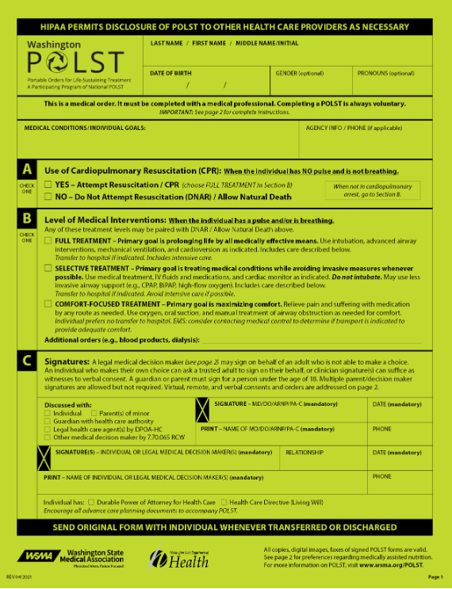
The POLST Form
Notes:
POLST stands for Portable Orders for Life-Sustaining Treatment.

Slide 12
What is the POLST form?
Easily identifiable
bright, lime green
Portable
goes with the individual from one care setting to another
Summary of treatment preferences
Easy to read in an emergency situation
Describes the individual’s care directions
Patient care preferences
Patient’s medical provider’s orders
Notes:
The POLST form is an easily identifiable, bright, lime-green form that provides a short summary of treatment preferences and medical provider’s order for care that is easy to read in an emergency situation.
It contains information about the individual’s care directions, such as preferences for resuscitation, medical interventions including medication(s), and artificially administered nutrition.
It is portable because it is intended to go with the individual from one care setting to another using a single uniform document.

Slide 13
What does the POLST form do?
Allow patients and their medical providers to discuss and develop plans to reflect the individual’s end of life care wishes.
Assists medical providers in honoring the individual’s wishes for life-sustaining treatment.
Directs appropriate treatment by EMS personnel.
Notes:
The form is intended to:
Allow people and their medical providers to discuss and develop plans to reflect the individual’s end-of-life care wishes.
Assist medical providers in honoring the individual’s wishes for life-sustaining treatment.
Direct appropriate treatment by EMS Personnel

Slide 14
Who qualifies to utilize the POLST form?
Anyone can qualify for a POLST.
It must be signed by the individual’s medical provider.
It is most relevant to those with a serious health condition or those who would like to place limitations on the emergency medical care they may receive.
Notes:
Completing a POLST form is an individual’s choice. It is voluntary.

Slide 15
What is required for the POLST form to be valid?
Patient’s name
Patient’s date of birth
Patient’s or legal medical decision maker’s signature and date
Medical provider signature date
ALL copies, digital images, and faxes of completed and signed POLST forms are valid
Notes:
In order to be valid, the POLST form must contain the individual’s name, date of birth, date, and the person’s or legal medical decision maker’s signature. Verbal consent for the individual’s signature may be documented by a clinician.
The POLST form must be signed and dated by the medical provider. A verbal order for the medical provider’s signature may be recorded.
All copies, digital images, and faxes of signed POLST forms are valid.

Slide 16

Where is a POLST form used?
Everywhere.
The completed POLST form is a medical provider order form that remains with an individual when transported between care settings, regardless of whether the setting is a person’s home, a long-term care facility, or a hospital.
Notes:
Because the form stays with the patient and is transported between care settings, a POLST form could be used anywhere the patient is.

Slide 17
How is the POLST form transferred?
The original form remains in the possession of the patient.
Original, photocopies, digital images, and faxes of signed POLST forms will be honored.
Duplicated copies may be placed in the patient’s chart upon discharge or before interfacility transports.
HIPAA permits disclosure of POLST to other healthcare providers as necessary.
Notes:
The POLST form is transferred between healthcare settings.
The original form, which is bright lime-green, is preferred, but photocopies, digital images, and faxes of signed POLSTs will be honored.
Institutions may wish to keep a duplicated copy in the permanent medical record upon discharge or before inter-facility transports.
HIPAA permits the disclosure of POLST to other healthcare providers as necessary.

Slide 18
Who keeps the POLST form & where is it kept?
In the Home:
At a medical facility:
Kept by the patient
Placed in a prominent location:
  Next to the front door
  On or in the refrigerator
  Look for a Vial of Life or other container
Kept by the facility staff
Placed in the patient’s medical chart
18
Notes:
Who keeps the POLST form and where will it be located?
In the home, the individual keeps the POLST form in a prominent location:
- Next to the front door
- On or in the refrigerator
- Look for a Vial of Life or another container
When staying in a medical facility, the POLST form will be kept by the facility in the individual’s medical chart along with other medical orders.

Slide 19
Revocation of the POLST form
A POLST form may be revoked by:
  The individual verbally revoking the order
  The individual destroying the form
  The individual drawing a diagonal line or the word VOID across the front of the form
  The medical providers by expressing the patient’s revocation of the order
  The legal medical decision maker

Slide 20
An individual’s wish to withhold resuscitation should always be respected.

Slide 21

A Special Situation:
When the family vigorously and persistently insists on CPR, even if a valid POLST order is located:
Attempt to convince the family to honor the individual’s decision to withhold CPR. If the family persists, then;
  Initiate resuscitation efforts until relieved by advanced level providers.
  Continue treatment and consult medical control.
Notes:
An individual’s wish to withhold resuscitation should always be respected.
Sometimes, however, the family may vigorously and persistently insist on CPR even if a valid POLST order is located. These verbal requests are not consistent with the individual’s directive. However, in such circumstances:
Try to convince family to honor the individual’s decision to withhold CPR. If family persists, then;
Initiate resuscitation efforts until relieved by advanced level providers (AEMT’s and/or Paramedics, for EMRs and EMTs)
EMS personnel should continue treatment and consult medical control.

Slide 22
Other valid resuscitation orders
Verify the order has a medical provider signature requesting “Do Not Resuscitate.”
Verify the presence of the individual’s name on the order.
Contact on-line medical control for further consultation.
Notes:
Sometimes healthcare facilities prefer to use their own health care resuscitation orders.
When EMS providers see other resuscitation orders, they should do the following:
Verify that the order has a medical provider signature requesting Do Not Resuscitate.
Verify the presence of the individual’s name on the order.
Contact on-line medical control for further consultation.
In most cases, on-line medical control will advise withholding CPR following verification of a valid medical provider-signed DNR order.
If there is any question on the validity of a form, CPR should be started.

Slide 23
Next Steps
Always refer to local protocols

Slide 24
Providing Comfort Care
Manually open the airway.
Clear the airway of secretions with an appropriate suction device.
Provide oxygen via nasal cannula at 2-4 liters per minute.
Positioning for comfort.
Splinting.
Controlling bleeding.
Providing pain medications pertinent to the level of certification/licensure.
Provide emotional support to the individual and family
Always refer to local protocols
Notes:
Comfort care measures for the dying individual may include:
Manually open the airway. Do not provide positive pressure ventilation with a bag valve mask, pocket mask, or endotracheal tube.
Clear the airway, including stoma, of secretions using an appropriate suction device.
Provide oxygen via nasal cannula at 2-4 liters per minute.
Positioning for comfort
Splinting
Controlling bleeding
Providing pain medications pertinent to the level of certification/licensure.
Provide emotional support to the individual and family.
Contact the individual’s physician or on-line medical control if directed by local protocols or if questions or problems arise.

Slide 25
Run report documentation
Complete
Complete a medical incident report form.
Identify
Identify the individual as having a valid POLST form.
Follow
Follow your local MPD protocols for individuals who have died.
Notes:
All individual contacts must be properly documented.

Slide 26
Support grieving family members
Once a death has occurred, the family and relatives become your patients.
Notes:
You may be done providing care to your patient, but if they have passed away, the family and relatives have now also become your patients.

Slide 27
When you end a resuscitation, you gain a new set of patients:
The grieving family.
Notes:
It’s not a pleasant job to tell someone that his or her relative has died from cardiac arrest. Although telling relatives about a death is an important issue in emergency care, it has not received much practical attention. Initial contact with the family has a strong effect on how its members respond to grief. Bad news conveyed in an inappropriate, incomplete, or uncaring manner may have long-lasting psychological effects on a family.
As a rescuer, one of the hardest switches in emergency medicine is to move from the inability to achieve ROSC to dealing with a family in shock from sudden grief. Rescuers go from the technical aspects of directing a resuscitation – a no-time-for-feelings situation – to the post-resuscitation situation where feelings, thoughts, and empathy for loss begin a grief reaction. Feelings of failure, sadness, and inadequacy may make it difficult to initially support and counsel the patient’s family.
In the next several slides, we will cover 18 tips for how best to tell the worst news.
NOTE: Excerpts in this section are from: Emergency Cardiac Care Committee and Subcommittees, American Heart Association, Guidelines for Cardiopulmonary Resuscitation and Emergency Cardiac Care, I: Introduction. JAMA. 1992, 68:2172-2183

Slide 28
How best to tell the worst news
One EMS provider on the team takes the lead.
Get yourself ready.
Gather information about the death.
Find a quiet location.
Get physically lower.
Nonverbal actions speak louder than words.
Notes:
One EMS provider on the team takes the lead. Decide quickly who might be most effective for these particular circumstances.
Get yourself ready. Recognize that you may be discouraged or overwhelmed. Take a deep breath and do what has to be done.
Gather information about the death. Obtain as much information as possible about the patient and the circumstances surrounding the death. Carefully go over the events as they happened:
Medical history
The event itself
Relationship between patient and survivor
Find a quiet location. When not in an enclosed building, be sure the location is a safe distance from hazards. Normal reactions to extreme grief can include involuntary physical responses such as walking or running about.
Get physically lower. If possible, sit down or have the family members sit down and kneel next to them.
Nonverbal actions speak louder than words. Make eye contact with the person closest to you. If there are several people, be sure to make eye contact with each of them during the conversation. Make eye contact, touch when appropriate.

Slide 29
How best to tell the worst news
Listen, and be still.
Use physical touch when appropriate.
Briefly review the history and circumstances.
Use the word “death” or “dead.”
Expect any reaction and allow time to express anguish.
Convey sympathy for a grieving family.
Notes:
7. Listen and be still. Silent reactions are fine. Don’t endlessly chatter. Answer questions.
Use physical touch if someone reaches out to you first.
Briefly review the history and circumstances. Allow as much time as necessary for questions and discussion. Review the events several times to ensure everything is understood and to facilitate further questions.
Use the word “death” or “dead.” Such simple terms are clear. Euphemisms are easily misunderstood. Avoid euphemisms such as “he’s passed on,” “she is no longer with us,” or “he’s left us.” Instead, use the words “death,” “dying,” or “dead.”
Expect any reaction and allow time to express anguish. Normal reactions to a loved one’s death range through a variety of physical, mental, and behavioral responses. Silent reactions are fine. Allow time for the shock to be absorbed.
Convey sympathy for a grieving family, but don’t let it sound like an apology. Convey your feelings with phrases such as “You have my (our) sincere sympathy,” or, “We are sorry for your loss.”

Slide 30
How best to tell the worst news
Find someone to be with them during this time.
Offer an opportunity to say goodbye to their loved one.
Tell them the plan for disposition of the body.
Ask if they have any questions. Answer them directly.
Don’t lie.
Leave clear information about follow-up contacts.
Notes:
Find someone to be with them during this time. Do they want you to call a neighbor, family member, clergyman, or chaplain?
Offer an opportunity to say goodbye to their loved one. Use a phrase such as, “Would you like to say goodbye to George, and see him now?” If equipment is still connected, let the family know.
Tell them the plan for disposition of the body. What is going to happen next? Know in advance what happens next and who will sign the death certificate. Physicians may impose burdens on staff members and family if they fail to understand policies about death certification and disposition of the body. Know the answers to these questions before meeting with the family.
Ask if they have any questions. Answer them directly. Use simple sentences. People in crisis may have trouble understanding complex messages.
Don’t lie to them. This is especially important when a crime scene is involved or an autopsy will be performed.
18. Leave clear information about follow-up contacts for the family for when you have gone, such as for a social worker, counselor, or chaplain. Enlist the aid of a social worker or chaplain if not already present. If time allows, offer to contact the patient’s physician and remain available if there are further questions.
The community thinks of EMS personnel as superhuman rescuers who can work miracles in brief periods. Expectations about what EMTs and paramedics can do for the surviving relatives are frequently unrealistic. In the short period after resuscitation efforts, rescuers can do little more than set into motion a normal grief reaction. EMS providers must prepare for the next emergency. The most important task is to mobilize personal and community resources for those plunged into sorrow by the unexpected loss of a loved one.

Slide 31
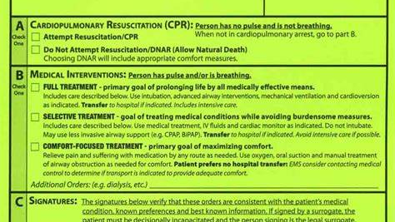
POLST FORM CONTENTS
Notes:
We are going to walk section by section through the POLST form. The examples are in black and white for ease of reading on the screen, but an original POLST form will be bright, lime green.

Slide 32
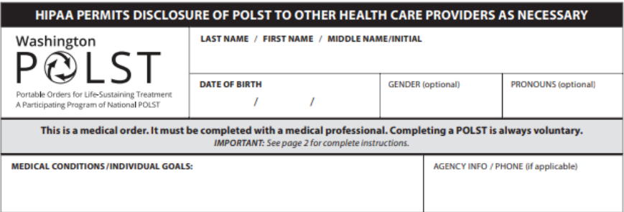
Individual Information
Notes:
This section must be completed with the individual’s name and date of birth. The gender and pronoun sections are optional.

Slide 33
Medical Conditions/Patient Goals
Notes:
Medical Conditions/Individual Goals section is used to give more context or details about the patient.
Before moving on to the next sections, please note that:
If the individual requires treatment, the caregiver should first initiate any treatment orders recorded on the POLST, and then contact the attending medical provider.
Any order section that is not completed indicates that full treatment should be provided for that section until clarification is obtained.

Slide 34
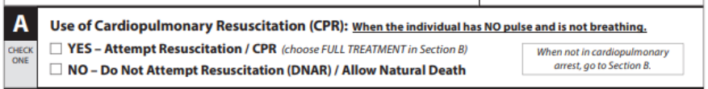
Section A – Cardiopulmonary Resuscitation (CPR)
Notes:
Section A: Use of Cardiopulmonary Resuscitation (CPR).
This section gives guidance on what to do if the patient has no pulse and is not breathing.
If the individual WANTS CPR, the Yes - Attempt Resuscitation/CPR box is checked.
If the individual DOES NOT WANT CPR, the No - Do Not Attempt Resuscitation/DNAR (Allow Natural Death) box is checked. Resuscitation should not be attempted.
Comfort measures will always be provided, even when DNAR has been selected.
If the patient is not in cardiopulmonary arrest, go to section B.

Slide 35
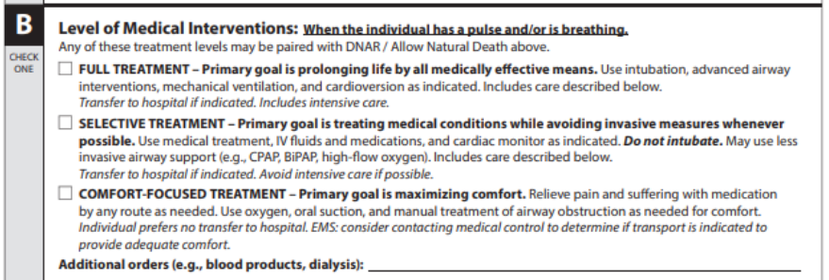
Section B: Level of Medical Interventions
Notes:
Section B: Level of Medical Interventions
This section is used when the individual has a pulse and/or is breathing.
After providing the appropriate treatments at the indicated level, healthcare providers should then contact the attending medical provider or online medical control.
Full Treatment – Primary goal is prolonging life by all medically effective means. Use intubation, advanced airway interventions, mechanical ventilation, and cardioversion as indicated. Transfer to hospital if indicated. Includes intensive care.
Selective Treatment – Primary goal is treating medical conditions while avoiding invasive measures, whenever possible. Use medical treatment, IV fluids, and cardiac monitor as indicated. Do not intubate. May use less invasive airway support such as CPAP, BiPAP, or high-flow oxygen. Transfer to hospital if indicated. Avoid intensive care if possible.
Comfort-Focused Treatment – Primary goal is maximizing comfort. Relieve pain and suffering with medication by any route as needed. Use oxygen, oral suction and manual treatment of airway obstruction as needed for comfort. Individual prefers no hospital transfer. EMS providers should consider contacting medical control to determine if transport is indicated to provide adequate comfort.
Additional orders, such as those regarding blood products or dialysis, may be listed and considered.
Comfort care is always provided regardless of indicated level of EMS treatment.

Slide 36
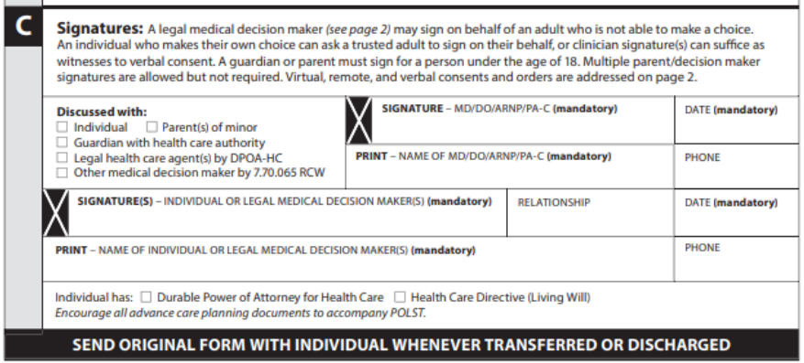
Section C: Signatures
Notes:
Section C: Signatures
The following are required for the POLST form to be valid:
- A medical provider printed name, signature, and date.
- Patient or legal medical decision maker’s signature and date.
Note:
A legal medical decision maker may sign on behalf of an adult who is not able to make a choice. An individual who makes their own choice can ask a trusted adult to sign on their behalf, or clinician signature(s) can suffice as witnesses to verbal consent. A guardian or parent must sign for a person under the age of 18. Multiple parent/decision maker signatures are allowed but are not required. Virtual, remote, and verbal consents and orders are addressed on page 2 of the form.
Legal healthcare agent refers specifically to a person named by DPOA-HC, as outlined in RCW 7.70.06
The relationship box is to clarify the relationship between the individual and their legal medical decision maker
Telephone order signatures are valid.

Slide 37
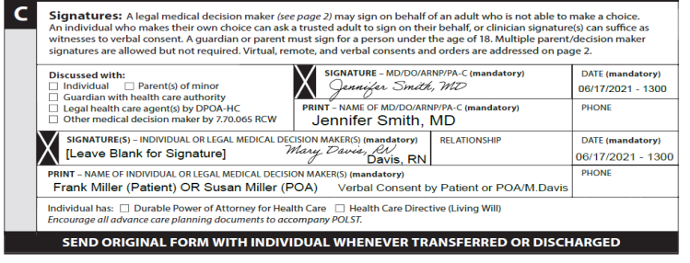
Example of Signature Box
Notes:
Signatures for verbal and telephone orders may vary depending on organizational policies. Follow local protocols and contact medical control as needed.
Here’s an example of verbal consent by patient or legal medical decision maker.
Note where it states verbal consent by patient or PAO/M Davis

Slide 38
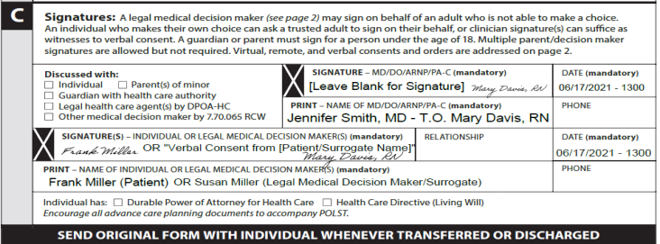
Example of Signature Box #2
Notes:
This example shows a verbal consent of telephone orders from a signing physician.

Slide 39
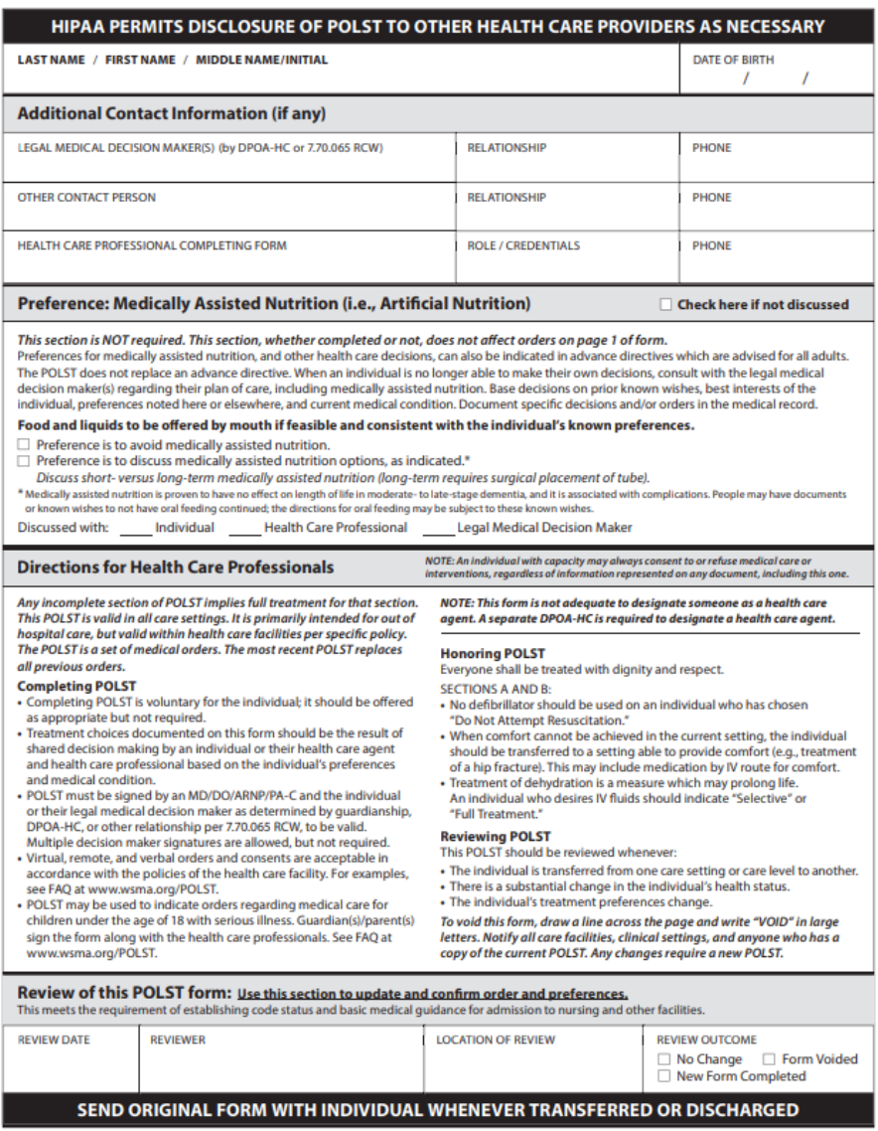
Page 2 - for EMS awareness
Notes:
Page 2 – Non-Emergency Transport Medical Treatment Preferences (NOT APPLICABLE TO EMS CARE) – For EMS Awareness
Individual information
This section is completed with the individual’s name and date of birth.
Additional contact information, if any.
This section provides space for additional contact information and is optional.
Preference: Medically Assisted Nutrition (i.e., artificial nutrition)
This section is NOT required.
This section, whether completed or not, does not affect the orders on page 1 of the form.
Preferences for medically assisted nutrition, and other healthcare decisions, can also be indicated in advance directives which are advised for all adults.
The POLST form does not replace an advanced directive.
Additional areas on the form include:
Directions for healthcare professionals, such as how to complete, use, and review the POLST form
Documentation area for POLST form review.

Slide 40
Review of Patient Care & Treatment
Notes:
Providers should refer to their local protocols for medical direction, as they may differ some from the example provided in the curriculum.

Slide 41
Determining resuscitation status
Look for a Valid POLST form, or other healthcare resuscitation order form.
    If in a home setting, look for a POLST form next to the front door, on or in the refrigerator, or look for a Vial of Life.
    If in an extended or intermediate care facility, look for the resuscitation form in the patient’s chart.
When a form is located, verify it is complete with the patient’s information and appropriate signatures.
Contact medical control for further consultation as needed
Notes:
You will determine your patient’s resuscitation status by verifying the patient has a valid POLST or other healthcare resuscitation order form.
Look for a POLST form next to the front door, on or in the refrigerator, or in a Vial of Life.
If the patient is in an extended or intermediate care facility, look for the resuscitation form in their chart.
The Washington State Department of Health encourages medical facilities to use the POLST form, however, some healthcare facilities prefer to use their own healthcare resuscitation orders. If you encounter an order form that is not the POLST form, verify the presence of the individual’s name on the order and that the order has a medical provider signature requesting “Do Not Resuscitate.”
If a non-POLST form is used, or if there are questions concerning validity of the POLST form, contact on-line medical control for further consultation. In most cases, on-line medical control will advise to withhold CPR following verification of a valid physician-signed resuscitation order.
If validity cannot be determined, begin resuscitation efforts.

Slide 42
Valid resuscitation orders on hand:
POLST:
Provide resuscitation based on the individual’s wishes identified on the form.
Provide medical interventions identified on the form.
Always provide comfort care.
Other Resuscitation Orders:
Contact medical direction.
Follow specific orders in the resuscitation order as appropriate to your provider certification level.
Notes:
You’ve determined the patient has valid resuscitation orders on hand. Now what?

Slide 43
Exceptions
Do not initiate resuscitation measures when the patient is determined to be obviously dead:
  Decapitation
  Evisceration of the heart or brain
  Incineration
  Rigor mortis
  Decomposition
  Dependent lividity
If, in your medical judgment, you determine your patient has attempted suicide or is a victim of a homicide, begin resuscitation.
43
Notes:
Even if resuscitation is desired per the POLST form, do not initiate resuscitation on an obviously dead patient, such as those who, in the absence of respiration and cardiac activity, have experienced one or more of the following:
- Decapitation
- Evisceration of the heart or brain
- Incineration
- Rigor mortis
- Decomposition
- Dependent lividity.
If in your medical judgment, you determine your patient has attempted suicide or is a victim of a homicide, begin resuscitation. Follow local protocols and contact medical control as needed.

Slide 44
Stopping resuscitative efforts for DNR/DNAR Status
Once you are aware of a valid DNR/DNAR status, stop the following treatment measures:
  Basic CPR
  Intubation
  Cardiac monitoring and defibrillation
  Administration of resuscitation medications
  Any positive pressure ventilation
Notes:
If resuscitative efforts were started before learning of a valid DNR/DNAR order, stop these treatment measures:
Basic CPR
Intubation – do not remove the endotracheal tube. Instead, leave it in place but stop any positive pressure ventilations.
Cardiac monitoring and defibrillation
Administration of resuscitation medications
Any positive pressure ventilation

Slide 45
Revoking the resuscitation order
The following individuals can inform the EMS system that the DNAR order has been revoked:
  The patient
  The patient’s physician
  The legal medical decision maker for the patient
Notes:
The EMS system may be notified by the following individuals that a POLST or other resuscitation order has been revoked:
The patient – verbally, by destroying the form, by drawing a diagonal line across the form or writing the word VOID across the front of the form.
The patient’s physician by expressing the individual’s revocation of the directive.
The legal medical decision maker for the patient, expressing in-person the individual’s revocation of the directive.
Other relatives or friends of the individual may not revoke the POLST form.
An individual’s wish to withhold resuscitation should always be respected.
Sometimes, however, the family may vigorously and persistently insist on CPR even if a valid POLST order is located. These verbal requests are not consistent with the individual’s directive. However, in such circumstances:
Try to convince family to honor the individual’s decision to withhold CPR. If family persists, then;
Initiate resuscitation efforts until relieved by advanced level providers (AEMT’s and/or Paramedics, for EMRs and EMTs)
EMS personnel should continue treatment and consult medical control.

Slide 46
Next Steps
Provide comfort care
Conduct an ongoing assessment as appropriate
Transport if necessary
Support grieving family members
Document, Document, Document
Always follow local protocol

Slide 47

EMS Provider Mental Health
Seek help if needed.
Take time for yourself.
Breathe.
Meditate.
Make your mental health a priority.
Find healthy coping mechanisms.
We are not invincible, even if we are superheroes.
Notes:
Coping with loss is difficult for all humans, whether it is the loss of a loved one or the loss of a patient. For many EMS providers across Washington State, we work or volunteer in the communities we live in, often responding to our neighbors or other people we are close to.
So final thoughts here, that are not included in the actual curriculum but should be on the forefront, always:
Your health is important. We often put great emphasis on our physical health, but less focus on our mental health.

Slide 48

Any Questions?

Slide 49
Thank you to Mason County EMS for the assistance with creating this presentation

Slide 50
To request this document in another format, call 1-800-525-0127. Deaf or hard of
hearing customers, please call 711 (Washington Relay) or email doh.information@doh.wa.gov.

