Slide 1

Update: Implementation of Opioid Prevention and Treatment Initiatives
ACH, Tribe and State Opioid Collaboration Project
September 14, 2018

Slide 2



Presenters
Jason McGill, JD
______
Senior Policy Advisor
Kathy Lofy, MD
_____
State Health Officer
Charissa Fotinos, MD, MSc
______
Deputy Chief Medical Officer,
Clinical Quality and Care Transformation
Caleb Banta-Green,
PhD MPH MSW
_____
Interim Director
&
Principal Research Scientist

Slide 3
Overview
Jason McGill Caleb Banta-Green
Senior Policy Advisor Interim Director and Principal Research Scientist
Governor’s Office UW ADAI

Slide 4
Overview: Our State Opioid Prevention and Treatment Initiatives
Overview
Dr. Kathy Lofy, Chief State Health Officer, Dept. of Health
Dr. Charissa Fotinos, Deputy Chief Medical Director, Health Care Authority
Dr. Caleb Banta-Green, Interim Director & Principal Research Scientist, UW ADAI

Slide 5
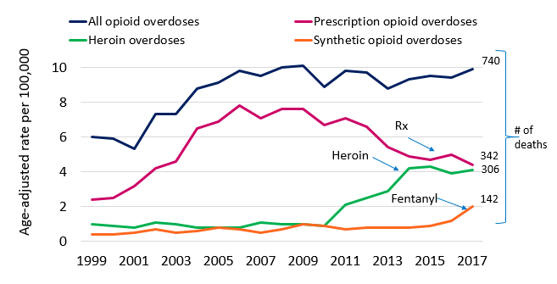

Opioid-Related Overdose Deaths 2000–2017*
Earlier this year we saw an overall decline – but now we are experiencing an increase driven by synthetic opioids/ Fentanyl – much of it is probably illicit/ counterfeit.
Good news: We are experiencing a nearly 50%, now sustained, decline in Rx use.
Source: DOH Death Certificates (Note: prescription opioid overdoses exclude synthetic opioid overdoses)
*Data for 2017 are preliminary as of 8/23/2018.

Slide 6
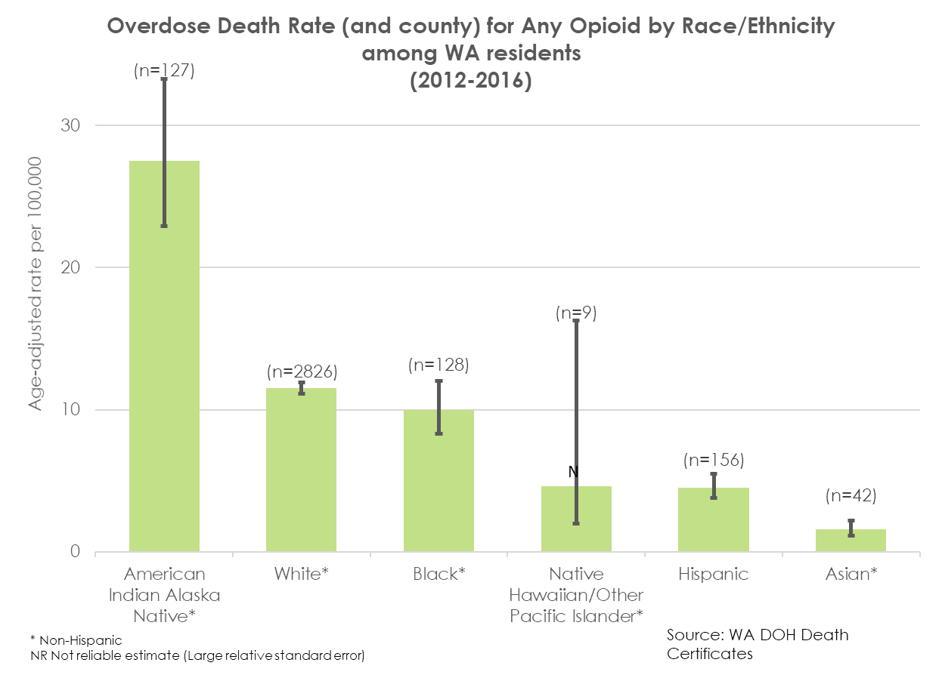
Significant disparities exist

Slide 7
Opioid-Related Disease Burden in Washington
Deaths
740
Opioid Overdose Hospitalizations
1,615
Opioid Substance Abuse
Treatment Admissions
14,389
Persons 12+ years who misused pain-relievers
in the past year
324,000
Opioids involved in an overdose death listed as underlying cause of death. Washington preliminary death certificate data, 2017.
Washington Hospital Discharge Data, Comprehensive Hospitalization Abstract Reporting System (CHARS), 2017.
Treatment and Assessment Report Generation Tool, 2015.
National Survey on Drug Use and Health, 2015-2016.

Slide 8
Strong State Opioid Response Plan/Executive Order – Plan Just Updated
Priority Goals
Goal 1: Prevent opioid misuse & abuse | Goal 2: Treat opioid use disorder | Goal 3: Reduce morbidity & mortality | Goal 4: Use data to monitor & evaluate
We still have gaps:
Prevention
  Schools
  Public Health
Treatment
  Pregnant and parenting women
  People who are justice involved
  Community behavioral health system
3. Recovery supports
Prevent misuse in youth & improve prescribing practices | Expand access to treatment | Distribute naloxone to heroin users | Optimize and expand data sources
Priority Actions
Source: https://www.doh.wa.gov/YouandYourFamily/PoisoningandDrugOverdose/OpioidMisuseandOverdosePrevention

Slide 9
Key Action Items Stemming from State Plan
Task | Lead | Partners | Expected Outcome | Status | Due Date
Implement HB 1427 Develop prescribing rules Use PMP data to improve prescribing | DOH / B&Cs | Agency Medical Directors’ Groups | New pain rules, Prescribing reports | In Progress | This Fall
Implement State Targeted Response grant (18 projects); new State Opioid Response grant & State funding Expand Hub & Spoke Implement public education campaign | DSHS | HCA UW ADAI DOC DOH | Improved access to treatment and decrease overdose deaths | In Progress; Hub and spokes statewide; public campaign begun | STR grant ends April 2019; SOR grants begins soon
Implement Prescription Drug Overdose grant Provide overdose education Purchase/distribute naloxone | DSHS | UW ADAI DOH | Increased use of naloxone use by first responders and the public | In Progress | Grant ends Sept 2021
Criminal Justice Work Group and develop work plan | DSHS | CJ, DOC, AG, Jails, HIDTA, ADAI, Juvenile Justice | Increased use of evidence-based treatment | Plan completed; working on leg. & DP | Potential policy & 2019-21 Budget
Support Accountable Communities of Health with opioid-related transformation projects | HCA | DSHS DOH | Increase MAT and decrease overdose deaths | In Progress | Plans due Nov 2017
Non-pharmacological treatment for pain (collaborative care; CBT/PT OT; chiropractic; acupuncture; massage etc.) | HCA | Professions, LNI | Literature review and assessment of evidence for recommendation for new services in Medicaid | Review finished; decision package | 2019-21 Budget
Notes:
John –
This list of high level action items are activities that have been planned and are being implemented by partners across this effort.
As you can see, some resources for our efforts are being provided by grants and legislation and many partners are working together to solve this issue.
However, for an issue this complex innovative solutions and unusual partnerships will be needed. The Executive Order set the stage for this work to happen. Now more must be done.

Slide 10
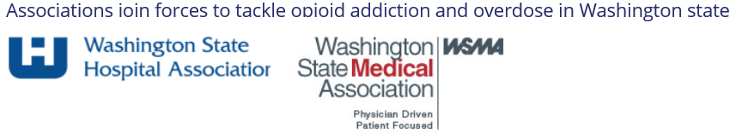
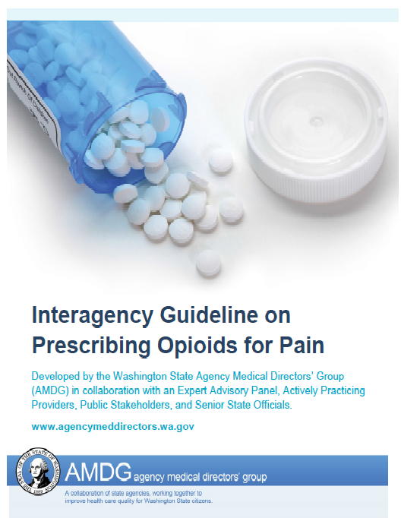



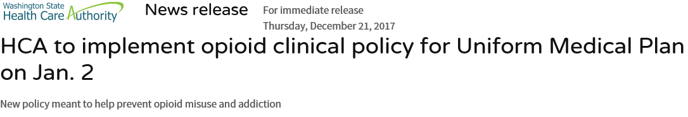
Years of Good Work in Our State re: Safe Opioid Prescribing and Reducing the Supply
Opioid prescribing rules
ER for emergencies initiative
Dental prescribing guidelines
Prescribing metrics
Provider feedback reports
Prescribing limits for Medicaid clients and for public employees
Raising awareness about non-opioid alternatives
Offering tele-pain consulting to providers
Launching youth prevention programs
Opioid criminal justice and drug/gang task forces
Legal action against opioid prescription manufacturer
Eliminating pill mills through regulation and enforcement
Notes:
John –
Washington has worked over the last 10 years to reduce the availability of opiods in 2 ways
1) Safe prescribing practices
2) Reducing the illegal supply of opiods
Work to improve Opiod prescribing practices has been ongoing for the last 10 years. We are lucky to have Dr Gary Franklin from LNI with us today. He was the first in the county to recognize deaths from prescription opioids in our injured workers and led the nation with the development of the first opioid prescribing guidelines.
Work currently underway includes:
Opiod prescribing rules are being written by state healthcare provider boards and commissions
Dental prescribing guidelines were recently developed and adopted by “The Bree Collaborative”, under Dr. Franklin’s leadership,. These guidelines prevent people from getting inappropriate prescriptions for opioids after dental procedures.
Measures on prescribing practices were developed and adopted by “The Bree collaborative”. These measures are being used by LNI, HCA and DOH to provide feedback reports to providers on their prescribing practices.
Medicaid is about to implement new prescription limits for opiods.
Coverage of non-opiod pain treatments by health plans is being encouraged by the Office of the Insurance commissioner, as is encouraging health plans to improve prescriber monitoring systems.
There is also work underway to reduce the illegal supply of opiods. Cross agency work is just starting in this area.
The Attorney General hosted a very successful summit in June and recently filed a lawsuit against Purdue Pharma for deceptive marketing of opiods.
DOH is funding a toxicologist at state toxicology lab so that seized illegal drugs can be tested for fentanyl more quickly. (optional) while this is reduced the backlog it can still take over 6 months for a sample to get tested. Demand for testing is still much higher than we can respond to.

Slide 11
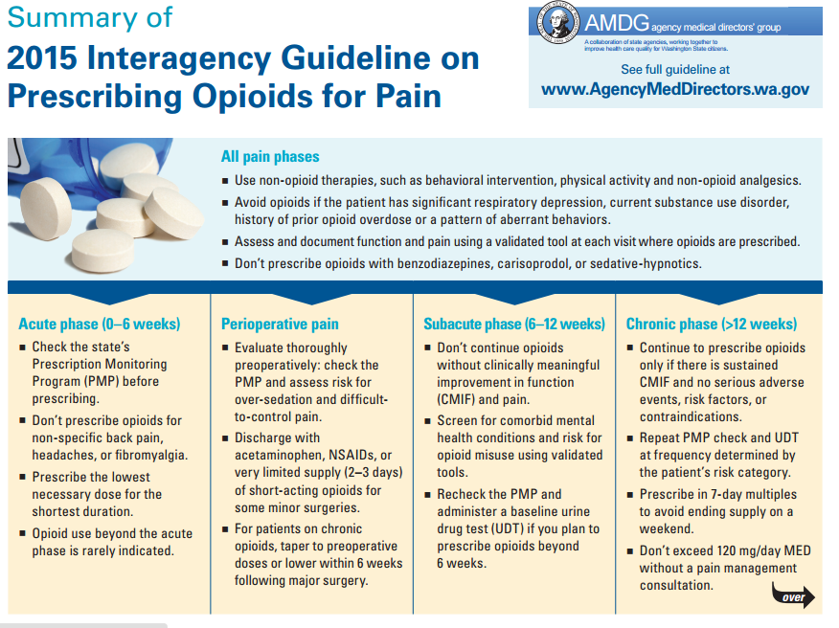

Slide 12
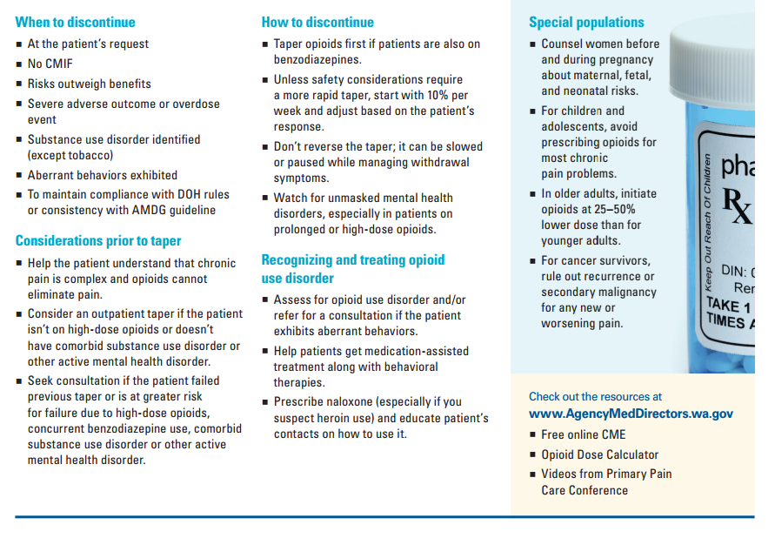

Slide 13
CDC Opioid Guidelines-March 2016
Determining When to Initiate or Continue Opioids for Chronic Pain
  1. Nonpharmacologic therapy and nonopioid pharmacologic therapy are preferred for chronic pain. Clinicians should consider opioid therapy only if expected benefits for both pain and function are anticipated to outweigh risks to the patient. If opioids are used, they should be combined with nonpharmacologic therapy and nonopioid pharmacologic therapy, as appropriate.
  2. Before starting opioid therapy for chronic pain, clinicians should establish treatment goals with all patients, including realistic goals for pain and function, and should consider how therapy will be discontinued if benefits do not outweigh risks. Clinicians should continue opioid therapy only if there is clinically meaningful improvement in pain and function that outweighs risks to patient safety.
  3. Before starting and periodically during opioid therapy, clinicians should discuss with patients known risks and realistic benefits of opioid therapy and patient and clinician responsibilities for managing therapy.

Slide 14
CDC Opioid Guidelines-March 2016
Opioid Selection, Dosage, Duration, Follow-Up, and Discontinuation
  4.When starting opioid therapy for chronic pain, clinicians should prescribe immediate-release opioids instead of extended-release/long-acting (ER/LA) opioids.
  5.When opioids are started, clinicians should prescribe the lowest effective dosage. Clinicians should use caution when prescribing opioids at any dosage, should carefully reassess evidence of individual benefits and risks when increasing dosage to ≥50 morphine milligram equivalents (MME)/day, and should avoid increasing dosage to ≥90 MME/day or carefully justify a decision to titrate dosage to ≥90 MME/day.
  6.Long-term opioid use often begins with treatment of acute pain. When opioids are used for acute pain, clinicians should prescribe the lowest effective dose of immediate-release opioids and should prescribe no greater quantity than needed for the expected duration of pain severe enough to require opioids. Three days or less will often be sufficient; more than seven days will rarely be needed.
  7.Clinicians should evaluate benefits and harms with patients within 1 to 4 weeks of starting opioid therapy for chronic pain or of dose escalation. Clinicians should evaluate benefits and harms of continued therapy with patients every 3 months or more frequently. If benefits do not outweigh harms of continued opioid therapy, clinicians should optimize other therapies and work with patients to taper opioids to lower dosages or to taper and discontinue opioids.

Slide 15
Why Consider Post-op Pill/Duration Recs?
The vast majority of pills prescribed post-op are left over and may be used for subsequent misuse or diversion
Voepel-Lewis et al, JAMA Pediatrics 2015; 169: 497-8-leftover pills in kids via parent diaries
  T&A 52 pills dispensed 44 pills left (day 4)
  MSK 34 pills dispensed 30 pills left
  Minor abd, 31 pills dispensed 28 pills left
  GU,periph proc
1 million opioid naïve patients undergoing surgery
Composite outcome dependence, abuse or overdose
Total duration of opioid use was the strongest predictor of misuse, with each refill and additional week of opioid use associated with an adjusted increase in the rate of misuse of 44.0%
Highest risk in 15-24 yr age group

Slide 16
Continued Use by Initial Days of Therapy MMWR March 17, 2017
Source: Shah et al. MMWR 2017 Mar 17;66(10):265-9

Slide 17
Acute Opioid Prescribing by Specialty
Source: DOH Prescription Monitoring Program Data

Slide 18
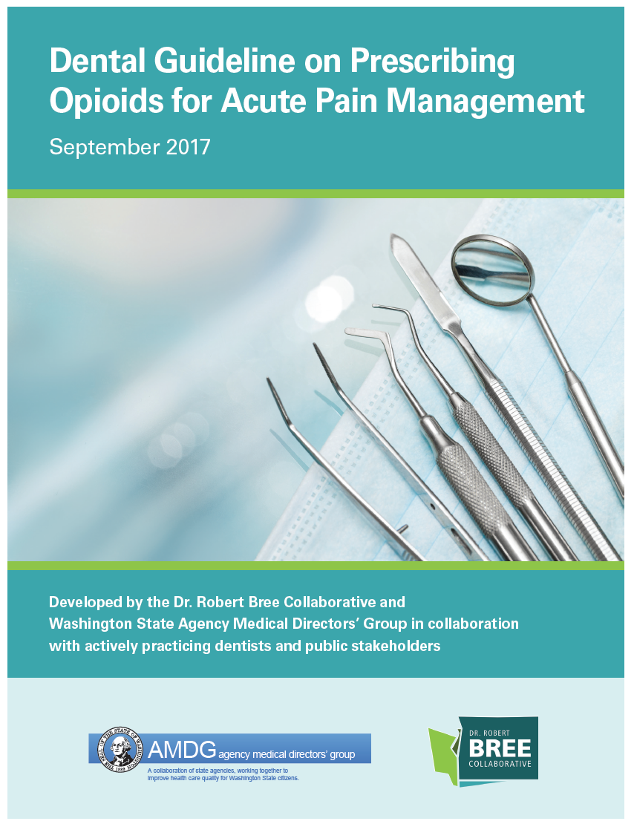

Slide 19

Bree/AMDG Dental Guideline Recommendations
Conduct a thorough history including dental and medical
Prescribe non-opioid analgesics as first line
Consider pre-surgical or pre-emptive medication
If an opioid is warranted, follow the CDC guideline (lowest effective dose of immediate-release opioids; ≤ 3 days will be sufficient)
  Limit to 8-12 tablets for adolescents and young adults through 24 years old
  Avoid opioids when patient/parent requests no opioid prescription or patient is in recovery and at high risk of relapse for SUD
Educate on appropriate use, duration and adverse effects of opioids and share information on disposal of leftover opioids
Support patients with SUD who are undergoing dental procedure

Slide 20
Washington Bree Opioid Metrics
General prescribing
Prevalence of opioid use | % with ≥1 opioid Rx of all enrollees, by age
Long-term prescribing
Chronic opioid use | % with ≥60 days supply of opioids in the quarter
High dose use | % with doses ≥50 and ≥90 mg/day MED in chronic opioid users
Concurrent use | % with ≥60 days supply of sedatives among chronic opioid users
Short-term prescribing
Days supply of first Rx | % with ≤3, 4-7, 8-13, and ≥14 supply among new opioid patients
Transition of chronic use | % new opioid patients transitioning to chronic use the next quarter
Morbidity and Mortality
Opioid overdose deaths | Rate of overdose deaths involving opioids
Non-fatal overdoses | Rate of non-fatal overdoses
Opioid use disorder | Rate of opioid use disorder among patients with ≥3 quarters of use

Slide 21
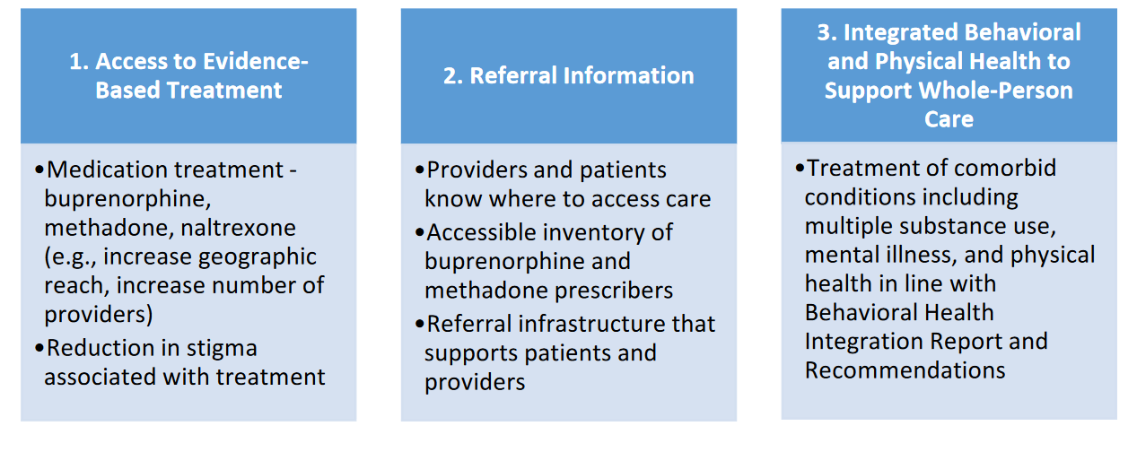
WA Bree Opioid Use Disorder Treatment Recommendations

Slide 22
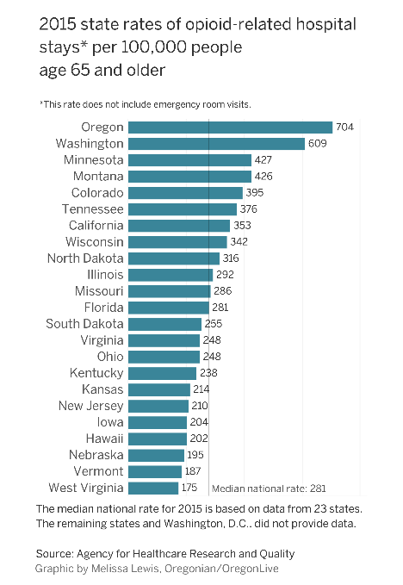
A Note about Prescribing Opioids in Older Adults
Goal – Reduce risk of falls
  Follow same best practices for prescribing opioids (AMDG)
  Prescribe immediate-release opioids at the lowest effective dose (AMDG)
    Initiate opioid therapy at a 25% to 50% lower dose than that recommended for younger adults. Source: AHRC

Slide 23


Efforts Working to Reduce Rx:
Painkiller Use Down by 8th, 10th, 12th Graders
1.2.A.i: Decrease the rate of Opioid overdose deaths from 9.8 per 100,000 in 2015 to 9.0 in 2020
Q.
Use a painkiller to get high, like Vicodin, OxyContin or Percocet, in last 30 days?
Source: WA State Healthy Youth Survey provided by BHA-DSE
Notes:
Michael –
Rates of use appear to be dropping in 8th, 10th and 12th graders. Which is great news, and may be showing the effect of our prevention strategies.
The chart shows that use has been reduced by one-half across all grades since 2006. The 8th grade use was at 4% in 2008, and 2% in 2016. The 10th grade use was at 10% in 2006, and 4% in 2016. The 12th grade use was at 12% in 2006, and 5% in 2016.
Although we don’t collect 30 day heroin use on the HYS, lifetime use by 8th, 10th and 12th grades is 4% or less.
These reductions are thought to be attributed not only to youth prevention efforts, but also to the greater expense in buying pain killers on the street. These costs are likely to climb as the Prescription Drug Monitoring Program comes into full implementation across the state. There is emerging evidence that people addicted to pain relievers will turn to obtaining and using heroin, which is considerably less expensive.
We are also happy to report that rates of heroin and prescription pain killer abuse are also dropping among young adults ages 18-25 years old according to our statewide young adult survey. (this is different than heroin related overdose deaths)

Slide 24
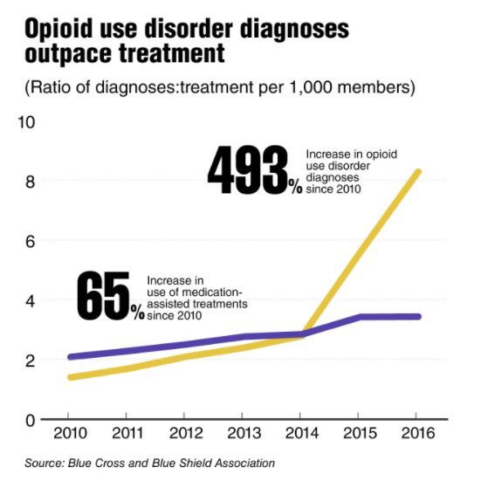
Our Focus Now Is Treatment & Recovery
Data shows more treatment is needed
What is effective opioid treatment?
How are we addressing access to treatment?

Slide 25

1.2.A.i: Decrease the rate of Opioid overdose deaths from 9.8 per 100,000 in 2015 to 9.0 in 2020
Treatment Coverage for Medicaid Clients With Opioid Use Disorder
by Accountable Communities of Health, 2016, Shows Significant Gap
SOURCE: Health Care Authority Provider One
Notes:
Charissa -

Slide 26

Many People in Washington Are Not
Getting Treatment
1.2.A.i: Decrease the rate of Opioid overdose deaths from 9.8 per 100,000 in 2015 to 9.0 in 2020
How interested are you in reducing or stopping your opioid use?
What types of help would you want if they were easy to get?
56% medication treatment
39% detox
34% individual counseling for addiction
Source: UW Alcohol and Drug Abuse Institute, WA State Drug Injector Health Survey, 2017
Notes:
Charissa –
Many more people would like treatment than are currently getting it.
56% would like methadone, buprenorphine or naltrexone treatment
39% would like detox
34% would like 1:1 counseling for addiction

Slide 27
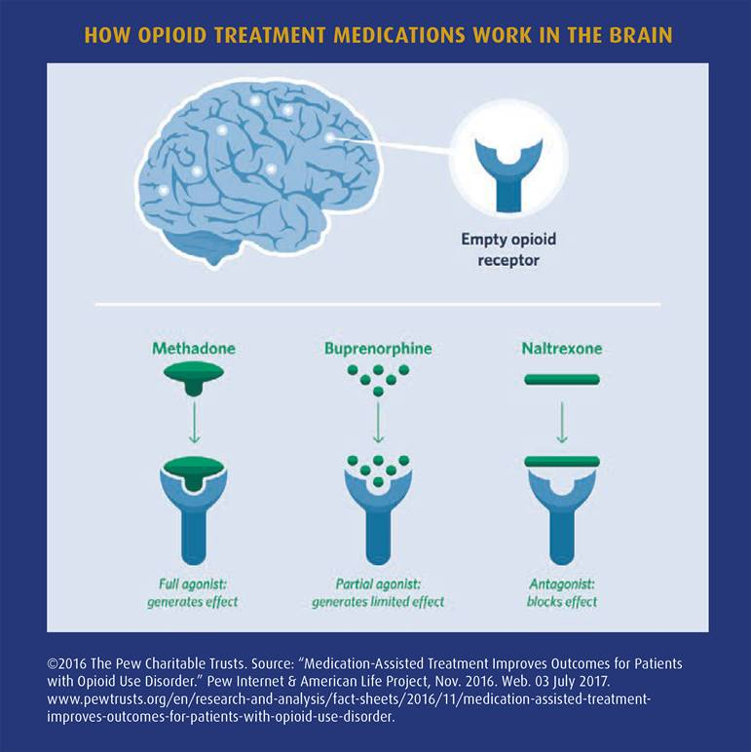
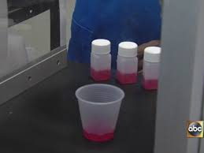
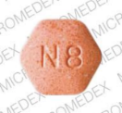
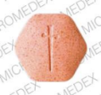
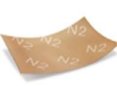
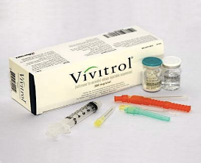
What Is Medication for Opioid Use Disorders?
1.2.A.i: Decrease the rate of Opioid overdose deaths from 9.8 per 100,000 in 2015 to 9.0 in 2020
Methadone
Delivered by Opioid Treatment
Providers (OTPs)
Buprenorphine
Delivered by providers in
office-based practice & OTPs
Naltrexone
Delivered by providers in
office-based practice
Notes:
Charissa –

Slide 28

How Are We Addressing Access to Treatment?
Answer: WA State Hub and Spoke Opioid Treatment Network
Nurse care manager helps
patients and providers
coordinate care, reduce barriers
and, improve overall health
Spokes - Clinic
Treatment Med. Maintenance
Priority populations: Pregnant and parenting women & justice involved
REFERRALS FROM
Community outreach staff
Spokes - SES
Treatment Med. Maintenance
Hubs
Treatment Med.
Induction & Stabilization
REFERRALS FROM
Recovery Helpline
Spokes – Mobile unit
Treatment Med. Maintenance
Treatment decision making- ongoing
Care navigation- ongoing
Caleb Banta-Green calebbg@uw.edu 09/12/17, adapted

Slide 29
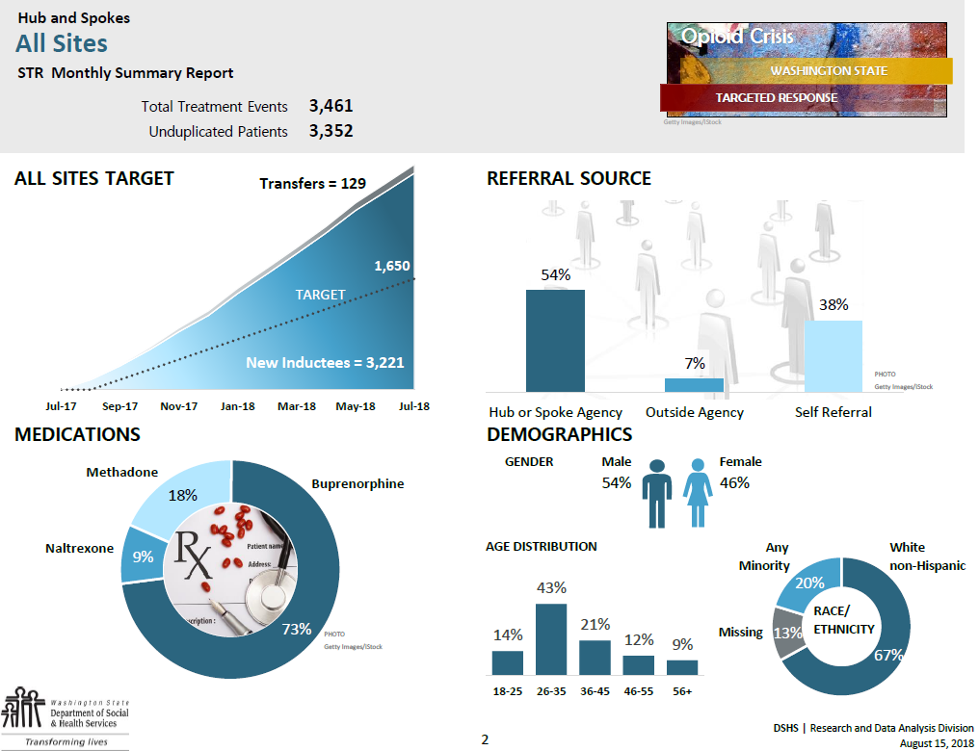
Federal required metrics show that our Hub and Spoke Opioid Treatment Networks are outperforming goals.
Over 3,221 people in treatment
Proof of concept proven – we must expand statewide
Full report available

Slide 30
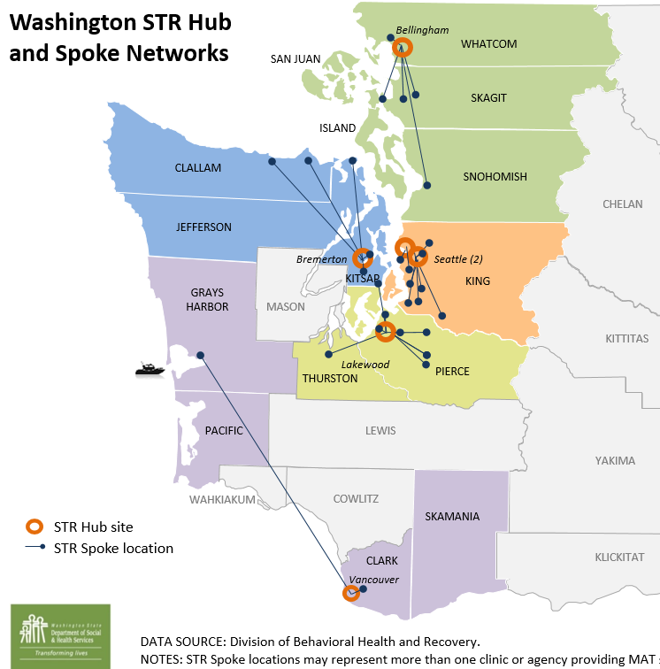
Current
Future expansion
Legislature expanded Hub and Spoke Opioid Treatment Networks to Cover Entire State
Contracts are near final for 5 new Hubs, each with a minimum of 5 spokes
New Hubs include:
  Comprehensive Healthcare – Yakima
  Ideal Option – Everett
  MultiCare Health System – Spokane
  Olympic Peninsula Health Services – Port Hadlock
  Providence NE Washington Medical Group – Colville

Slide 31
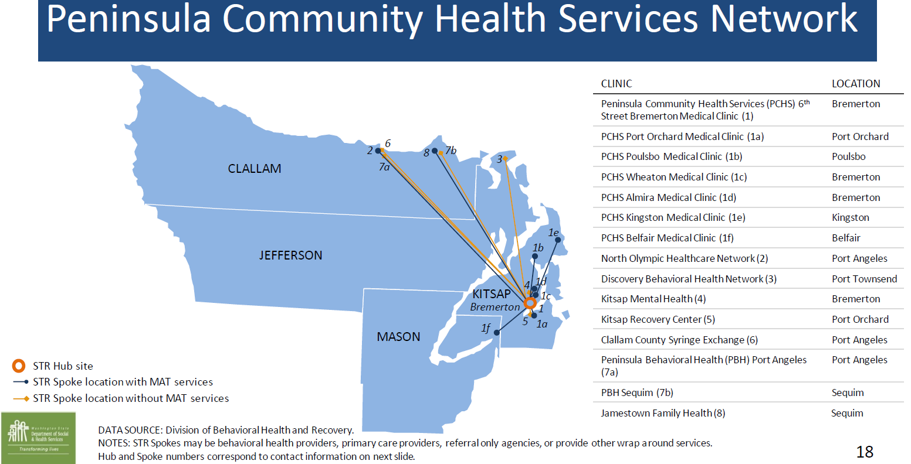

Slide 32
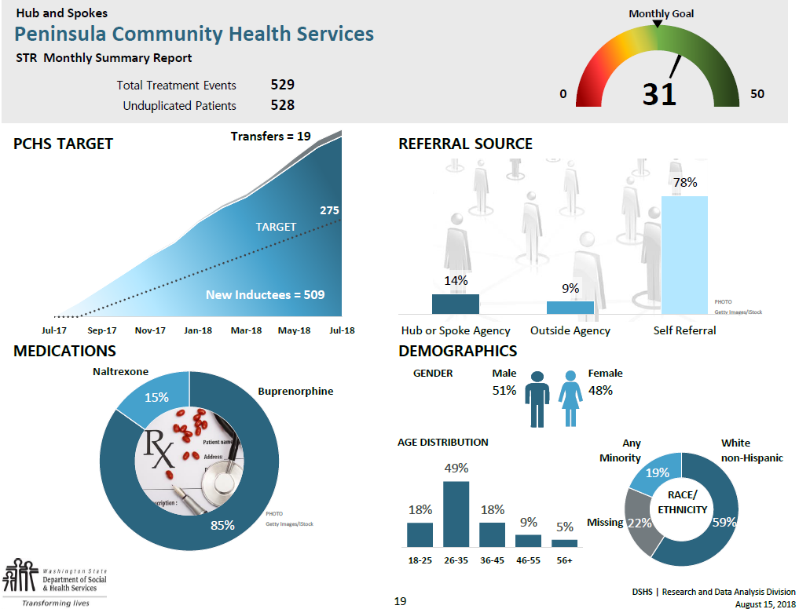

Slide 34
Other Notable Work
Legislature funded recovery helpline improvements to track MAT provider capacity
~Real time with 2-1-1 system (operational ~December 2018)
  FYI: For help with addiction, contact the Washington Recovery Helpline at 1–866–789–1511 or visit https://www.warecoveryhelpline.org/
Statewide multi-media campaign to promote the helpline (January 2019)
Grant program for Tribal-specific strategies to treatment and prevention
Drug take-back program public messaging and supports
Youth drug prevention funding in schools/high need areas
Substance use disorder peer support counseling and recovery services
Statewide electronic emergency (EMS) data system to report overdoses and near overdoses, and to connect with peer recovery
Prescription Monitoring Program improvements to integrate with electronic health systems and provider feedback reports
County pilot program for substance use disorder diversion from the criminal justice system

Slide 35
Purdue and other actions underway
State | Manufacturer defendants | Distributor defendants
WA Sept 2017 | Purdue
AL Feb 2018 | Purdue
AK Oct 2017 | Purdue
AR Apr 2018 | Purdue, Janssen, Endo
Cherokee April 2017 |  | Cardinal, McKesson, Amerisource Bergen,
DE Jan 2018 | Purdue, Endo | Cardinal, McKesson,
KY Nov 2017 | Endo | Cardinal, McKesson, Amerisource Bergen
FL May 2018 | Purdue, Teva, Janssen, Endo, Allergan, Mallinckrodt | Cardinal, McKesson, Amerisource Bergen
LA Sept 2017 | Purdue, Teva, Janssen, Endo, Allergan
MS Dec 2015 | Purdue, Teva, Janssen, Endo, Allergan
MO June 2017 | Purdue, Endo, Janssen
MT Nov 2017 | Purdue
OKL June 2017 | Purdue, Teva, Janssen, Allergan
NH Aug 2017 | Purdue
NJ Oct 2017 | Purdue
NM Sept 2017/Dec 2017 | Purdue, Teva, Janssen, Endo, Allergan | Cardinal, McKesson, Amerisource Bergen
NV May 2018 | Purdue
NC May 2018 | Purdue
ND May 2018 | Purdue
Puerto Rico Mar 2018 | Purdue
OH June 2017/ Feb 2018 (dist) | Purdue, Teva, Janssen, Allergan, Endo | Cardinal, McKesson, Amerisource Bergen, Miami-Luken
SC Aug 2017 | Purdue
SD Mar 2018 | Purdue, Janssen, Endo
TN May 2018 | Purdue
TX May 2018 | Purdue
WV |  | McKesson

Slide 36
Note on Congressional Legislation
Efforts to reduce illicit Fentanyl from entering the country by closing US Postal Service loopholes, requiring foreign packages to reveal contents
Support for people in treatment and recovery
  Reauthorizes CURES act
  SAMHSA grant program for community opioid recovery centers (ECHO model)
  HHS to determine best practices and then implements e.g. use of recovery coaches
  HHS to create “plan of safe care” for babies born dependent to opioid drugs
  HHS grants to support people in recovery with employment and housing
  Lifts MAT cap from 100 to 275 and establishes grant program to help providers
  Expands grant program for first responders
  Research for non-opioid treatment for chronic pain
Budget is NOT allocated, some estimate it might be ~$8B
It does NOT change IMD exclusion or behavioral health info sharing (42 CFR 2 – but it does direct HHS to study it)

Slide 37
Reconsider 2018 Legislation (HB 2489/SB 6150)
(Passed House unanimously but ran out of time in Senate)
Takes next steps for prevention and recovery
  Concentrates youth prevention in high-needs areas
  Improves Prescription Monitoring Program integration with EHR
  Requires patient notification of opioid prescriptions (now in new proposed rules)
  Uses EMS near-overdose response; connects with peer supports
  Ensures more access to Naloxone with statewide standing order
  Provides for rapid-response team for areas experiencing overdoses
  Requires drug and gang task force coordination
  Funds diversion programs and tribal-specific strategies
  Plans for better use of non-pharmacological treatment for pain
Focuses on treatment for people with opioid use disorder
  Sets up statewide community hub & spoke opioid treatment networks
  Increases Medicaid rate (to Medicare level) paid to providers to treat people
  Updates clinical terminology in statute, removes stigma
  Requires state Medicaid waiver for treatment while people are incarcerated
  Funds services for people while incarcerated to reduce recidivism
Requires metrics, reporting
Consider budget investments for serious gaps—treatment for:
(1) Pregnant and parenting women &
(2) Justice-involved
Other items include
Non-pharm services in Medicaid;
PMP integration; &
Connections with community behavioral health system, generally
Notes:
Budget:
Hub and spoke opioid treatment network expansion $2.315 NGF $4.630 Total (DSHS)
Medication Assisted Treatment (MAT) Medicaid rate increase $1.214 NGF $6.156 Total (HCA)
More Assisted Outpatient Treatment (AOT) $437 NGF $1,041 Total (in addition to extra mental health AOT $290 NGF $691
Naloxone distribution, the opioid overdose reversal medication $864 Total (DSHS)
Pregnancy supports for prevention and treatment for people with opioid use disorder (PCAP) $417 NGF $687 Total (DSHS)
Grant program for Tribal nation specific strategies to treat and prevent opioid use disorder $1.5M Total (DSHS)
MAT real time tracking along with public messaging through the recovery hotline and training supports $1.3M Total
Drug take back program public messaging and supports $1.12M Total (DSHS)
Youth drug prevention funding to continue our successful program in high need areas $1.65M Total (DSHS)
Substance use disorder peer support counseling services $806 Total (DSHS)
Statewide electronic emergency data system to report overdoses and near overdoses $300 NGF $996
Improves the Prescription Monitoring Program to integrate with provider electronic health systems $160 Total
Medication Assisted Treatment and Naloxone for people on probation with opioid use disorder $90 NGF $90 Total
Supports for the state Toxicology lab ($1.032M funding shared with other lab services)
Expands eligibility for housing supports ($59 Total (DSHS)
Snohomish county program for SUD diversion from the criminal justice system $800 Total (Commerce)
Higher Ed. Behavioral Health $500/$100 Total (WSAC/UW)
Behavioral Health Organization enhancement to improve diversion opportunities $23.09M NGF and $63.3M Total (DSHS)

Slide 38
Department of Health Updates
Kathy Lofy, MD
State Health Officer
Department of Health

Slide 39
Engrossed Substitute House Bill 1427 (2017)
  Opioid prescribing rules
    Cover prescription limits for acute pain, PMP checks, and threshold for consultation
    Medical Commission rules will be effective January 1, 2019
    Rules from other four Boards/Commissions anticipated to be effective November 1, 2018
  Prescribing feedback reports – determined metrics, obtained providers’ specialty data, calculated metrics
  Washington State Hospital Association Coordinated Quality Improvement Program – shared PMP data
  Prescriber overdose notifications using Emergency Department Information Exchange and PMP data – will pilot this month
Notes:
In 2017, the State passed the Engrossed Substitute House Bill (ESHB) 1427, an aggregation of multiple bills. The bill provided language requiring the B/Cs to develop and adopt opioid prescribing rules. The bill language improved access to medication-assisted treatment and expanded access and uses of PDMP data including use of PMP data to send Overdose Notifications to provider whose patients have recently experienced an overdose in the emergency department.
Olympic ACH Pilot Go-Live date is 9/10/2018
For a patient receiving a diagnosis code in the Emergency Department of having an OD event EDIE will check the PMP for recent prescribers, check the pre-manage system for Primary Care Provider and send notifications via email and fax informing of the OD event.

Slide 40
Fewer People are Receiving Opioid Prescriptions
Source: Prescription Monitoring Program (https://www.doh.wa.gov/DataandStatisticalReports/HealthDataVisualization)
Note: Tramadol became a controlled substance in August 2014.
Notes:
This slide shows a declining trend in the proportion of patients who have received an opioid prescription each quarter during 2012 through the first quarter of 2018. Overall, there has been about a 25% decrease in the proportion of people who have received an opioid prescription during this time period.
However, if you look at the data closer, you can see that the blue line shows about a 50% decrease in kids 10-17 years old receiving an opioid prescription and the green line shows about a 45% decrease in people 18-24 years old receiving an opioid prescription. In the first quarter of 2018, about 2% of 10-17 year olds received a prescription and about 4% of 18-24 year olds received an opioid prescription in the first quarter of 2018.
The reason that the lines for 25-44 year olds and 45-64 year olds do not show a steady decline through the entire time period is because tramadol became controlled substance in August of 2014. Declines in these age groups is not as dramatic as the younger age groups.
0-9 yrs (not shown) : 14.4 – 4.0 (72% decrease)
10-17 yrs: 34.6 – 16.6 (52% decrease)
18-24 yrs: 75.7 – 41.3 (45% decrease)
25-44 yrs: 109.3 – 75.3 (XX% decrease)
45-64 yrs: 151.3 - 139.9 (XX% decrease)
65-74 yrs: 151.7 – 150.7 (went up to 171.0 in 2015q4 and then decreased)
75+ yrs: 160.1 – 158.4 (went up to 175.0 in 2014q4 and then decreased)

Slide 41
Days’ Supply of New Opioid Prescriptions
Source: Prescription Monitoring Program (https://www.doh.wa.gov/DataandStatisticalReports/HealthDataVisualization
Note: A patient with a new opioid prescription is a person who filled an opioid prescription in the current quarter but not in the previous quarter. Days supply refers to the estimated number of days the prescription will last. All authorized refills are included in the days’ supply, even if they were not filled because they reflect the prescriber’s prescribing. Opioid prescriptions prescribed for more than 59 days’ supply are excluded.

Slide 42
Other substances on rise too
2000–2017*
1167
740
# of deaths
392
342
306
142
Source: DOH Death Certificates (Note: prescription opioid overdoses exclude synthetic opioid overdoses)
*Data for 2017 are preliminary as of 8/23/2018.
Notes:
Statewide, all overdose deaths, opioid overdose deaths and synthetic non methadone (largely fentanyl) deaths increased in 2017;
Psychostimulant deaths also have been increasing
Statewide, prescription opioid deaths have been decreasing
Heroin deaths have been relatively stable

Slide 43
Washington Opioid Overdose Deaths, 2017*
Of these 277 deaths
77 (28%) involved a sedative
33 (12%) involved alcohol
102 (37%) involved either a sedative or alcohol
*Source: DOH Death Certificates (Data for 2017 are preliminary as of 8/23/2018)
Note: 25 opioid overdose deaths were not able to be classified
Notes:
61% of opiate overdose deaths able to classify involved illicit opiates (blue on pie chart).
Of opiate overdose deaths with a prescription opiate only, 145 (20% of classifiable opiate overdose deaths) did not detect another substance: psychostimulants, sedatives or toxic effects of alcohol. An additional 63 (9%) had only sedatives detected.
25 opioid overdose deaths that were not able to be classified - Mamadou printed out the underlying cause of death, the multiple causes and the text. When you look at the text, 8 deaths also included mention of methamphetamine; 1 mentions acute amphetamine and opiate intoxication; 1 death mentions cocaine, 7 additional are polydrug (including ethanol, benzos, and other depressants)
More than half of opioid deaths and almost half of prescription opioid deaths are polysubstance deaths
Of 740 opioid deaths in 2017, 396 (54%) had a psychostimulant, sedative, alcohol or some combination of these detected from toxicological analysis.
Of 342 prescription opioid deaths, 168 (49%) had a psychostimulant, sedative, alcohol or some combination of these detected from toxicological analysis.
Almost 1 in 5 prescription opioid deaths also detected an illicit opiate:
Of 342 prescription opioid deaths, 38 (11%) also detected heroin.
Of 342 prescription opioid deaths, 29 (8%) also detected a synthetic opioid that was not methadone
Almost 1 in 6 prescription opioid deaths also detected psychostimulants:
Of 342 prescription opioid deaths, 57 (17%) also detected psychostimulants.
More than 1 in 4 prescription opioid deaths also detected sedatives:
Of 342 prescription opioid deaths, 94 (27%) also detected sedatives.
[NOTE Polysubstance deaths are not mutually exclusive – for example, in 10 of the 57 prescription opioid deaths where psychostimulants were detected, sedatives were also detected.)
We can’t yet differentiate the proportion of deaths that involve prescription versus illicit opiates. Nevertheless, this slide underscores the need for the dual approach to reducing the availability of opioids:
Promote safe prescribing practices
Reduce illegal supply of opiates and other drugs

Slide 44
Prescription Monitoring Program Queries Are Increasing
2012 2013 2014 2015 2016 2017 2018
(estimated)
Source: Department of Health Prescription Monitoring Program
Notes:
Edits needed: modify axis (16 instead of 16,000,000 and add axis label of Millions); make stacked bar for queries. Change legend labels, clearly show 2018 is estimated.
This slide shows the total controlled substances dispensed in Washington and the number of data queries of PMP from 2010-2017, with estimates for 2018.
You can see a modest decrease in controlled substance prescriptions and a marked increase in queries of the PMP.
As of July 2018, there were 1.7 million queries per month.
The increase in queries is a direct result of integration of the PMP into EDIE and EHRs via the HIE.
To date, we have fully integrated 14 healthcare organizations representing 925 clinics, hospitals and urgent care centers.
An additional 8 healthcare organizations representing 236 clinics, hospitals and urgent care centers are in testing or preparing for integration.
Another 104 healthcare organizations representing an additional 429 clinics, hospitals and urgent care centers have registered their intent to integrate with PMP.

Slide 45
Treatment
Charissa Fotinos, MD, MSc
Deputy Chief Medical Director
Health Care Authority

Slide 46
Background
Braided funding and cross-agency, multisector work has resulted in a four-fold increase in the number of persons accessing medication for opioid use disorder
Through this work, treatment gaps have been particularly noticeable in two populations:
  Pregnant or parenting persons
  Criminal justice system-involved persons

Slide 47
Growth in Medication Prescribing for
Opioid Use Disorder Among Medicaid Clients
21,558
12,129
9,429
2017
SOURCE: Provider One client Eligibility tables (HCA) & Client Outcomes Database (DSHS RDA).
Note: Excludes dual eligibles and persons with third-party liability; includes all Medicaid eligibles in the year with Medication assisted treatment (MAT)
Notes:
Charissa-
Increase coincides with ACA adoption in 2014 and expansion of the Medicaid population since then.
early Medicaid eligible population (in our inclusion criteria)
2013 – 1,081,315
2014- 1,601,977
2015- 1,781,367
2016 – 1,843,664
We currently have 23 licensed OTPs (methadone clinics) between 2011-2016, we licensed 6 new OTPs, 1 canceled its licensure for total of 5. We expect 5 more clinics to be on board during SFY 2018
Buprenorphine: major changes in July 2015

Slide 48
Successful Initiation of Medication With State Targeted Response Funds
STR targets for medication treatment have been greatly exceeded
How can we sustain these gains as funding sources change?

Slide 49
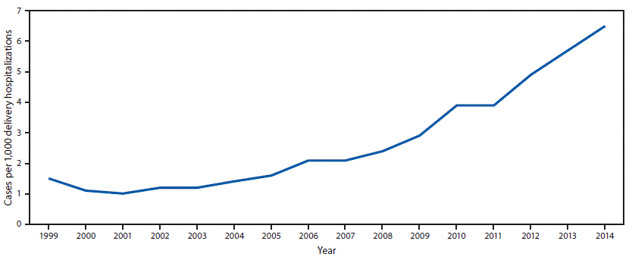
Pregnant and Parenting Persons
Dramatic increase in U.S. rate of opioid use disorder identified at labor and delivery
Washington State rates of neonatal abstinence syndrome also rising
https://www.cdc.gov/mmwr/volumes/67/wr/mm6731a1.htm?s_cid=mm6731a1_w

Slide 50
Current Programs for Pregnant and Parenting Persons
Parent-Child Assistance Program (PCAP)
  3 year home visitation model
  Care managers provide linkage, support, transportation, and referral to treatment
  Increased support from Legislature with 2018 budget
Pregnant Parenting Women (PPW)
  Residential substance use disorder treatment services
  Housing support services
  Therapeutic intervention for children
Notes:
PPW Substance Use Disorder Outpatient Treatment Services
Substance Use Disorder Residential Treatment Services
Housing Support Services
Therapeutic Intervention for Children
PCAP
PCAP is a three‐year home visitation model, implemented by highly trained, clinically supervised case managers providing visits at least twice a month.
Provide, linkage, support, transportation, treatment referral
Clients continue participation through relapses
Case managers link clients with substance abuse treatment, provide support for treatment completion and recovery, and help clients develop relapse prevention strategies.

Slide 51
An Extremely Vulnerable Population
Parent-Child Assistance Program
  During 2014–2017:
    1,234 enrolled and only 165 left (moved, disengaged, requested to leave)
  110 women were on waiting list
  74% had been beaten by a partner
  64% were abused as children
  44% had unstable housing
  38% were beaten while pregnant
  29% had CPS involvement when they were children
  Average Adverse Childhood Experiences score: 5.4
Source: Washington State Dept. of Health

Slide 52
Improving Outcomes for Pregnant and Parenting Persons
Gaps
Strategies
Clinical support for providers | Increase access to services across the state
Access to integrated care | Increase wrap around services
Implement best practices through pregnancy, labor, and delivery | Increase family involvement
Access to post-partum contraception | Work to standardize child removal/re-unification practices
Pass opioid bill to update language around treatment and to recognize OUD as a medical condition
Consider targeted investments to increase the reach of and support to persons who are pregnant or parenting

Slide 53
Criminal Justice System-Involved Persons
Risk of overdose death from opioids highest 1st two weeks after release, (up to 40x higher)
Medication treatment reduces overdose-related death, reduces recidivism, and improves treatment retention
Recent survey of 33 of Washington’s 65 jails
  14 provide opioid treatment medication for continuation, management of withdrawal symptoms, or induction
  Fairly uniform interest across sample in implementing treatment, but limitations exist due to resource constraints

Slide 54
Current DOC and JRA Programs/Initiatives
DOC: Re-entry work release
and violator programs
DOC: Care for Offenders with
OUD Releasing from Prison
JRA: Bridge to Recovery
6 prisons currently
Shared decision making/warm hand-offs
Naloxone
2,300 screens
1,300 enrolled
7/17–8/18
Expedited Medicaid enrollment
Outreach 265
Enrolled 106
Warm hand-offs
Naloxone
Evidence-based juvenile rehabilitation model
Wrap-around and transition services/education/jobs
3 sites
57 unduplicated clients
Notes:
. TDM Yakima, Nisqually, SCORE, RJC, Reynolds, Corrections Center, Corrections Center for women
DOC defines recidivism “as any felony offense committed by an offender within 36 months of release from prison which results in a readmission to prison.”
STR OUD Treatment Decision Re-entry Services & COORP ($690,500)
Description:
WA-Opioid STR together with the Department of Corrections (DOC) has developed and is operating two programs. The reentry work-release and violator programs are located in five communities across Washington State and provide re-entry services for discharging work-release and parole violators who have been identified as having OUD. The second program; Care for Offenders with OUD Releasing from Prison (COORP), identifies incarcerated individuals with OUD, expected to be released, and connects individuals to MAT services in the county of their release, and expedites their enrollment in a Medicaid health plan.
I have attached the most recent data sheet for the DOC projects that will provide the demographic male/females being service by each project. Year 2 to the Re-entry project has expanded to the Women’s Correctional Center in Purdy. The COORP project, in year 2, has expanded to State-Wide resulting in increased enrollment in MAT. Both projects are distributing Naloxone even if the individual does not accept a referral to MAT. DOC has experienced individuals that initially decline MAT, accept the Naloxone, use the naloxone and come back to DOC and ask for MAT referral and ultimately enrolling in MAT. Six prisons are allowing individuals “violators” who are on Suboxone to continue their medication. Program manager is working to increase referral network throughout the state to allow for “warm Hand-offs” to MAT services. In July, program manager reached out to 40 individuals, 14 (or 35%) accepted referral to MAT in the community.
Bridge to Recovery (JRA) ($201,000)
Description:
Develop an evidenced-based Juvenile Rehabilitation model that reduces substance abuse disorders, increases education and employment opportunities for youth and addresses systemic barriers that perpetuate the cycle, and implement ACRA reentry transition activities that link youth to mainstream services
JR has been slow to embrace MAT. They are also experiencing limited resources for MAT. DBHR is working with JR staff monthly to reduce these barriers. Year 2 contract is also addressing youth that are at “high risk” for OUD by providing educational groups and provide OUD/MAT training for JR staff

Slide 55
Improving Outcomes for Criminal Justice System-Involved Persons
Gaps
Strategies
Advocate for passage of opioid bill to recognize OUD as a medical condition
Identify and advocate for funds to increase jail’s and DOC’s ability to treat with opioid treatment medications
Statewide access to treatment at release | Continuation of treatment in all settings
Access to external health records | Access to induction in all settings
Continue building linkages to community prescribers | Housing/jobs
Accurate information about treatment options/naloxone | Gender appropriate services

Slide 56
Investing in Washington State Opioid Response Plan
Michael Langer
Acting Assistant Director
Division of Behavioral Health and Recovery
Health Care Authority

Slide 57
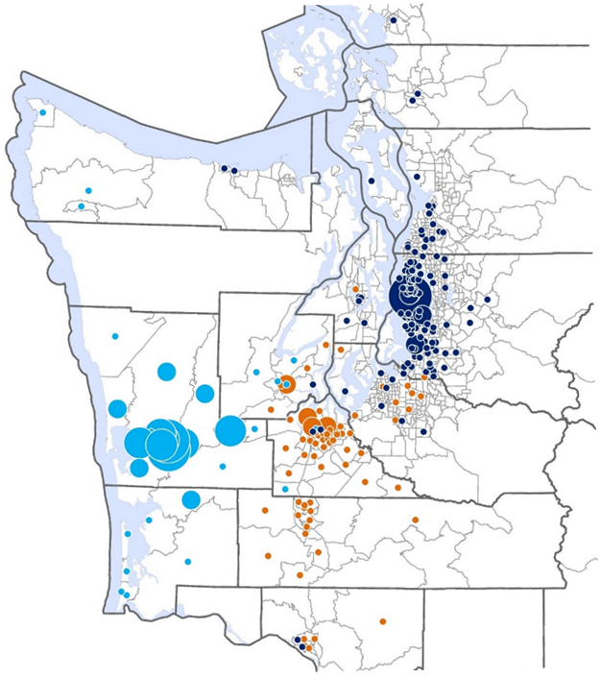
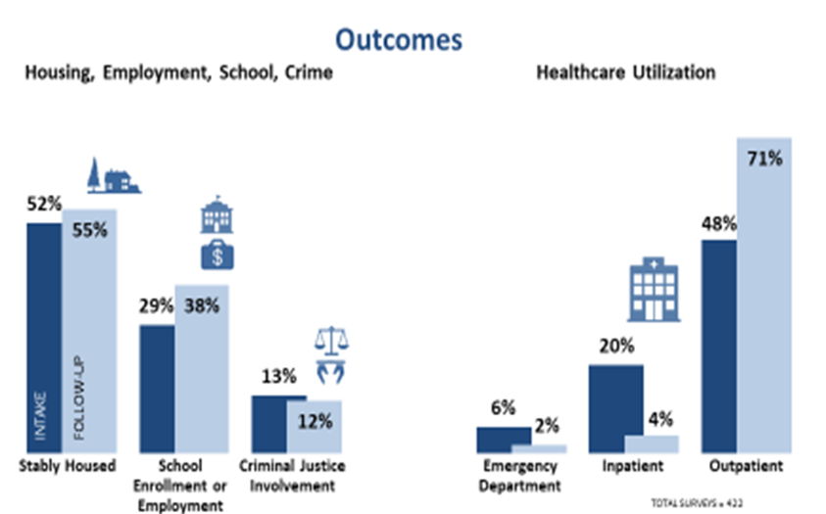
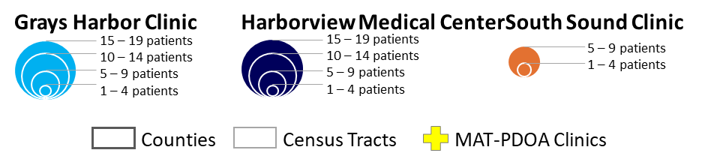
Medication Assisted Treatment – Prescription Drug and Opioid Addiction
$996,616 per year for 3 years, 2015-2018 ($2,989,850 total)
Treatment Inductions | 934
Counties Served | 14
Average Miles Traveled | 20
Further Than 60 Miles | 8%
Notes:
We recently completed the MAT-PDOA grant. This grant allowed us to expand access to medication assisted treatment (MAT) across the state.
Using SAMHSA’s national treatment model, we implemented program in a large urban safety net primary care clinic and two Opioid Treatment Program sites serving a predominantly rural population.
This project provides new tools to replicate integrated MAT statewide.
The project was a collaborative effort between Washington State, Harborview Medical Center, and Evergreen Treatment Services to address the rising rates of opioid-related problems in Washington State, including overdose deaths and addiction treatment admissions.
Project highlights:
Increased the number of patients receiving MAT by increasing capacity in primary care office based settings and OTPs.
We also increased treatment retention. The project had 934 inductions, and after 1 year, 51% of those clients were still participating in treatment.
We also saw improvements to travel distance to access treatment. One average, clients traveled 20 miles to access treatment, and only 8% traveled more than 60 miles.
We also saw an impact on adverse outcomes related to OUD. We saw increases in housing stability, school enrollment or employment, and slightly fewer involvements with criminal justice systems.
We saw significant changed to treatment access. Fewer emergency department visits, and more clients in outpatient treatment.
outpatient treatment.

Slide 58
Prevent Prescription Drug/Opioid
Overdose-Related Deaths
$1 million per year over 5 years 2016-2021 ($5 Million total)
Naloxone
Preventing overdose-related deaths
Distribution
Supply Naloxone kits to formal and informal first responders
Training
How to use Naloxone, opioid guidelines, overdose, and opioid use disorders
10,000 Naloxone kits distributed, October 2016–August 2018
1,695 overdoses reversed
Notes:
The PDO grant allows us to purchase and distribute Naloxone kits to first responders.
We work with the University of Washington’s Alcohol and Drug Abuse Institute to train formal and informal first responders in communities across the state. This includes educating providers on opioid guidelines, patient overdose, and opioid use disorders, and developing new models of treatment and coordination.
We started in for high need areas which included Skagit, Pierce, Thurston, and Walla Walla counties with plans to expand to Spokane by the end of 2018.
Through this grant we have been able to distribute over 10,000 Naloxone kits between October 2016 and August 2018. Between October 2016 and August 2018 we have been able to save 1,695 lives.

Slide 59
State Targeted Response to the Opioid Crisis
$11,790,256 per year for 2 years, 2017-2019 ($23,580,512 total)
Prevention
Prescriber/provider education
University of Washington TelePain
Public education campaign
Safe storage curricula & training
Prevention workforce enhancements
Community Prevention and Wellness Initiative (CPWI) expansion
Analysis of evidence-based practices
Community enhancement grants
  Treatment
  Hub & Spoke
  Mobile OTP van
  Low-barrier buprenorphine pilot
  PathFinder peer project
  Tribal treatment
  Treatment payment assistance
  DOC treatment decision re-entry services & COORP
  Bridge to Recovery (JRA)
  Naloxone distribution
  Prescription Monitoring Program
Notes:
The STR grant addresses the opioid crisis by increasing access to treatment, reducing unmet treatment needs, and reducing opioid overdose related deaths.
STR funds a wide range of projects in opioid prevention, treatment and recovery activities for OUD.
Prevention project highlights include:
Provider education: 283 dentists and oral health professionals were trained on new opioid prescribing guidelines.
UW Telepain: 1,283 people participated in UW weekly TelePain calls including:
502 physicians,
34 physicians assistants,
161 Nurses/Nurse Practitioners, and
586 other healthcare professionals.
Public Education Campaign Starts with One
Reached 1,135,218 people through TV an radio PSAs, feature stories in local newspapers, social media campaigns, and our website www.getthefactsrx.com. The campaign website alone had 35,810 unique website views.
Safe storage and disposal curricula: educating community partners and promoting safe storage and disposal through Starts with One
8,242 pounds of medication returned to CBO-STR co-sponsored sites.
Prevention workforce enhancements: support Prevention Summit and Spring Youth Forum
644 attendees, 280 were youth attendees
CPWI: 5 new CPWI sites focused on prevention opioid misuse and abuse
a total of 3,088 youth and families received prevention services.
Analysis of EBP: contracted with WSU to analyze prevention programs to be used by community prevention providers.
8. 4 Community Enhancement Grants serving 298 youth/families through primary prevention; emphasis on medicine take-back and campaign strategies.
Treatment project highlights include:
Hub & Spoke Each Hub/Spoke network was contracted to complete 25 unique inductions per month or 200 total for the grant period. The benchmark for the first year was set at 1,200 unique individual inductions,
At the end of year one grant period, the project exceed expected benchmark by 102% or 1,226 individual inductions.
Mobile OTP van
93 total treatment events, 87 unduplicated patients
Low-barrier buprenorphine pilot.
171 total treatment events, 147 unduplicated patients, 290% performance over contract requirement
PathFinder Peer Project
Enrolled 441 unique individuals through homeless outreach efforts, 125 of whom were inducted onto MAT.
Tribal Treatment
Developed a tribal opioid awareness campaign in consultation with 15 Tribes across Washington State. Focus on MAT, overdose awareness, and treatment resources.
6 Treatment payment assistance
7. DOC treatment re-entry services and COORP
1624 total screens, 941 unduplicated offenders
8. Bridge to Recovery (JRA)
41 total events, 41 unduplicated clients
Naloxone distribution
Distributed 3,206 kits (goal was 3,000)
Prescription monitoring program
(data from DoH)

Slide 60
State Targeted Response Grant Highlights
Starts with One statewide public education campaign implemented, including Tribal adaptation. Over 35,000 website views.
5 new Community Prevention Wellness Initiative communities. Over 3000 youth and families served.
6 Hub and spoke opioid treatment networks established. More than 3,200 new MAT patients served.
Dept. of Corrections- re-entry staff conduct opioid use disorder treatment decision making
Substance Use Disorder Peers providing outreach to homeless encampments and hospital emergency rooms. 441 individuals enrolled, 125 received MAT services.

Slide 61
2018 State Budget Opioid Investments
Over $10 Million dedicated to implementing State Opioid Response Plan
State funds
  Hub and spoke opioid treatment networks
  Parent child assistance program
  MAT prescriber rate increase
  Substance use disorder peers
Direction for federal substance abuse block grant
  Community prevention and wellness communities
  Drug take-back strategies
  Naloxone
  MAT provider directory and public education campaign
  Tribal prevention, treatment, Naloxone

Slide 62
State Opioid Response Grant
Up to $21,260,403 per year for 2 years ($45,520,806 total) (PENDING)
Prevention
CPWI expansion
Treatment
Opiate Treatment Network (OTN)
Recovery Support
Community enhancement grants
Prescriber education trainings
Opioid summit
Starts with One
Naloxone distribution program
OTN TA/Training
MAT treatment assistance
Tobacco cessation and cross-addiction training
Tribal prevention and treatment grants to 14 tribes
TDM and COORP
Client-directed recovery support services
Peer recovery support staff
OUD and MAT training to community recovery support services
Notes:
The State Opioid Response grant will allow us to build on many of the projects we were able to launch with STR funding, in prevention, treatment, and recovery support services.
Future projects include:
Prevention
Continued CPWI expansion
Community enhancement grants
Prescriber education trainings
Opioid Summit
Starts with One opioid prevention public education campaign
Contract with DoH in Naloxone distribution program
Treatment
Opiate Treatment Network (OTN)
OTN TA/Training
MAT Treatment Assistance
Contract with DoH for tobacco cessation programs (Tobacco Quitline, cross-addiction training)
Tribal prevention and treatment grants to 14 Tribes
Treatment Decision Model (TDM) and Care for Offenders with OUD releasing from prison programs (COORP)
Recovery Support Services
OUD and MAT training to community recovery support services
Client-directed recovery support services
Peer recovery support staff

Slide 63
Snapshots of DOH on-line metrics

Slide 64
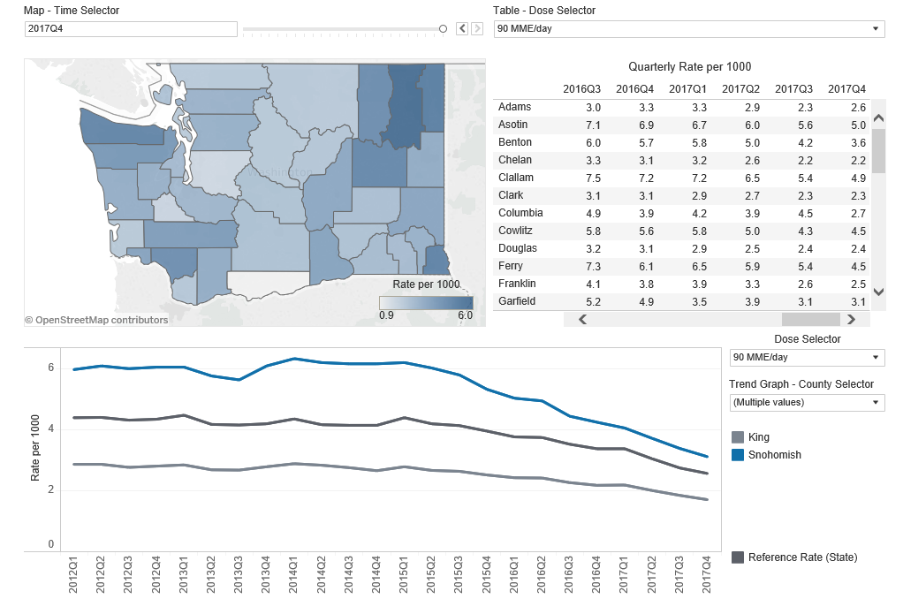
Rate of patients with high-dose chronic opioid prescriptions (> 90 MME/day), 2012–2017
Source: Prescription Monitoring Program (https://www.doh.wa.gov/DataandStatisticalReports/HealthDataVisualization)

Slide 65
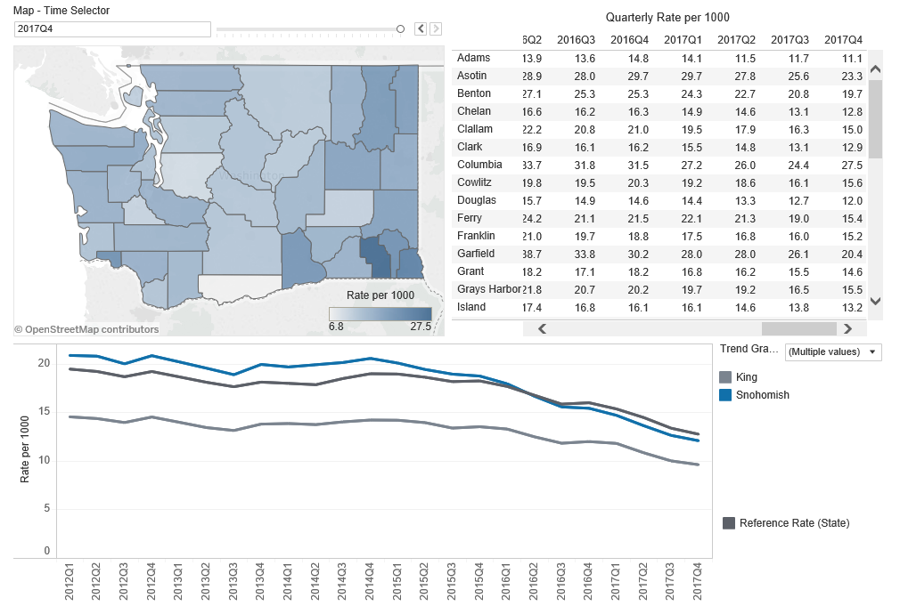
Rate of patients with concurrent opioid and sedative prescriptions, 2012–2017
Source: Prescription Monitoring Program (https://www.doh.wa.gov/DataandStatisticalReports/HealthDataVisualization)

Slide 66
Sneak preview of ACH specific opioid related data

Slide 67
Percent of untreated patients with OUD starting MAT in the previous 3 months

Slide 68
Number of Providers who can prescribe buprenorphine per 1,000 people with OUD

Slide 69
Percent of people with OUD receiving medication treatment

Slide 70
Percent of people who stop buprenorphine within 2 weeks of starting it

Slide 71
Percent of providers with a waiver using it to treat patients covered by Medicaid

Slide 72

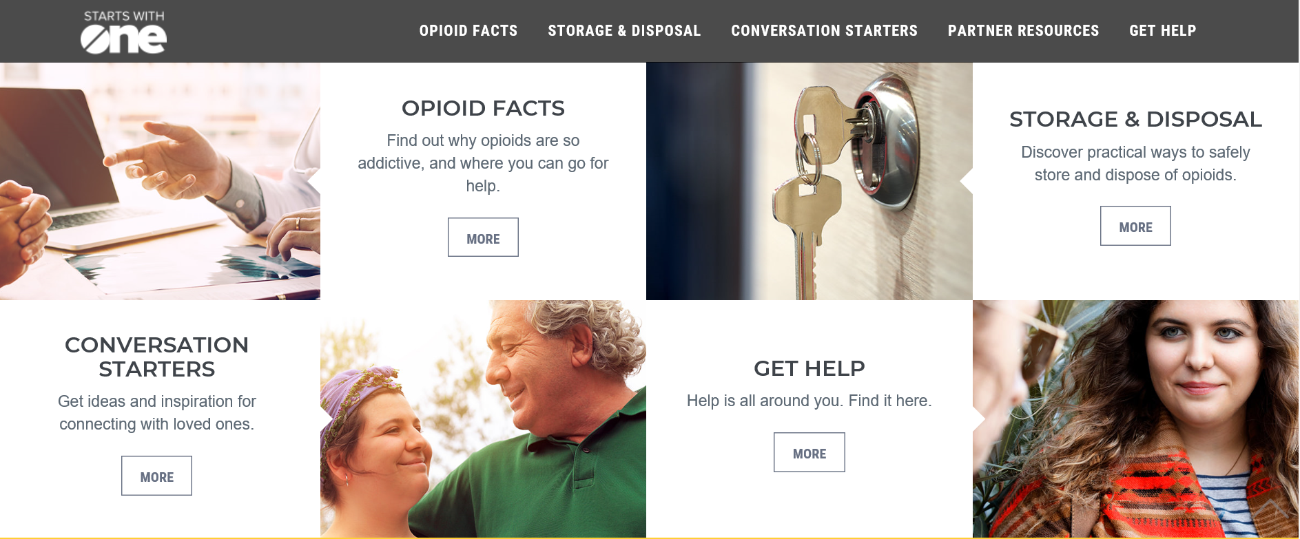
Public Media Campaign
Info at: https://www.getthefactsrx.com/
New Tribal focused campaign
  Resources:
    Posters
    Videos
    PSAs

Slide 73
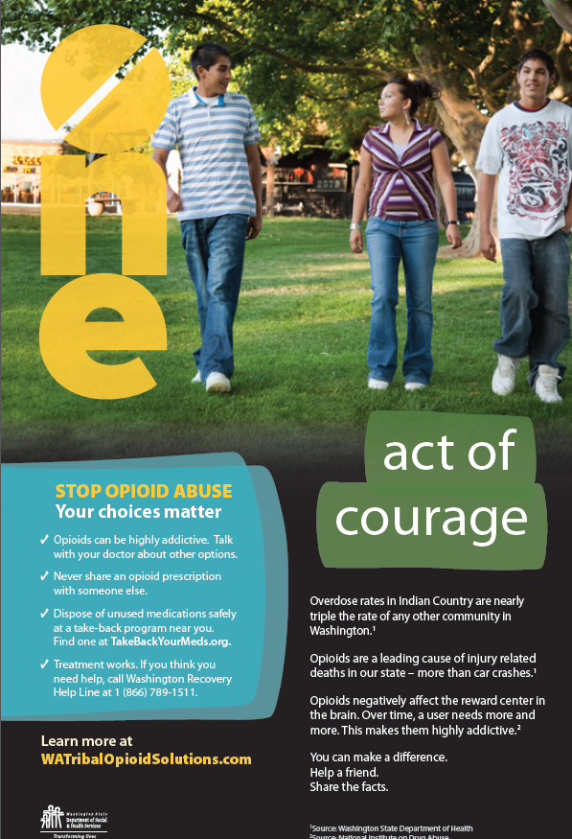


Slide 74
Questions?
Charissa Fotinos
Deputy Chief Medical Director
Health Care Authority
360-725-9822
charissa.fotinos@hca.wa.gov
Michael Langer
Acting Assistant Director
Div. of Behavioral Health & Recovery
Health Care Authority
360-725-3740
michael.langer@hca.wa.gov
Kathy Lofy
State Health Officer
Department of Health
206-418-5510
kathy.lofy@doh.wa.gov
Jason McGill
Senior Policy Advisor
Governor’s Office
360-902-0448
jason.mcgill@gov.wa.gov
Caleb Banta-Green
Interim Director & Principal Research Scientist
UW Alcohol and Drug Abuse Institute
calebbg@uw.edu

